Slide 1
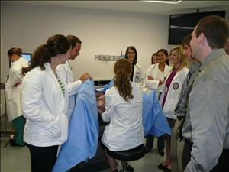
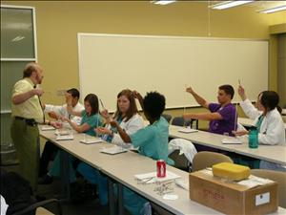
LSU Health Sciences Center OB/GYN Residency Program
Get to Know Us Virtual Social
Please join us for one of our virtual socials to learn more about the OB/GYN Residency Program at LSU Health!
September 4, 2020 – 7:00-8:00 pm (CST)
September 11. 2020 – 7:00-8:00 pm (CST)
September 18, 2020 – 7:00-8:00 pm (CST)
Please pre-register by emailing obvirtualsocial@lsuhsc.edu to receive a link to the meeting.
Welcome and Introduction: Dr. Asha Heard, Program Director
Q&A Session with Dr. Heard
Open Discussion with Current Residents
Q&A with Current Residents

