Slide 1
HR Talent Acquisition/GME Office
I-9 Training

Slide 2
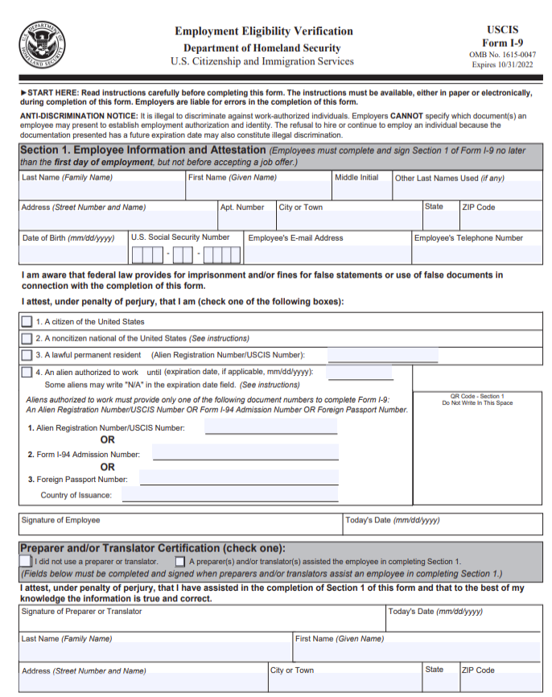
I-9 Form, Page 1

Slide 3
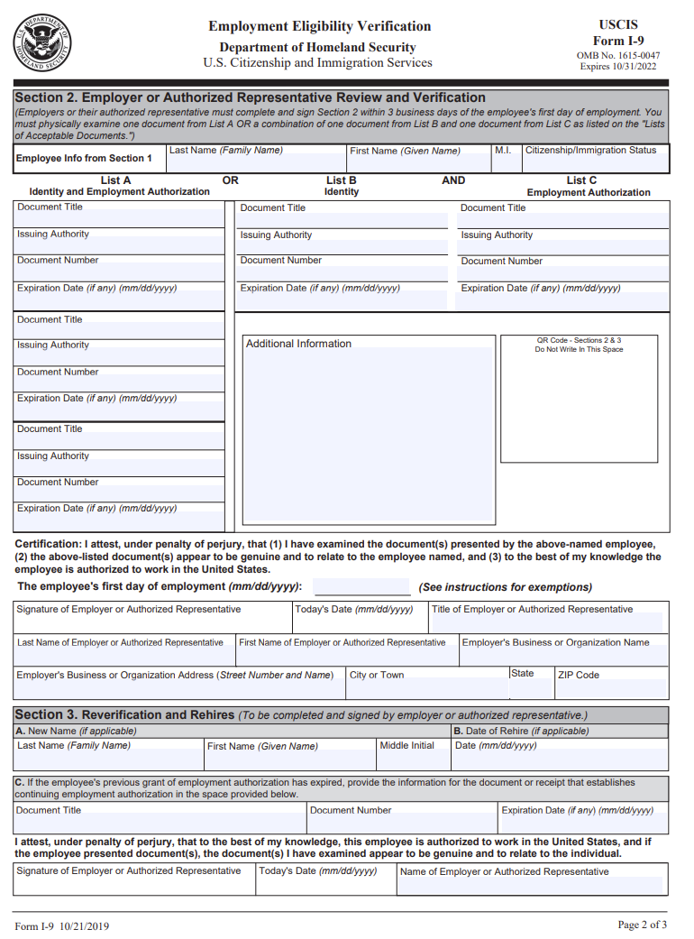
I-9 Form, Page 2

Slide 4
HRM Talent Acquisition
recruittalent@lsuhsc.edu
2023 I-9 Process
Invitations to employee’s section 1 will not be sent to incoming House Officers until 30 days prior to start date - 6/1/2023 (or later if an off-cycle start)
Please be prepared to certify and upload supporting documents at same time
Link sent to Hiring Manager to complete certification is not evergreen and will need to be resent by Talent Acquisition if supporting document(s) are not uploaded at same time certification is complete
If B & C documents are being used, upload as ONE document (cost savings – charged per upload)
Please take your time in completing I-9 documents – when corrections are needed, it takes more time to complete and complicates the I-9 process (corrections increase the likelihood of Tentative Non-Confirmation cases and other issues)

Slide 5
HRM Talent Acquisition recruittalent@lsuhsc.edu
Compliance Notes
Page 1 must be completed by employee no later than first day of paid work
Page 2 certification must be completed by employer no later than third business day after first day of paid work
Deadline for July 1, 2023 start date is Tuesday, July 4, 2023 - please plan to complete prior to deadline in all instances possible
Must view original I-9 documents during certification process
Must ensure documents provided are acceptable documents from list A or B AND C
  Form I-9 Acceptable Documents | USCIS
    Expired documents are not acceptable
    Restricted social security card is not an acceptable C document

Slide 6
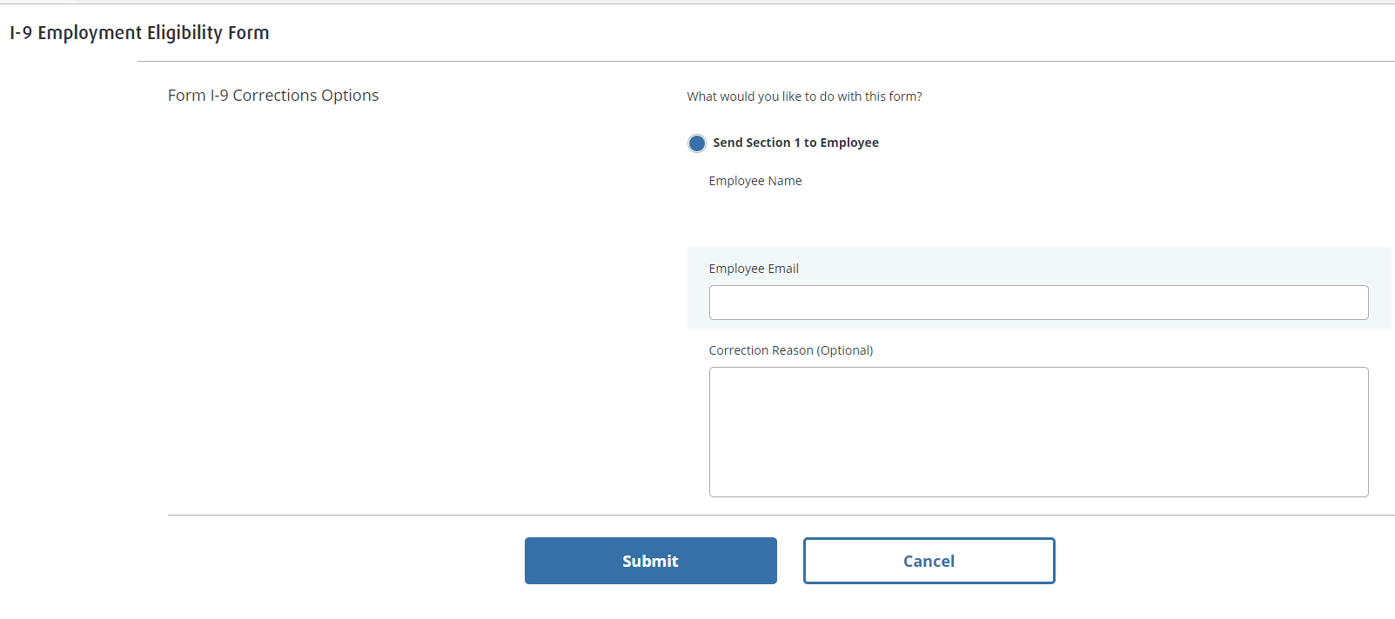
HRM Talent Acquisition recruittalent@lsuhsc.edu
How to avoid corrections
When reviewing original supporting documents, if the information differs on supporting documents from how the employee filled out page 1, resend to employee to make correction prior to certifying I-9. This will save time and energy making avoidable corrections later (and possibly avoid TNC case.)
Manage I-9 forms > Right click on name > Correct I-9 form

Slide 7
HRM Talent Acquisition
recruittalent@lsuhsc.edu
Re-verification Process
Reasons why Re-verification may be required:
Employee Work Authorization renewal
Name change
Hire Right will guide you through next steps based on your selection(s)
recruittalent@lsuhsc.edu is also notified when expired documents need to be re-verified
Talent Acquisition will email current coordinator to advise when re-verification is required
Rehire within 3 years – do not re-verify original form, complete new I-9 form
How to re-verify
Manage I-9 forms > Right click on employee name > Select Re-Verify I-9 form
select update myself or send to Hiring manager (whomever viewing original documents)

Slide 8
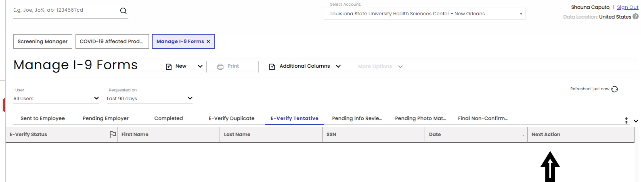
HRM Talent Acquisition
recruittalent@lsuhsc.edu
Tentative Non-Confirmation
Tentative Non-Confirmation can occur for a variety of reasons
Avoiding/correcting mistakes prior to submitting a I-9 will decrease TNC cases
When you do have a TNC case
Manage I-9 Forms > Right click on employee > Next Action
Notify recruittalent@lsuhsc.edu so we can advise/support completion of next action required according to individual situation
Timely action is required - please monitor your Manage I-9 Forms page regularly

Slide 9
HRM Talent Acquisition
recruittalent@lsuhsc.edu
Resources
I-9 Form Supervisor Training Guide:
https://acrobat.adobe.com/link/review?uri=urn:aaid:scds:US:6614aaf8-733c-3719-8029-a03bc9d8e1e0
Complete Hire Right I-9 User Guide:
https://www.lsuhsc.edu/administration/hrm/docs/I-9%20and%20E-Verify%20Solutions%20User%20Guide_JAN122018.pdf

Slide 10
Questions?

