Slide 1
Clinical and Educational Work Hour Rules and Violations
Chris Callac, MS Information Management Specialist Office of Medical Education 504-568-2988 ccalla@lsuhsc.edu

Slide 2
Sources
ACGME Common Program Requirements (CPR)
Residency: https://www.acgme.org/Portals/0/PFAssets/ProgramRequirements/CPRResidency2020.pdf
Fellowship: https://www.acgme.org/Portals/0/PFAssets/ProgramRequirements/CPRFellowship2020.pdf
ACGME Common Program Requirements FAQ (CPR FAQ)
https://www.acgme.org/Portals/0/PDFs/FAQ/CommonProgramRequirementsFAQs.pdf

Slide 3
80 Hour Week
Clinical and educational work hours must be limited to no more than 80 hours per week, averaged over a four-week period, inclusive of all in-house clinical and educational activities, clinical work done from home, and all moonlighting. CPR VI.F.1.

Slide 4
80 Hour Week
Averaging must occur by rotation. This is done over one of the following:
a four-week period;
a one-month period (28-31 days);
or the period of the rotation if it is shorter than four weeks.
When rotations are shorter than four weeks in length, averaging must be made over these shorter assignments. This avoids heavy and light assignments being combined to achieve compliance. CPR FAQ P. 27

Slide 5
80 Hour Week
Where violations of the 80-hour requirement are identified, programs will be subject to citation and at risk for an adverse accreditation action. CPR IV Background and Intent
Why?
Because it is averaged over 4 weeks.
When a resident works over 80 hours during one week, it should be balanced out on the other weeks

Slide 6
80 Hour Week
Included
Not Included
All time spent at hospital / work sites
Clinical work from home (electronic medical records / charting)
Conferences and outside meetings
Taking phone calls
Moonlighting
Reading in preparation for following day’s cases
Studying
research done from home
Travel time for outside meetings

Slide 7
80 Hour Week
Exceptions
NONE
Vacations / Leave
vacation or leave days should be omitted from the numerator and the denominator for calculating clinical and educational work hours, call frequency, or days off CPR FAQ P. 27
Beware – on short rotations, too many leave days can cause a violation.

Slide 8
80 Hour Week

Slide 9
24 + 4 (Maximum Work Period Length)
Clinical and educational work periods for residents must not exceed 24 hours of continuous scheduled clinical assignments. CPR VI.F.3.a)
Up to four hours of additional time may be used for activities related to patient safety, such as providing effective transitions of care, and/or resident education. CPR VI.F.3.a).(1)

Slide 10
24 + 4 (Maximum Work Period Length)
Additional patient care responsibilities must not be assigned to a resident during this time. CPR VI.F.3.a).(1).(a)
must not be permitted to participate in the care of new patients in any patient care setting;
must not be assigned to outpatient clinics, including continuity clinics; and
must not be assigned to participate in a new procedure, such as an elective scheduled surgery. CPR FAQ P. 23

Slide 11
24 + 4 (Maximum Work Period Length)
Exceptions
to continue to provide care to a single severely ill or unstable patient; VI.F.4.a).(1)
humanistic attention to the needs of a patient or family; or, VI.F.4.a).(2)
to attend unique educational events. VI.F.4.a).(3)
These additional hours of care or education will be counted toward the 80-hour weekly limit. VI.F.4.b)

Slide 12
24 + 4 (Maximum Work Period Length)

Slide 13
Call
In-House Call
Residents must be scheduled for in-house call no more frequently than every third night (when averaged over a four-week period). CPR VI.F.7.
At-Home Call / Pager Call
Time spent on patient care activities by residents on at-home call must count toward the 80-hour maximum weekly limit. The frequency of at-home call is not subject to the every-third-night limitation, but must satisfy the requirement for one day in seven free of clinical work and education, when averaged over four weeks.

Slide 14
Call
At-Home Call / Pager Call (Continued)
Residents are permitted to return to the hospital while on at-home call to provide direct care for new or established patients. These hours of inpatient patient care must be included in the 80-hour maximum weekly limit. CPR VI.F.8.b)
PGY-1 residents are not initially allowed to take at-home call because appropriate supervision (either direct supervision or indirect supervision with direct supervision immediately available) is not possible when a resident is on at-home call. CPR FAQ P. 26

Slide 15
Call

Slide 16
Call

Slide 17
Short Break (Mandatory Free Time)
Residents should have eight hours off between scheduled clinical work and education periods CPR VI.F.2.b)
Residents must have at least 14 hours free of clinical work and education after 24 hours of in-house call CPR VI.F.2.c)

Slide 18
Short Break (Mandatory Free Time)
Exceptions
At Home Call / Pager Call –
When residents/fellows assigned to at-home call return to the hospital to care for patients, a new time-off period is not initiated, and therefore the requirement for eight hours between shifts does not apply. The frequency and duration of clinical work done from home and time returning to the hospital must not preclude rest or reasonable personal time for residents/fellows. CPR FAQ P. 27

Slide 19
Short Break (Mandatory Free Time)
Non-Working Periods – Break / Not Working
This will prevent a short break violation when residents have a gap between a shift / work period and another activity such as a conference.
Time recorded as such DOES count towards the 80 hour limit and 24+4 limit
It prevents residents from having to record “working time” for time they were not actually working

Slide 20
Short Break (Mandatory Free Time)

Slide 21
Day Off (Mandatory Free Time)
Residents must be scheduled for a minimum of one day in seven free of clinical work and required education (when averaged over four weeks). At-home call cannot be assigned on these free days. CPR VI.F.2.d)
One Day
The common clinical and educational work hour requirements specify a 24-hour day off.
Many Review Committees have recommended that this day off should ideally be a calendar day (i.e., the resident/fellow wakes up in his or her home and has a whole day available).
Review Committees have also noted that it is not permissible to have the day off regularly or frequently scheduled on a resident’s/fellow’s post-call day CPR FAQ P. 23

Slide 22
Day Off (Mandatory Free Time)

Slide 23
Day Off (Mandatory Free Time)

Slide 24
Day Off (Mandatory Free Time)
Exceptions
The hours spent moonlighting are counted toward the total hours worked for the week. No other clinical and educational work hour requirements apply CPR FAQ P. 25
Moonlighting must not interfere with the ability of the resident to achieve the goals and objectives of the educational program, and must not interfere with the resident’s fitness for work nor compromise patient safety. VI.F.5.a)

Slide 25
Duty Types – Why They Matter
Shift, Clinic, Continuity Clinic
Regular working hours that contribute to the 80 hour week, checked for short break violations, and cannot be > 24 hours
Call
Same as above, but also count as “call”
Post Call
Same as “Call” but will not trigger a violation when used for 4 hours after 24 hours of “call”.

Slide 26
Duty Types – Why They Matter
Conference
For conferences, journal club, didactics, and other educational events. Can also be used following 24 hours of call.
Moonlighting
When moonlighting, either internal or external. Will NOT trigger short break or day off, but WILL trigger an 80-hour violations
Vacation/Leave
Vacation, sick leave, educational leave. Leave does NOT count as a day off when checking duty hour rules.

Slide 27
Duty Types – Why They Matter
At Home Call-Not Called In
Used when at home during home call. Hours logged do NOT count towards 80 hour limit.
At Home Call-Called In
Used when called in to work during at home call. Hours DO count towards 80 hour week but do NOT trigger short break violations.

Slide 28
Duty Types – Why They Matter
Break / Not Working – to be used for short breaks throughout the day. This should be used to fill in any gaps in working time to prevent a “Short Break” violation. Any time recorded with this work type counts towards the 24 maximum shift length and 80 hour work week limits.

Slide 29
Dealing with Violations
The goal is accuracy, not removing violations
If a violation truly did occur, it should stay
MANY violations are data entry problems
3rd year resident suddenly started recording ALL free time (nights/weekends) with Break / Not Working
FIX THE PROBLEM!!!! Don’t explain why it is not a violation

Slide 30
Viewing Hours / Violations
Use the Chart View
Duty Hours -> View Hours - Chart View
Change the dates to the rotation start/end

Slide 31
Example 1 Violations

Slide 32
Example 1 Recorded Time

Slide 33
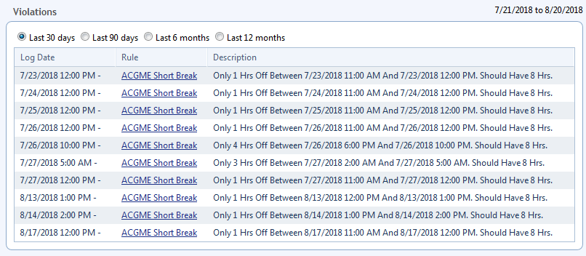
Example 2 Violations

Slide 34
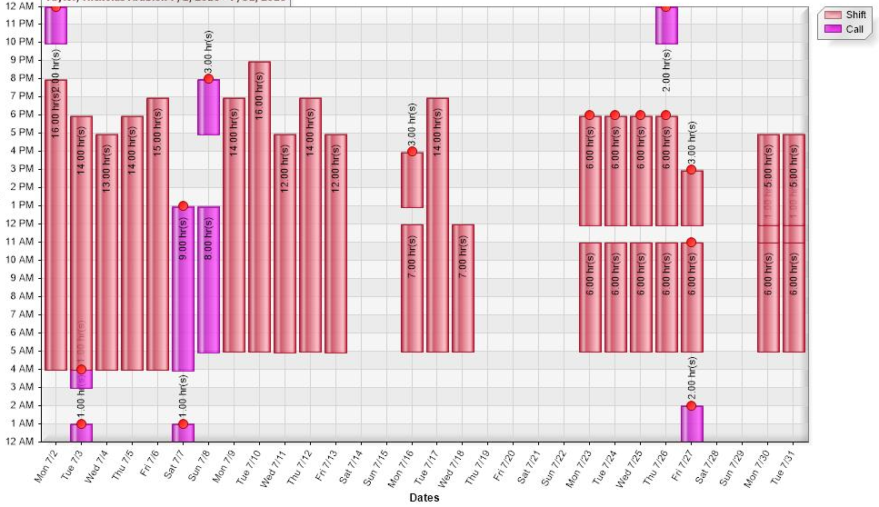
Example 2 Recorded Time

Slide 35
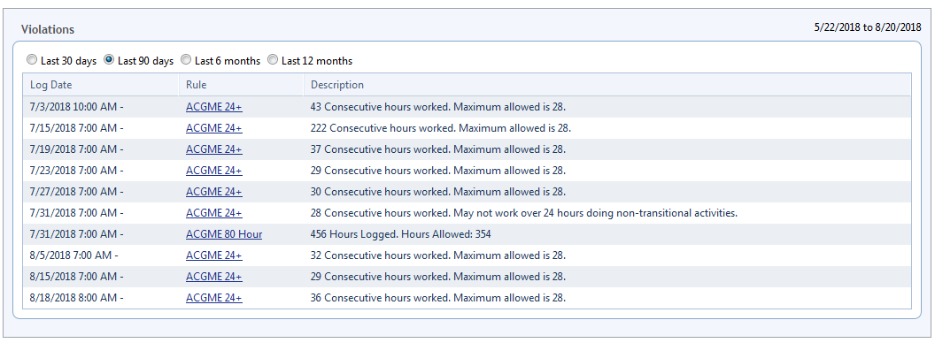
Example 3 Violations

Slide 36
Example 3 Recorded Time

