Slide 1
Coordinator Meeting
April 19, 2022
EQuIP Rotation, Appointment Packets, Eras Registration

Slide 2
Agenda
QI Forum
EQuIP Rotation
Digital PLAs
Appointment Packet Process
GME Tracking System
Diplomas
VA Dates
LSU ID Badge Photo Dates
ERAS Registration
Reminders/Upcoming Dates

Slide 3
QI Forum – June 8, 2022
Submissions are being collected for the QI Forum – scheduled as a hybrid event for June 8, 2022.
- All submissions are due April 22 (this is the extension deadline)
- Participation in the event is highly encouraged by your residents and fellows!
Keynote Speaker – Brian Wong, MD, FRCPC
Director and Site Director of Sunnybrook Health Sciences Centre
Member, AAMC Teaching for Quality Steering Committee

Slide 4
EQuIP Rotation
Enhancing Quality Improvement for Patients Rotation
In-depth orientation to the principles of quality improvement, patient safety and process improvement
2nd Year (and above) House Officers
2- or 4-week blocks
Name, PGY Level, Cell #, LSU Email, Program, & Dates you would like to attend
Email Julie at jcain2@lsuhsc.edu to schedule your residents

Slide 5
PLAs are going DIGITAL!
Please check your Program Letters of Agreement expirations. Many expire near or at the end of the AY.
Refer to the Knowledge Base for templates, signatories, updates regarding all PLAs.
We are moving to digital PLAs through Adobe Sign. IT is working on licenses and IN-PERSON training will take place this week and next week. If you have not signed up for a training, contact Julie.
Until then: Make sure you have email addresses for your Site Directors.
Reminders: UMCNO-5 years; everyone else-10 years.

Slide 6
AMA GCEP Modules
New Hires will be entered into the GCEP system by the GME office in August.
New Hires will receive an email from the GME office explaining the purpose of the GCEP Modules and deadline - August.
Promotions will be done by the GME office.
Emailed reports have been sent on the 1st of each month.
When submitting the Exit Packet, you need to include all training levels for the House Officer.
Notes:
GME office will enter all new hires in the AMA system in August.
Promotions and Curriculum assignments will also be done by the GME office.
Reports are emailed out on the 1st of the month. Ensure your house officers are completing the modules.
For the exit packet please make sure to include all training modules done by the house officer for entire time in training.

Slide 7
Appointment Packet Discussion
Proposal – Appointment packet goes away
Program Responsibilities
Electronic Contract Initiation
TB Form Submission
GME Responsibilities
Driver Safety Form Initiation
Moonlighting Form Initiation
Health Requirements Form Initiation

Slide 8
Appointment Packet Item Tracking
Electronic forms would be initiated by GME Office and received by residents (same as the COVID vaccination release forms)
Status of all items would be updated/visible in GME Tracking System
All signed/submitted documents will be available for download from GME Resident Files

Slide 9
GME Tracking System
Available at the end of this week
Link will be distributed by email when ready
Will track
New Hire Packets
Contracts
Program Exit Packets
TB / Driver Safety / Moonlighting / Health Requirements
COVID vaccination releases
Maybe others
Questions contact Chris Callac

Slide 10
GME Tracking System
Demo

Slide 11
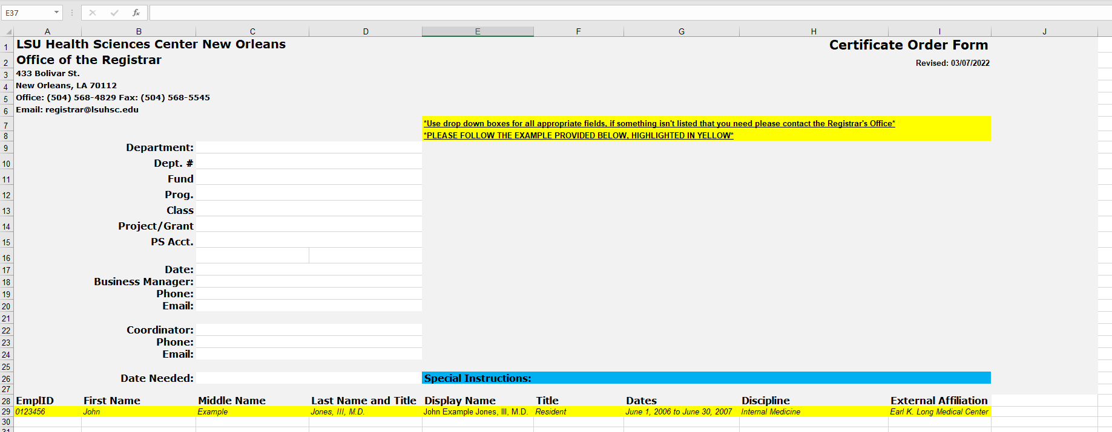
Ordering Diplomas
Certificate Order Form
Completed forms should be emailed to registrar@lsuhsc.edu.
Include Certificate Order and your department on the subject line of the email.
Expect 3-4 week processing timeframe.
Notes:
Graduating house officers should receive diplomas
A copy of the certificate order form can be found on the knowledgebase and is also linked here.
Completed forms should be emailed directly to the Registrar.
Sometimes there can be a long wait for diplomas depending on the time of year. Order early.

Slide 12
VA Paperwork Reminders
Due Now
Coordinator Tracker – only include the list of House Officers that will rotate to the VA during 2022-2023
TQCVL - only include the list of House Officers that will rotate to the VA during 2022-2023
Due May 6, 2022
New & Returning Rotators VA Application Packet/Returning Packet
Via LSU Health FileS File Transfer System

Slide 13
LSU ID Badge Photos
Taken at HRM office
6th Floor Resource Center
DATES:
May 1
May 3-5 (9am-11am)
May 10-12 (1pm-3pm)
May 17-19 (9am-11am)
May 22-24 (1pm-3pm

Slide 14
ERAS 2023 Registration
New for 2023: Invite new users and revoke inactive users from within the EAM system.
Complete Registration in EAM (ERAS Account Maintenance) before May 31,2022 @ 4:00 pm. CT, before ERAS 2023 opens in June. Registration at this time is only for programs that participated in ERAS during 2021-2022. New Programs added to ERAS will receive registration information soon.
Update Program Information: Include the Application Selection language, U.S. Citizen, Permanent Resident, J-1 VISA Sponsored by ECFMG and any other program specific information applicants should know before applying to the program.
Training Resources Available: on the ERAS PDWS Community Site and ERAS Client Technical Support

Slide 15
Reminders
April Beginning of the Month Reports (BOM) Due Now
March End-of-the Month Reports (EOM) Due Now
Payroll Lock for April 16-30 Payroll – Tuesday, April 26, 2022
New Hire House Officer Drug Testing Began April 1, 2022 and ends April 30, 2022 (New Hires out of the Country complete testing when they arrive).
New Hire Data in New Innovations – TODAY

Slide 16
Coming in May
May 15:
Computer Account Activation
LSU Orientation Portal
Due Now:
Appointment Forms & Spreadsheets
Internal Transfer Paperwork

Slide 17
Q/A

