Slide 1
New Hire Paperwork Meeting
March 8, 2022
New Hire Paperwork Meeting
New Hire Paperwork, Contracts, COVID Release Forms, GME Rotation Sites, NRMP Match & SOAP

Slide 2
Sara Blakemore
GME Coordinator

Slide 3
GME Rotation Sites
Programs Not Confirmed as of 7 PM yesterday
Child Psychiatry
Emergency Medicine - Hyperbaric
Family Medicine - Bogalusa
Medicine - Cardiology
Medicine - Electrophysiology
Medicine - Interventional Cardiology
Ophthalmology - Retina
Pediatric Orthopaedics
Physical Medicine & Rehabilitation - Pain Medicine
Plastic Surgery - Aesthetics
Plastic Surgery - Integrated
Plastic Surgery - Microsurgery
Psychiatry - Addiction
UHC - Internal Medicine

Slide 4
COVID Release Forms
House Officers will be required to sign a release form so that LSUHSC (i.e. you in the program) are able to release their COVID vaccination status.
COVID vaccination status means vaccination proof or exemption proof
If house officers do not complete release form, they will have to submit their COVID vaccination status to the requesting hospital
Will be completely electronic from GME Office directly to House Officers. (You will be able to check status of your residents, but you will not need to collect and submit to GME.)
Most likely being sent to house officers TODAY

Slide 5
New Hire Paperwork
Changes for 2022-2023 Academic Year Onboarding
Updated New Hire Checklist
Library Form Removed from New Hire Packet
Minor changes to GME Data Sheet
Need color copies of I-9 Documents
Electronic Appointment Packets

Slide 6
New Hire Paperwork
New Hire Checklist, PER 2, and login information for incoming House Officers available in the Academic Year Forms system
https://www.medschool.lsuhsc.edu/medical_education/graduate/appointments/
New Hire Forms will not be available until Tuesday, March 22nd
Appointment Packets will NOT be made available to incoming House Officers thru New Hire Paperwork system. It must be initiated by coordinators like the electronic contracts.

Slide 7
New Hire Packet
Sample completed packet available in the Knowledge Base (updated for 2022-2023 AY onboarding) https://lsugme.atlassian.net/wiki/spaces/NEWHIRES/pages/27072125/Sample+New+Hire+Packet
Incoming House Officer completes, prints and signs the New Hire paperwork,
The GME Data sheet must account for all time from Medical School Graduation through the start date of LSU Training Program with no gaps longer than 1 month- this is very important.
Incoming House Officers must sign where noted on all the forms in the New Hire packet
Social Security card must be signed (wet signature)
Electronic Signatures are NOT accepted
Incoming House Officers submit the completed and signed New Hire Paperwork Packet to their Program Coordinator by May 1, 2022

Slide 8
New Hire Paperwork – Site Onboarding
Packets available automatically for:
VA
Baton Rouge General
UHC Lafayette
Updated packets still needed by GME:
Lafayette General
Our Lady of the Angels
North Oaks
Women’s

Slide 9
New Hire Paperwork – Site Onboarding
No physical packets needed for:
Ochsner
Our Lady of the Lake
LCMC
UMC New Orleans
Children’s Hospital
East Jefferson
West Jefferson
Touro

Slide 10
New Hire Paperwork Demo

Slide 11
New Hire Packet
Coordinator reviews the New Hire Packet Received
Print the New Hire Check List for each New Hire Packet Received
Print the PER 2 for each New Hire Packet received (the Original & Dean/Dir page)
Check that all forms listed under the New Hire Packet section on the Checklist are included and signed where noted
Electronic Signatures are NOT Accepted
GME Data Sheet must account for all time from Medical School Graduation through the start date of the LSU Training Program, with no gaps longer than 1 month – Very Important.
Tax forms must be completed and signed – wet signature
Social Security Card must be signed (wet signature), by the Incoming House Officer and a readable color copy must be included.
Out-of-Country Incoming House Officers that don't have a Social Security Card, must submit the Letter/Receipt they received from the Social Security Office when they applied
This Letter/Receipt must be included in the New Hire Packet
Once they receive their Social Security Card, a Color copy must be sent to the GME office and to Human Resources
Incoming House Officers will have to resubmit, to Program Coordinator, any forms that are not included in the Packet; any forms that are incomplete; and any forms that do not have a wet signature (electronic signatures not accepted)

Slide 12
New Hire Packet
Program Coordinators send the reviewed, completed, and signed New Hire Packet to the GME Office before or by May 31, 2022
Attach New Hire Packet Checklist to the Packet
Include Signed PER 2 with the New Hire Packet (the Original & Dean/Dir Page)
Tape any Voided Checks to the separate "Direct Deposit Cancelled Check" page (if not taped) - Do not paperclip or staple to the Direct Deposit Form. A Completed bank direct deposit form is accepted in lieu of a voided check.
Do Not Hold completed packets, send packets to the GME office once the packet is completed – DO NOT wait until the last week or last day in May to send multiple packets.

Slide 13
2022-2023 Contracts
•All contracts will be electronic. Email communication will be coming out soon. Please work with your Department Head & Program Director to ensure they understand where these will be in their Inbox
•House Officers MUST have contracts on file in the GME Office that includes all dates he/she is in the Training Program, especially if they were out on LOA and training dates changed
New language added to contracts including change in sick leave policy: "House Officers are permitted 14 days (two 7 day weeks) of non-cumulative paid sick leave per year for illness or injury of the resident or for an immediate family member. Extended sick leave without pay is allowable at the discretion of the Department and in accordance with applicable law."

Slide 14
NRMP – Match Week & SOAP Schedule Joint NRMP & ERAS March 3, 2022, Webinar & Slides Posted on NRMP Website
Monday, March 14, 2022 NOTE: Times on NRMP website are Eastern Time
8:00 am CT Programs learn if they filled
Applicants learn if they matched
9:00 am CT SOAP applicants can start preparing and
sending applications via ERAS
Tuesday, March 14, 2022
7:00 am CT Programs can begin viewing SOAP applications in
ERAS and can contact applicants upon receipt of an
Application
10:30 am CT Program can begin creating preference lists in the R3 system

Slide 15
SOAP
Offer Rounds Thursday,
March 17, 2022
It is very important that programs be ready for SOAP in the event they learn on Monday of Match week that they have unfilled positions.
Round 1 8:00 – 10:00 am CT
7:55 am Deadline to certify preference list for Round 1 offers
8:00 am Applicants receive offers
10:00 am Applicant deadline to accept or reject offers
Round 2 11:00 am – 1:00 pm CT
10:55 am Deadline to modify and re-certify preference list for Round 2 offers
11:00 am Applicants receive offers
1:00 pm Applicant deadline to accept or reject offers
Round 3 2:00 pm – 4:00 pm CT
1:55 pm Deadline to modify and re-certify preference list for Round 3 offers
2:00 pm Applicants receive offers
4:00 pm Applicant deadline to accept or reject offers
Round 4 5:00 pm – 7:00 pm CT
4:55 pm Deadline to modify and re-certify preference list for Round 3 offers
5:00 pm Applicants receive offers
7:00 pm Applicant deadline to accept or reject offers

Slide 16
After the Rounds
Thursday March 17, 2022 NOTE: Times on NRMP website are Eastern Time
7:30 9m CT Programs can update the number of unfilled
positions to be displayed on the List of Unfilled
Programs
8:00 pm CT SOAP ends
Updated List of Unfilled Programs available to applicants to include
remaining unfilled SOAP programs and unfilled programs not
participating in SOAP
NOTE: Program Confidential Roster of Match Applicants will be released (by Email and R3 system) on March 17, 2022, at 1:00 pm CT

Slide 17
NRMP – Match Day NOTE: Times on NRMP Website are Eastern Time
Match Day - March 18, 2022 - 11:00 am CT
No Official Ceremony for Match Day, March 18, 2022 – per Dr. Lazarus, Student Affairs.
No official Match ceremony is because of a change in how Match Results are released as well as other concerns.
No Official Match Ceremony was announced to Department Chairs at the last Administrative Council Meeting.
DO NOT CONTACT STUDENTS Before 11:00 am Central Time. Programs are welcome to reach out to students AFTER the 11 am central time.
Program Match Results by Ranked Applicant and SOAP Programs Preferred Applicants available in R3 under Options -> Reports

Slide 18
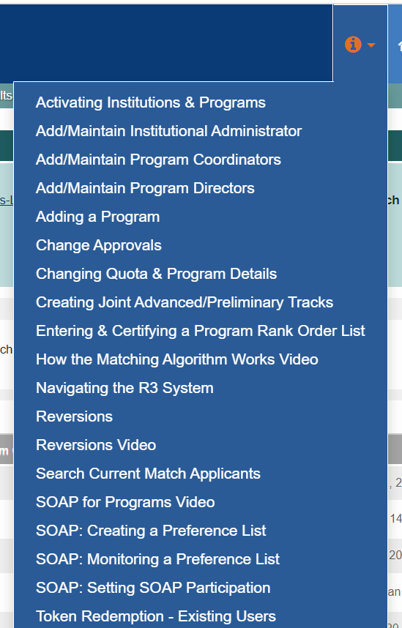
NRMP Resources
Join the Match Week and SOAP Listserv for the 2022 Main Residency Match (Email from NRMP March 3, 2022)
NRMP and ERAS will not take calls Match Week, questions answered using the listserv
Visit "SOAP Resources for Programs" web page
SOAP Guide for Programs (NRMP partnered w/ERAS)
Navigating Match Week and SOAP Webinar
NRMP Video Resources & Support Guides
Log-in select the icon, next to the Home option
Arrow with drop down list of videos and support guides

Slide 19
Reminder: NEW for House Officer Onboarding in 2022-2023
VA Paperwork will be submitted directly form the Program Coordinator to the VA through the LSU HealthFileS secure email platform.
LSBME will not accept Program Director Letters by Email. Send by U.S. Mail, FedEx, other, with tracking number to LSBME or to the attention of Mr. Matthew Cook at LSBME
All contracts will be signed electronically.
I-9 Hiring Managers will be the program coordinators
Drug Testing: New Vendor as of 7/1/2021 - APPLYA

Slide 20
Orientation Dates
LSU-NO: Monday, June 27 & Tuesday, June 28
LCMC: June 29 pick-up. Online modules required. Virtual Orientation sessions available TBD.
LSU-BR: Thursday, June 30 (tentative)
EPIC Training for LCMC: Virtual. Online modules required.

Slide 21
Resident Scheduler BOM & EOM Reports
Payroll Lockout is Wednesday March 9, 2022 for March 1-16
Check Un-assigned/Under Assigned
March BOM Reports are due NOW !
February EOM Reports are due NOW!

Slide 22
Save the Date
March 22, 2022 – Standard Coordinator Meeting (Switched from March 15, 2022)
I-9 Hiring Manager Training – Shauna Caputo – LSU Human Resources
Drug Testing Training – New Vendor APPLYA – Scott Embly

Slide 23
Thank You !
If you have any questions or need assistance, including help with the End-of-Year, and New Hire processes, Contact the GME Office staff
Sara Blakemore sblak3@lsuhsc.edu 504-568-2468
Julie Cain jcain2@lsuhsc.edu 504-568-2092
Chris Callac ccalla@lsuhsc.edu 504-568-2988
Treva Lincoln tlinco@lsuhsc.edu 504-568-8686
Yolanda Lundsgaard yleeha@lsuhsc.ede 504-568-3407
Dr. Becky Frey rodine@lsuhsc.edu 504-599-1161

