Slide 1
Coordinator Check In
May 17, 2022
LSU Online Orientation, On-boarding days, QI Forum, New Hire Paperwork

Slide 2
Agenda
LSU Orientation/Onboarding
QI Forum
IHI and AMA Module Requirements
Mask Fitting Dates for current House Officers
Pager Management
Paperwork requirements for Onboarding /New Hires
BOM & EOM Reminders
Webcast for Program Directors and Coordinators update

Slide 3
Orientation Dates
EPIC Training
–Beginning of June
Virtual
LCMC Onboarding
–June 29, 2022
Baton Rouge Orientation
–June 27, 2022
LSU New Orleans Onboarding Days
–June 27, 2022 or
–June 28, 2022

Slide 4
LSU Online Orientation
Live May 15, 2022
www.medschool.lsuhsc.edu/medical_education/graduate/virtualorientation/
No house officer have logged in yet
Residents can
View progress of some new hire requirements
Complete modules
Sign up for Onboarding Day day/time
Coordinators can:
View progress for all residents
View all modules and presentations
View list of new hire requirements
See which onboarding day residents have registered for

Slide 5
LSU Orientation
Benefits Overview:
Links to sign up in on the Orientation Portal after watching Benefits video
House Officers can attend a virtual session with HR for support and Q/A
Dates:
May 30 @10am
June 7 @ 2pm
June 15 @ 2pm
June 17 @ 10am
June 21 @ 10am
June 23 @ 2pm

Slide 6
LSU New Orleans Onboarding Days
House Officers must attend one of the onboarding dates.
June 27, 2022 or June 28, 2022
1 hour appointment
Mask Fitting will be available in their allotted 1-hour appointment session
Sign-Up link available in the Orientation Portal
House Officer will need to bring the following items:
Marriage Certificate (if applicable)
Birth Certificate for dependents (if applicable)
Social Security Card for dependents (if applicable)
US or Foreign Passport
Driver's License
Visa (if applicable)
DS 2019 (if applicable)
I-94 (if applicable)

Slide 7
REMINDERS: QI FORUM – JUNE 8 – Encourage your programs to participate for the afternoon

Slide 8
IHI Modules
Quality Improvement & Patient Safety Modules
https://lsugme.atlassian.net/wiki/spaces/POLICY/pages/668565505/IHI+Quality+Safety+Curriculum
Code: 51267
Send screenshot or copies of certificates to equip@lsuhsc.edu
QI 101, 102, 103, 201
PS 101, 102, 105, 201
Due by Onboarding!

Slide 9
AMA Modules
To be completed during 1st, 2nd, and 3rd year of training
Res 1, Res 2, Res 3+/Fel 1, Fel 2
These are required for your Exit Packets and are MANDATORY for promotion to the next HO Level and graduation.
If current residents cannot login, have them contact Julie for a personal link or for any problems- Jcain2@lsuhsc.edu

Slide 10
Digital PLAs
June 30th is the expiration date for many PLAs.
For questions or problems with Adobe Sign contact Julie.
If you are not licensed and if you would like one on one training, contact Julie.
The Knowledge Base reflects all changes in procedures for initiating PLAs.

Slide 11
Mask Fit Sign up for Current House Officers
Dates:
6/14/22 @ 12pm-4pm
6/15/22 @ 8am-12pm
6/20/22 @ 12pm-4pm
Sign Up Link: Mask Fit 2022

Slide 12
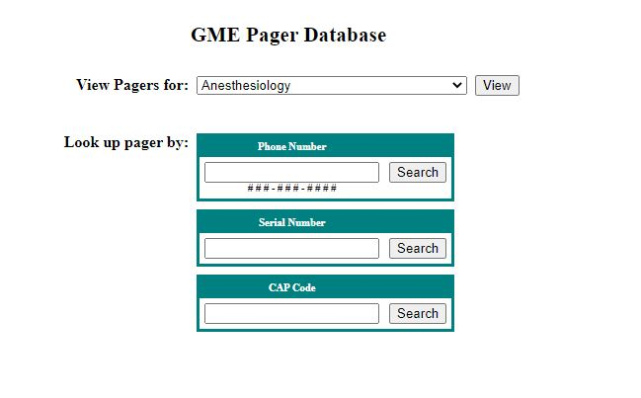
Pager Management
HOs leaving your program should return pagers to you to assign to incoming HOs.
Any pager not returned requires payment of the $55.20 lost pager fee.
Reassign pagers to new users before July 1st in the GME Pager Database. Changes will be accepted July 1.
Step-by-step instructions are available in the Knowledge Base.
If additional pagers are needed, contact Sara by the end of May.
Return any pagers no longer needed to Sara.
Contact Sara if any residents moving to fellowships wish to keep their existing pager number.
Any pagers not assigned to current residents will be shut off on August 1st and the department will be charged the $55.20 lost pager fee.

Slide 13
New Hire Paperwork
Review before forwarding New Hire Paperwork to the GME Office
GME Data Sheet Must include everything the House Officer has done after Medical School Graduation through starting LSU Residency/Fellowship Training, (included unemployed or studying for Step exams, traveling, working, etc).
Forms - All forms requiring a signature must be signed by House Officer
Social Security Card
Name must match name on New Hire paperwork
Card must be signed by House Officer
Copy included with new hire paperwork must be readable, not too dark, color copy is best.
DS-2019 – J-1 VISA Holders
LSUHSC-N.O. Training Program must be listed on the form
Valid Training dates for LSU Training program must be correct
Tax Documents
W-4: Wet signature required
L-4: Include # of exemptions, dependents, or 0
Wet signature required
Tape to a separate page if not on a full page

Slide 14
Graduating/Terminating House Officers
Email will be disabled on July 1, for House Officers graduating/terminating June 30
If they want to keep any emails, they should forward the emails to their personal email accounts.

Slide 15
PER 3: Electronic Change Source of Funds PER 3 with Load Resident Scheduler to make Corrections
Phase 2 of the electronic CSOF PER 3 includes updating Resident Scheduler before the PER 3 can be submitted.
Resident Scheduler update is completed as part of the CSOF process; not by accessing Resident Scheduler.
Training for initiating CSOF PER 3 and updating Resident Scheduler
Instructions will be sent to Coordinators
Training sessions: Plan to schedule a training session this week. Information will be sent when the date and time have been decided.

Slide 16
BOM & EOM Reports
BOM Reports
May BOM Reports are due now if have not submitted
June BOM Reports are due June 1, 2022
EOM Reports
April EOM Reports are Due Now. Accounting is following up often if reports have been received and corrections entered. Late reports delay sending invoices and LSU recouping funds.
Initiate PER 3s if needed (PER 3s are electronic and include updating Resident Scheduler too).
Send missing House Officer Responses from Past Months
May & June Reports MUST be sent as close to the Due Date as possible. May & June have year-end closing deadlines in Accounting and for some hospitals to pay invoices.
Payroll – May 16-31, 2022
Lockout: Wednesday, May 25, 2022
Payroll run: Thursday, May 26, 2022

Slide 17
Webcast for Program Directors and Coordinators on the 2022-2023 Annual Update Changes
This webcast will provide information about the Accreditation Data System (ADS) Annual Update timelines and changes for Academic Year 2022-2023 to help designated institutional officials, program directors, and coordinators better prepare for and effectively complete the Annual Update.
Register Here Thursday, May 26, 2022 11:30 a.m.-12:45 p.m. Central

