Slide 1
Coordinator Check In
February 15, 2022
VA New Hire Paperwork, New Hire Paperwork Discussion (Part 1)Appointment Form & Spreadsheets, New Hire in ERAS

Slide 2
VA New Hire Process
Welcome Crystal Cruz & Dr. Grundy!
Refer to separate uploaded slidedeck for Dr. Grundy’s slides.

Slide 3
LSBME – Permit Renewals
Second and final drop off to LSBME for Permit Renewals is this Friday.
Please submit all PD letters and $100 checks to the GME office (Treva or Yolanda) by Thursday, February 17 at noon.

Slide 4
Save the Date! Upcoming Meetings
Tuesday, February 22 – 10AM – Have questions about today’s meeting? Join us on Zoom to ask questions about anything mentioned today.
Tuesday, March 8 – 10AM – New Hire Paperwork Process. Discussion about changes to House Officer contracts and I-9s at this meeting.
Tuesday, March 22 – 10AM – Standing Coordinator Meeting. Tentatively hold for tutorial from CAP on Applya/Drug Testing Vendor.
ZOOM MEETINGS TO COME FOLLOWING THIS MEETING

Slide 5
TQCVL and Resident Tracker Spreadsheet Download
Prefilled TQCVL Spreadsheet and Coordinator Tracker spreadsheets can be downloaded from the GME Online Appointment Forms site.
Only resident levels expected to rotate will be included on the spreadsheets.
Rotation sites must be updated for 2022-2023 academic year before downloading.

Slide 6
APPOINTMENT FORM & SPREADSHEETS https://www.medschool.lsuhsc.edu/medical_education/graduate/appointments/ Appointment Form & Spreadsheets are due to Yolanda Lundsgaard by March 31, 2022
Appointment Forms are downloaded and printed from the 'GME On-Line Appointment Forms' link in Knowledge Base. The link is found in the Incoming House Officer Icon
House Officer Data is Auto-Populated into the Appointment Form and into the Spreadsheets from New Innovations
Appointment Form – Lists All House Officers in the Program
Spreadsheets lists House officers and Action
–Promotion
–Termination
–Off-Cycle
–House Officers Becoming Faculty
–Transfers
Internal Transfers
External Transfers

Slide 7
Appointment Form & Spreadsheets Cont'd ERAS-PDWS Data Imported into New Innovations
Applicant Data in ERAS is Imported into New Innovations from ERAS-PDWS by selecting 'Will Start' in ERAS PDWS
Will Start Selection must be completed by Noon on Match Day, March 18, 2022.
ERAS Applicants - 'Will Start' Selection Instrucitons:
Method 1: Coordinator Selects the 'Will Start' status individually for each Matched Applicant
Method 2: Coordinator Selects the 'Will Start' status for multiple Matched Applicants at once using bulk action
GME Office (Chris Callac) will complete the Data Import from ERAS to New Innovations. Data will not be imported before noon.
After the data is imported into New Innovations, Coordinators enter the Social Security Number, personal Email address, FMG Status, and any other biographical data, that is not included in ERAS, for each Incoming House Officer into New Innovations.

Slide 8
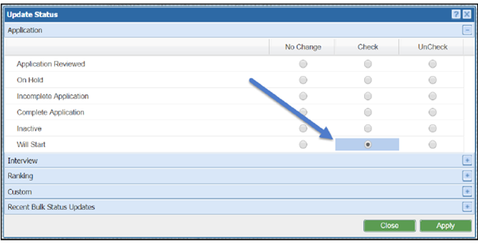
ERAS APPLICANTS 'Will Start' Option
Method 1 'Will Start' Selection
Method 2 'Will Start' Selection

Slide 9
Appointment Form & Spreadsheets ERAS-PDWS Data Imported into New Innovations Cont'd
- Non-ERAS Applicants
Coordinator Enters Applicant's Biographical Data manually into New Innovations including Social Security Number and personal Email address, FMG Status, Education, and all other data required in their New Innovations File.
- Continuing House Officers
Training Record data must be Correct in New Innovations
Training Record Data will auto-populate into the Appointment Form and Spreadsheets from New Innovations

Slide 10
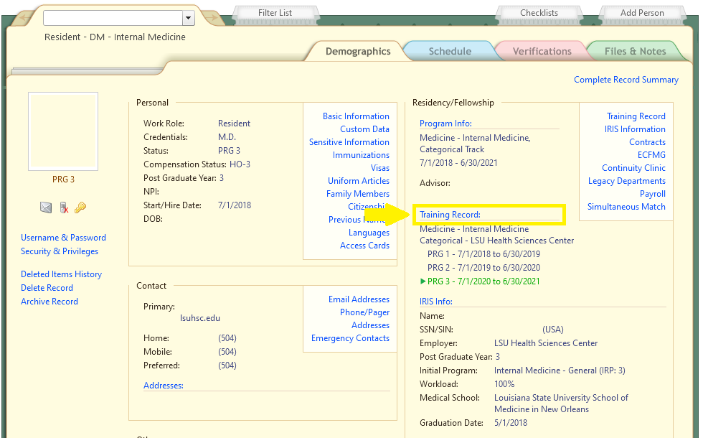
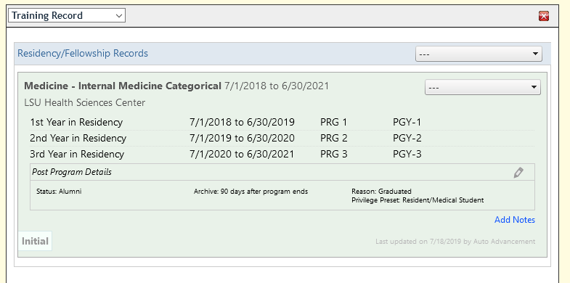
New Innovations Training Record
Add next program (internal transfer) Set by outgoing coordinator (1) Add Training Record
Extend training year (2) Adjust Training Dates
Add Chief year (2) Add Post Training Chief
Terminate early (2) End Training
Set Early Termination Reason (3) Reason
Add research year (2) Research Year
Set Termination Reason (3) Reason
Continuing as Faculty (3) Work Role and Status both set to Faculty
1
2
3

Slide 11
New Innovations Training Record Additional info Special Situations
Appointment forms and spreadsheets are updated nightly to reflect changes made in New Innovations.
Contact Chris Callac for
–Setting up gratis appointments
–Unusual promotion or demotion
–Appointment Form or spreadsheet is incorrect and you are unsure why
–Changes made in New Innovations not reflected on appointment form

Slide 12
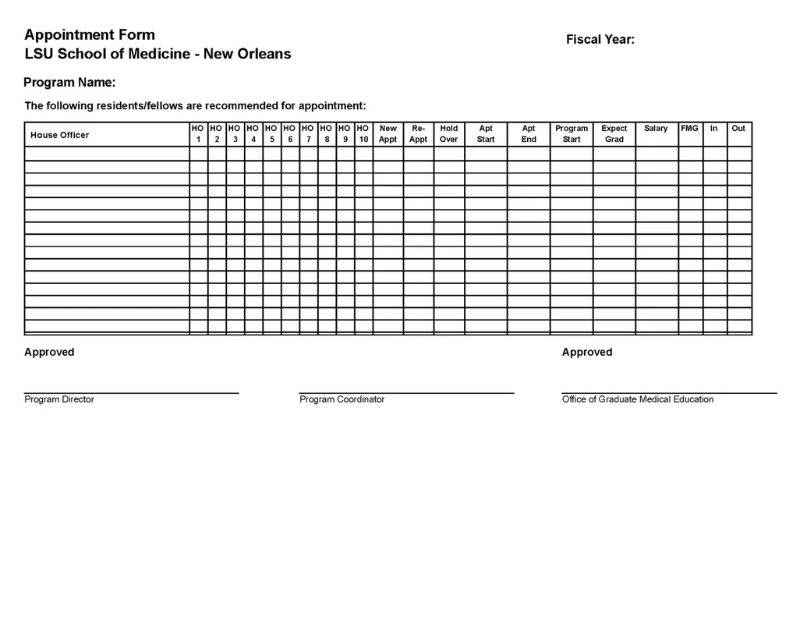
Appointment Form Appointment Form is Due to Yolanda Lundsgaard by March 31, 2022
https://www.medschool.lsuhsc.edu/medical_education/graduate/appointments/
The Appointment Form Lists All the House Officers in the Training Program any time between July 1 & June 30 for the Academic Year
Print in Landscape Format ONLY

Slide 13
Appointment Form Cont'd
The Appointment Form must also include House Officers Starting Promoting, and Terminating Off-Cycle (not July 1 Start and not June 30 Termination)
Do Not send Appointment Forms before receiving Match Results. Appointment Forms must include first year residents/fellows and all House Officers appointed outside a Match.
The Appointment Form MUST Be Printed in Landscape Format. Forms submitted in Portrait format are not accepted.
Download, Print, Sign and Submit the signed Appointment Form to Yolanda Lundsgaard in the GME Office by the due date.
Incoming House Officers, and Transfers from another LSU program will show status 'New Appt' on the Form

Slide 14
Appointment Form Cont'd
House Officers continuing in the same program from July 1 – June 30 will show status 'Re-Appointment' and include training date
House Officers that are Not Promoting July 1 are listed twice on the form. Once with their current House Officer Level with Status 'Hold-Over' and the dates at that Level; and on another line listed at the promoted House Officer Level with status Re-Appointment, and the dates at that House Officer Level.
House Officers that are Terminating Off-Cycle (not on June 30 of the Academic Year ending); are listed on the form with Status 'Hold-Over' and the effective termination date.
If there are changes, anytime during the Academic Year, to a Program's Roster of House Officers, or changes to a House Officer's training dates, an updated and signed appointment form must be sent to Yolanda Lundsgaard in the GME Office, after the change is made in New Innovations
Appointment Forms are not only required to have a record of the House Officers in each program for the Academic Year; the Forms are also used by the GME Office to document the House Officer Contracts that have been received in the GME Office, for Electonic Signature and Completed

Slide 15
Promotion Spreadsheet Promotion Spreadsheet is Due to Yolanda Lundsgaard by March 31, 2022
https://www.medschool.lsuhsc.edu/medical_education/graduate/appointments/
The Promotion Spreadsheet is used to check that all House Officers promoting July 1 from one House officer Level to the Next House Officer Level are included in the PS automated Promotion Process
Print Spreadsheet in Portrait Format ONLY

Slide 16
Promotion Spreadsheet Cont'd
The Promotion Spreadsheet lists All House Officers promoting from their current House Officer Level to the Next House Officer level
Download, Print, Sign and Submit the signed Promotion Spreadsheet to Yolanda Lundsgaard by the due date.
• Each Promotion level is listed on a separate page
• All House Officer Levels 1 – 6 will promote effective July 1, to the next level in the PS Automated Promotion Process, if they are included on the Promotion Spreadsheet
• House Officers that Don't Promote July 1, will not be included on the Promotion Spreadsheet

Slide 17
Promotion Spreadsheet Cont'd
Gratis Appointed House officers, (House Officers paid by the Military), Require a PER 3 to promote. They cannot be included in the automated promotion process for July 1 due to their Gratis Status.
Gratis House Officers that promote July 1, will not appear on the Promotion Spreadsheet, they will appear on the Exception List with the July 1 promotion date and House Officer Level
Review the spreadsheet and confirm that the House officers listed on the Promotion Spreadsheet will promote July 1, before submitting to Yolanda Lundsgaard in the GME Office
If a House Officer is listed on the Promotion spreadsheet, but should not promote July 1, and the Automated Promotion Process has been completed, a PER 3 will be required 3 to correct the error
Paperwork for House Officers Promoting is listed on the Continuing House Officers Instructions Sheet
https://lsugme.atlassian.net/wiki/spaces/POLICY/pages/2031746/Continuing+House+Officer+Appointments

Slide 18
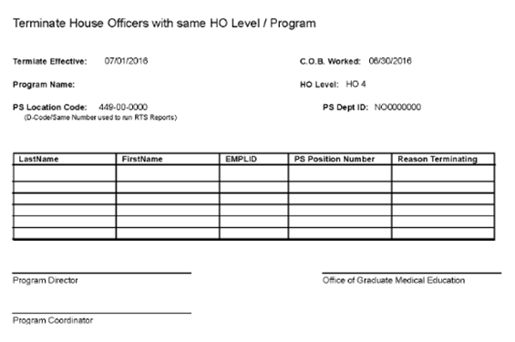
Termination Spreadsheet Termination Spreadsheet is Due to Yolanda Lundsgaard by March 31, 2022
https://www.medschool.lsuhsc.edu/medical_education/graduate/appointments/
The Termination Spreadsheet is used to check that all House Officers Terminating June 30 are included in the PS automated Termination Process
Print Spreadsheet in Portrait Format ONLY

Slide 19
Termination Spreadsheet Cont'd
The Termination Spreadsheet lists All House Officers Graduating, Terminating, Transferring to a Non-LSU Training Program or Resigning from the LSU Training Program June 30.
A PER 3 (electronic version), is required to Terminate House Officers that resign June 30 and House Officers that do not complete the training program and transfer to a non-LSU Training Program.
Download, Print, Sign, and Submit the signed Termination Spreadsheet to Yolanda Lundsgaard, in the GME Office, by the due date
All House Officers listed on the Spreadsheet will Terminate in the PS Automated Termination Process, last day worked c.o.b, June 30, Effective July 1, unless Resigning or Transferring to a Non-LSU training program and will not complete all years of the program
House Officer Email accounts will be disabled. Important EMails or EMails they want to keep, should be saved to other media devices.

Slide 20
Termination Spreadsheet Cont'd
Gratis Appointed House officers, (House Officers paid by the Military), are listed on the Termination Spreadsheet, but are not terminated in the PS Automated Termination Process.
A Paper PER 3 must be submitted for Terminating Gratis House Officers
Notification of Separation must be sent to the Email distribution list: LSUHSC-NONotificationofEmployeeSeparation@lsuhsc.edu
If a House Officer is listed on the Termination spreadsheet in error, and the PS Automated Termination Process has been completed, Paperwork to reinstate the House Officer's appointment and benefits will be needed. If this happens, Contact Yolanda Lundsgaard immediately.
Paperwork Required for Terminating House Officers is listed on the Instructions - Documents for Terminating House Officers sheet
https://lsugme.atlassian.net/wiki/spaces/POLICY/pages/41910305/Instructions+-+Documents+for+Terminating+House+Officers

Slide 21
Off-Cycle Spreadsheet Off-Cycle & Exceptions Tab Off-Cycle & Exceptions Spreadsheet is Due to Yolanda Lundsgaard by March 31, 2022
https://www.medschool.lsuhsc.edu/medical_education/graduate/appointments/
The Off-Cycle & Exceptions tab will show all House Officers who are Off-Cycle or need to be manually promoted/transferred/terminated.
Print this page in Landscape Format.

Slide 22
Off-Cycle & Exceptions Tab (Spreadsheet) Cont'd
House Officers that will be listed when the Off-Cycle & Exceptions Tab is select are:
House Officers Promoting Off-cycle (do not Promote July 1)
House Officers Terminating Off-Cycle (do not terminate June 30)
House Officers Transferring Without Promoting (House Officer level remains the same or changes to a lower House Officer level)
House Officers Graduating without Termination (becoming Faculty appointed Chief Resident or other Faculty appointment).
The Off-Cycle Spreadsheet is not a downloadable Spreadsheet like the Promotion and Termination Spreadsheet. It is a list of the House Officers in the Program that fit one of the criteria above
Print the list that is generated in Landscape Format, sign, and submit the List to Yolanda Lundsgaard, in the GME Office, by the due date.

Slide 23
Off-cycle & Exceptions Tab (Spreadsheet) Cont'd
Contracts for Off-Cycle House Officers Must match the training dates for each house Officer level he/she will be during their training time
Paper PER 3s are Required for these Off-Cycle House Officers:
House Officers Promoting Off-Cycle
House Officers Transferring and Promoting, or Transferring and Not Promoting Off-cycle
Electronic PER 3s for House Officers Terminating Off-Cycle:
- Request Department/Section Business Manager Submit an Electronic PER 3 in the PS HCM Production Database
All PER 3s for Off-Cycle House Officers MUST be submitted at least ONE MONTH before their Off-Cycle Promotion, Transfer or Termination Date (Includes Paper & Electronic PER 3s)

Slide 24
House Officers Becoming Faculty Spreadsheet House Officer Becoming Faculty Spreadsheet is Due to Yolanda Lundsgaard by March 31, 2022
https://lsugme.atlassian.net/wiki/spaces/FORMDOCS/pages/2031762/House+Officers+Becoming+Faculty+Spreadsheet
Coordinator Completes the Spreadsheet found in the Link above in Knowledge Base 'House Officers Becoming Faculty Spreadsheet‘
Training Record in New Innovations should reflect outgoing status of “Faculty”
House Officers Becoming Faculty are also included on the Termination Spreadsheet.
Termination Reason on Termination Spreadsheet MUST be: 'Graduated Con't as Faculty' (automatic once New Innovations outgoing status is updated)
Faculty Appointment dates can be delayed due to approval of Hospital Credentialing Packets and Dean's Office approval. If this happens, the House Officer can have a break in service which will affect Email access and benefits.

Slide 25
House Officers Becoming Faculty Spreadsheet Cont'd
It is Important to let Yolanda Lundsgaard know if the Faculty appointment will be Effective July 1
–This is so there is no break in service and Benefits remain active
The Automated Termination Process will Terminate the House Officer's title only if they are listed as becoming Faculty July 1, on the Spreadsheet. Benefits will remain active
If the Faculty Appointment will NOT be July 1, they are treated like other June 30 Terminating House Officers, Except Coordinator will also
Notify MS Computer Support of the Faculty Appointment, including effective date of Appointment, and request to keep their Email account activated so they can continue to receive EMails and have Emails received during training available

Slide 26
Faculty Becoming House Officers
https://lsugme.atlassian.net/wiki/spaces/FORMDOCS/pages/27104576/Faculty+Becoming+House+Officer+Checklist
A Physician with a Faculty Appointment going into a residency or fellowship program
LSU Chief Resident with a faculty appointment entering a Fellowship Training Program
An LSU Physician with a Faculty appointment entering a Fellowship Training program
There is NO Spreadsheet that auto-populates the data for LSU Faculty becoming House Officers
Paperwork needed is listed on the 'Faculty Becoming House Officer Checklist

Slide 27
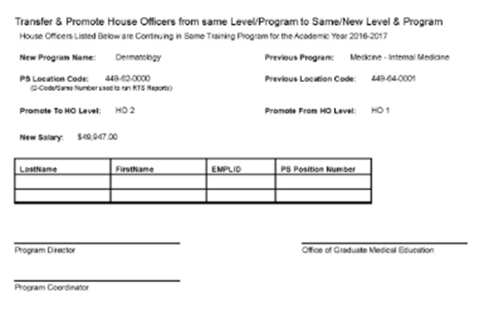
Transfer Spreadsheet – Internal Transfers Transfer Spreadsheet is Due to Yolanda Lundsgaard by March 31, 2022
Chttps://www.medschool.lsuhsc.edu/medical_education/graduate/appointments
Transfer Spreadsheet Lists All House Officers Transferring from one LSU Program to another LSU Program, with or without promotion (Internal Transfers) July 1
Only transfers INTO your program are shown.

Slide 28
Transfer Spreadsheet Cont'd
Internal Transfers include House Officers in Programs in New Orleans, Baton Rouge, Bogalusa, Lafayette, and Lake Charles
Paperwork required to submit to the GME Office for Internal Transfers is listed on the https://lsugme.atlassian.net/wiki/spaces/FORMDOCS/pages/27077060/Internal+Transfer+Checklist
House Officer Transfers not effective July 1, Require a PER 3 to Transfer and Promote or Change Title
PER 3s MUST be submitted to Yolanda Lundsgaard at least ONE MONTH prior to Transfer and/or Promotion Date

Slide 29
Transfers – External Transfers
External Transfers Include: Applicants transferring from a non-LSU Training Program to an LSU Training Program
Transfer could be into same Specialty or into different specialty
External Transfer Applicants that are not accepted to an LSUHSC Training Program in a Match or SOAP process, must complete the DIO Transfer Packet
https://lsugme.atlassian.net/wiki/spaces/FORMDOCS/pages/37191681/DIO+Transfer+Approval+Packet
The Completed DIO Transfer Packet is Submitted to the GME Office for Review
Programs Cannot offer the position to an External Transfer until Dr. Hilton has approved the DIO Transfer Packet
Once Approved, the GME Office will notify the Program Director and Coordinator and an offer letter can be sent to the Applicant

Slide 30
GME Rotation Sites
Rotation sites for the 2022-2023 Academic Year need to be updated/confirmed online by March 4th
https://www.medschool.lsuhsc.edu/medical_education/graduate/RotationSites/
Rotation sites set determine which new hire packets are available as part of the New Hire Forms automatically generated
If unsure about a new site, email ccalla@lsuhsc.edu with info
Rotation sites can be changed later if necessary

Slide 31
GME Rotation Sites
A few things to remember:
This list will not contain all rotation sites you may rotate to. It consists primarily of our larger partner sites. If you rotate to sites which are not listed, that is OK and we do not need to be notified.
If your sites are not properly updated for the academic year, your incoming house officers will not receive the correct hospital appointment packets when they download their new hire paperwork.
University Hospital and Clinics IS NOT University Medical Center - New Orleans. University Hospital and Clinics refers to the facility in Lafayette.
Additional information is in the Knowledge Base.

Slide 32
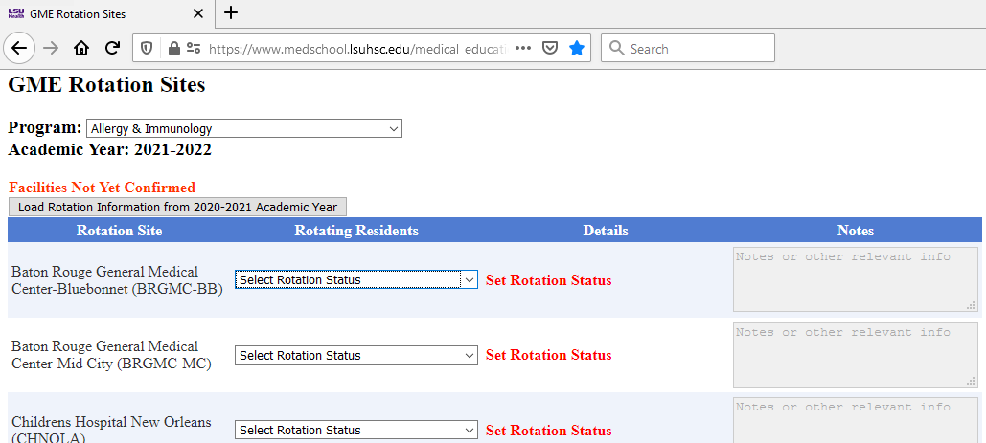
GME Rotation Sites

Slide 33
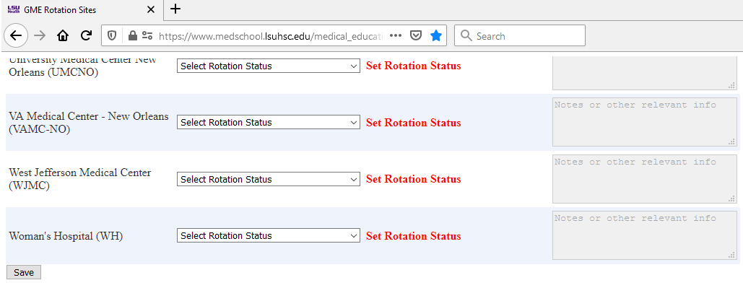
GME Rotation Sites

Slide 34
Announcements !!!
LSBME Permit Renewals
2nd LSBME Drop off on Friday, February 18, 2022
House Officer February 28 Check – 13 days in the Pay Period, (February 16-28). The check amount will be smaller than usual due to the number of days in the pay period.
Continue COVID Reporting:
–Link to report COVID to the GME office: https://forms.office.com/Pages/ResponsePage.aspx?id=iTYGNNSCiU6jKBq3nMWNnWCYPgvKe9lLk-p7V0sKjqBUMEZBUEhOVEs4OEk0MFFXTkcxTkRTUzNVVS4u
–Link to self report COVID to LSU: https://911.lsuhsc.edu/coronavirus/selfreporting.aspx

Slide 35
Upcoming Dates
February 22, 2022 – Focused Meeting on New Hire process 10:00 am – 11:00 am
March 2, 2022 - NRMP Rank Order List Certification Deadline8:00 pm CT
March BOM Reports Due
March 7, 2022 – February EOM Reports Due
Mar 8, 2022 – New Hire Paperwork Coordinator Meeting 10:00 am
Mar. 14 – 18, 2022 - NRMP – Match Week
Mar 17, 2022 – SOAP Rounds 1-4 – all day, 7:00 am – 8:00 pm
Mar. 18, 2022 – Match Day
Mar. 22, 2022 – Coordinator Meeting (switched from March 15)

Slide 36
Orientation Dates
LSU-NO: Monday, June 27 & Tuesday, June 28
LCMC: June 29 pick-up. Online modules required. Virtual Orientation sessions available TBD.
LSU-BR: Thursday, June 30 (tentative)
EPIC Training for LCMC: Virtual. Online modules required.

Slide 37
NEW for Onboarding in 2022-2023
VA Paperwork will be submitted directly form the Program Coordinator to the VA through the LSU HealthFileS secure email platform.
LSBME will not accept Program Director Letters by Email. Send by Mail/FedEx, etc with tracking number.
All contracts will be signed electronically.
I-9 Hiring Managers will be the program coordinators.
New Vendor as of 7/1/2021 - Applya for Drug Testing.

Slide 38
Sending VA Paperwork Securely to the VA - LSU HealthFileS
Login with LSUHSC Username and Password

Slide 39
Draft email like usual. Attach files as needed. This system also works for sending large files/attachments. 'Authentication Required' is another security layer but is not needed for the purpose of emailing the VA. Select 'Authentication Not Required' and 'Recipients Only' (default) so only the VA staff members are able to view contents of message.

Slide 40
LSU HealthFileS
You as the sender will receive an email when the email has been opened.
You'll also be able to log back in and view your sent messages.
For the future, you can also request files this way from others. For example, if someone needed to submit a SSN card to you, you can request a secure email from them by clicking 'File Requests' at the top.

Slide 41
Questions? & Save the Date!
Tuesday, February 22 at 10AM
Ask questions you may have from anything mentioned during today's meeting. Q&A and open discussion format – no material presented.
New coordinators and those needing a refresher are welcome!
Tuesday, March 8 at 10AM
New Hire Paperwork meeting. We will review the 2022-2023 paperwork and any changes that have been made.
Zoom links for these meetings will be sent today. Each will be recorded.
Reminder – March 22 at 10AM – Standard March Coordinator meeting

Slide 42
SHOUT OUTS!
Sherilyn Munoz-Dermatology
Beth Sutton-Family Med-Kenner
Kerry Wiltz-Female Pelvic Reconst
Judy Weber-Med-Electrophysiology
Natalie Worsham-Med-Geriatrics
Ann Marie Onesti-Med-Rheum
Krystal Lockhart-OB/Gyn

Slide 43
SHOUT OUTS!
Josh Butrick-Ophthalmology-Retina
Hanh Rimmer-Peds-Cardio
Hanh Rimmer-Peds-Hospitalist
Hanh Rimmer-Peds-Neonatal
Katherine Dickens-Psych-Forensic
Dana Brian-Radiology-Diagnostic
Jeanne Zar-Surgery-Critical Care
Linda Arruebarrena-Urology

Slide 44
Thank You !
If you have any questions or need assistance with the Appointment Form, Spreadsheets or other information I discussed in this power point presentation
Contact me
Yolanda Lundsgaard
GME Coordinator
Yleeha@lsuhsc.edu
(504) 568-3407

