Slide 1
Coordinator Check In
March 22, 2022
I-9 Hiring Process, Background Check, Drug Testing, Malpractice, LSBME, New Hire Documents

Slide 2
I-9 – Hiring Manager Process
Tutorial - Shauna Caputo from Human Resources
Handout with instructions has been posted to the Knowledge Base

Slide 3
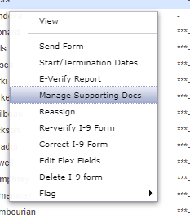
I-9 – Hiring Manager Process
Hire Right I-9 - How to upload supporting document
Once complete I-9 and certify, please complete the following steps:
Right click on employee name
Manage supporting documents:

Slide 4
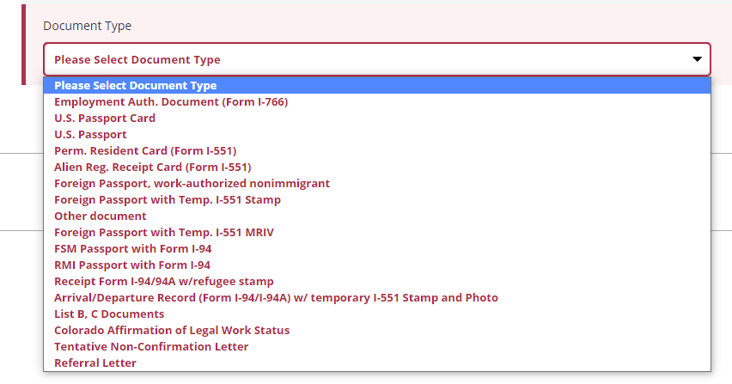
I-9 – Hiring Manager Process
Hire Right I-9 - How to upload supporting document
Manage supporting documents continued:
Select document(s) type:

Slide 5
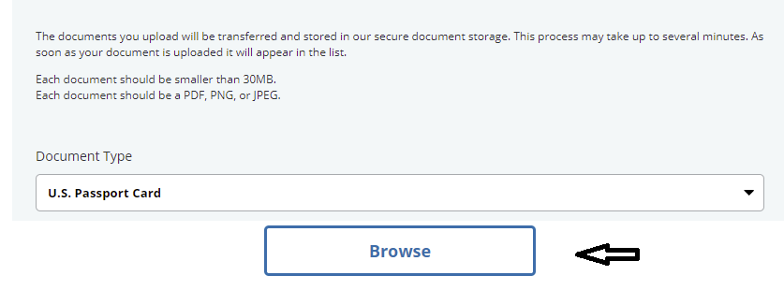
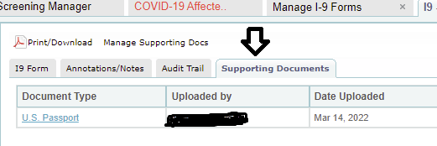
I-9 – Hiring Manager Process
Hire Right I-9 - How to upload supporting document
Select document(s) type continued:
Select saved document(s) from files to upload:
Verify documents are visible under supporting documents tab:

Slide 6
I-9 – Hiring Manager Process
Hire Right I-9 – Snap shots
J-1HireRight.Samples.J-1.ECFMG.pdf

Slide 7
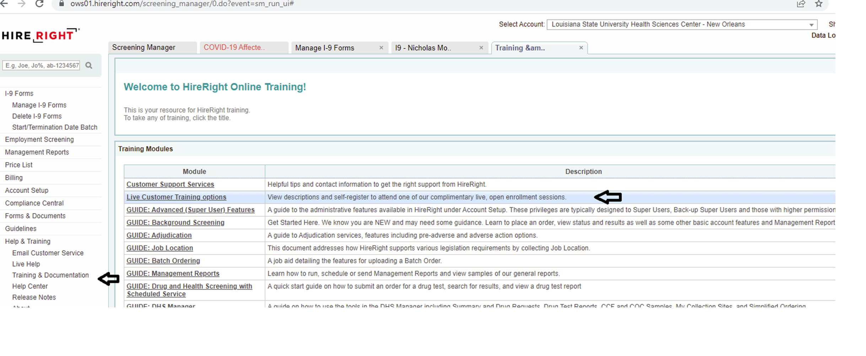
I-9 – Hiring Manager Process
For additional training:
Webinar Training: How to find times/register

Slide 8
I-9 – Process for Foreign Nationals
Tutorial – Remy Allen

Slide 9
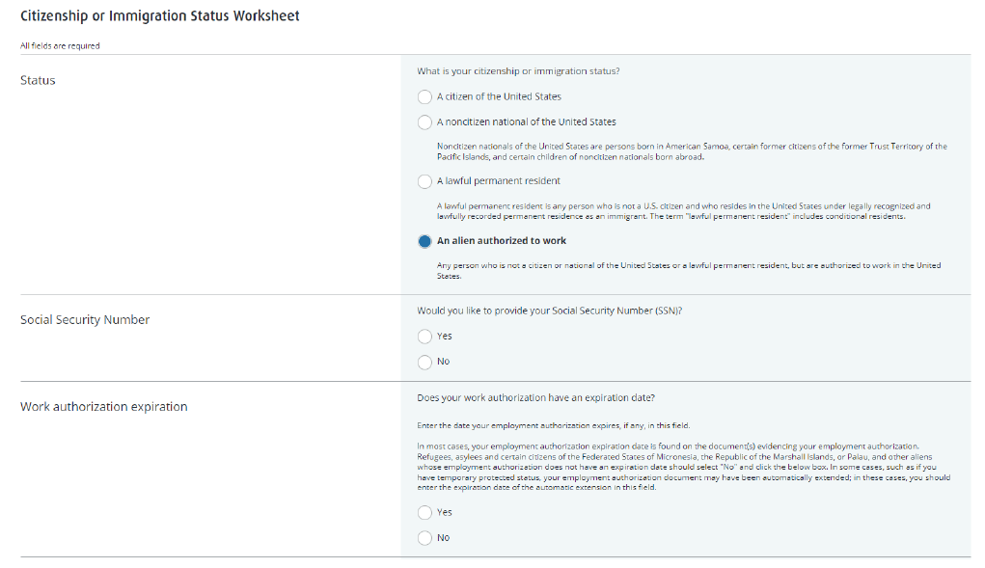

Slide 10
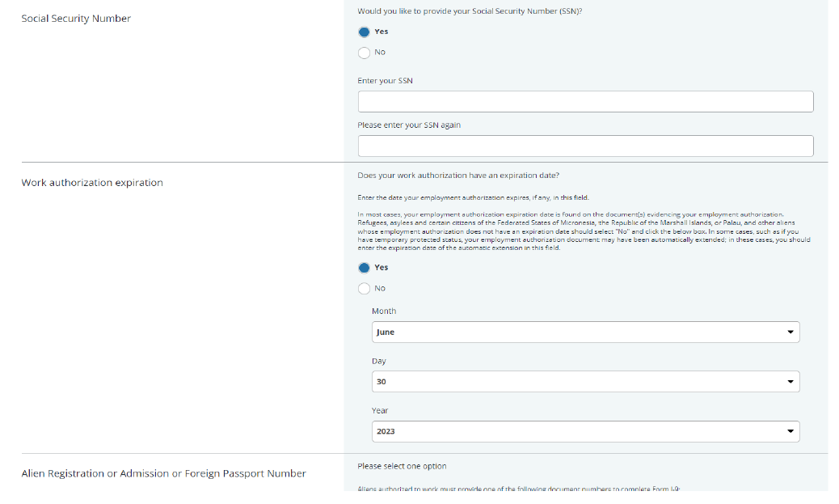

Slide 11
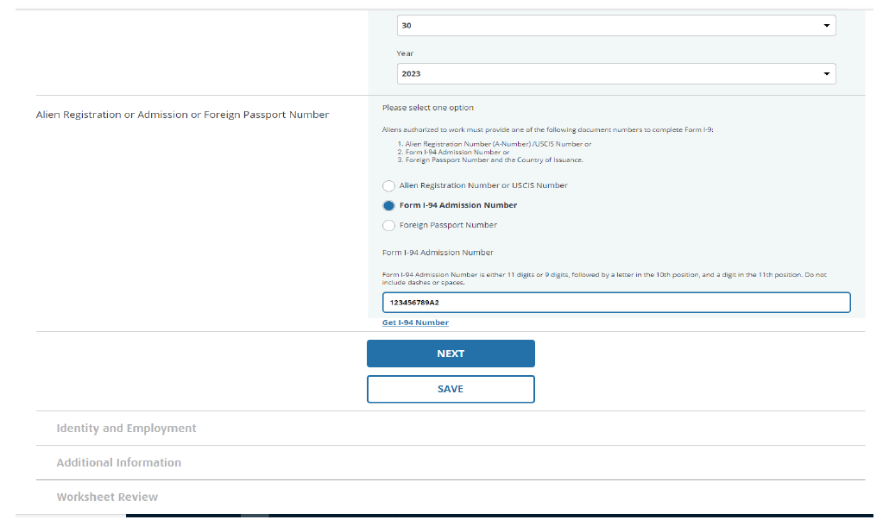

Slide 12
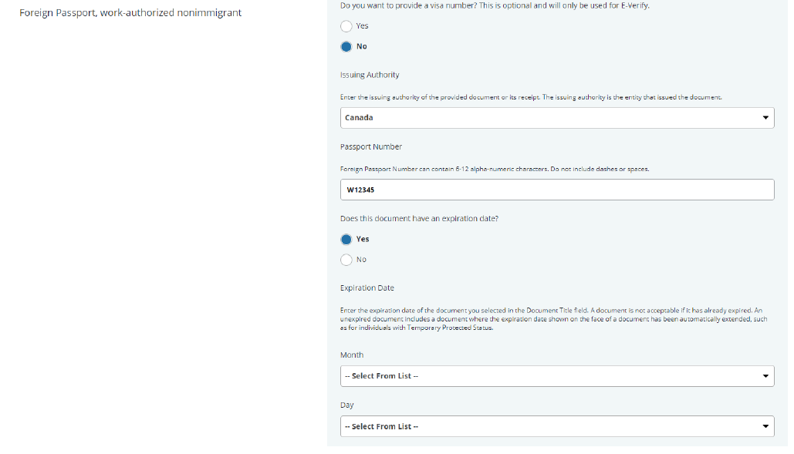

Slide 13
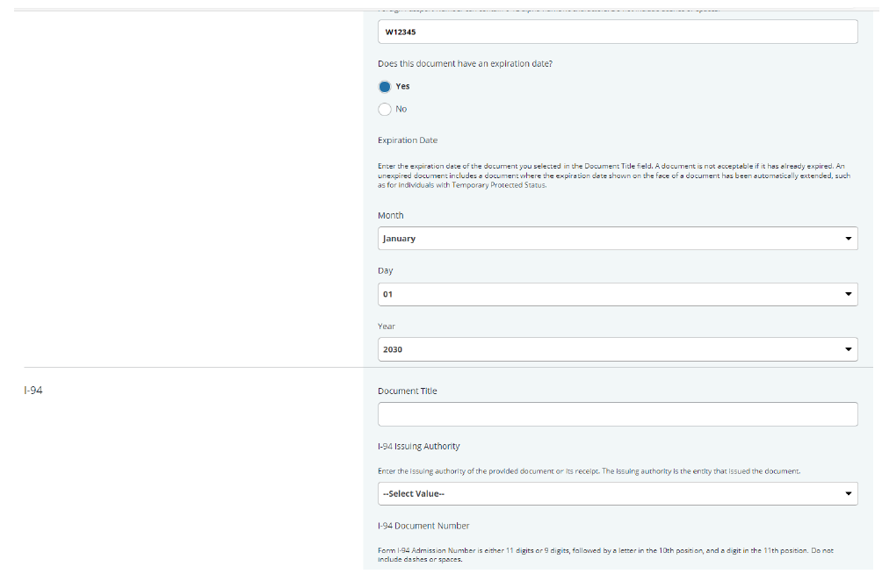

Slide 14
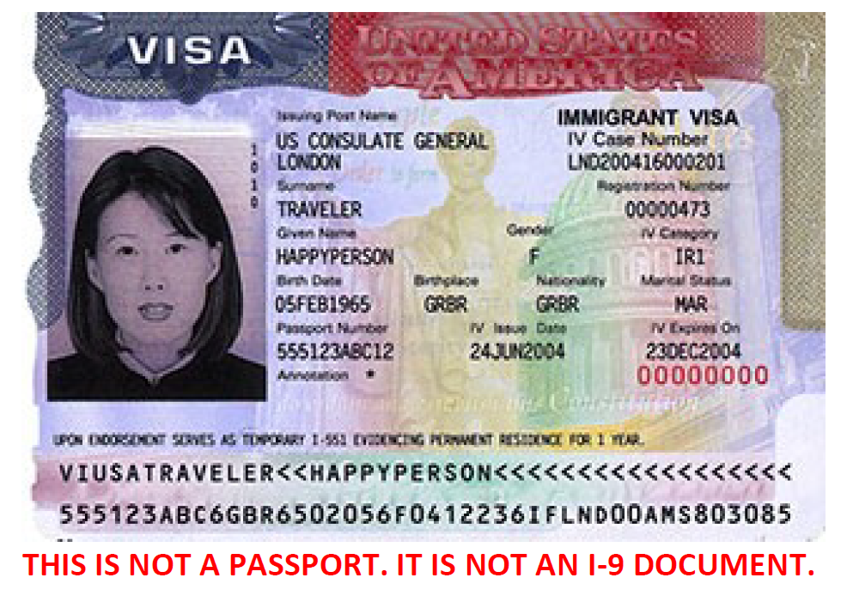

Slide 15
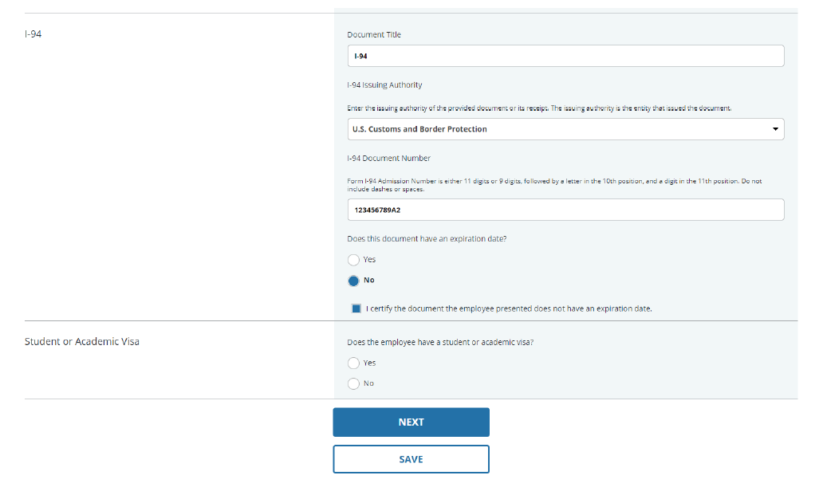

Slide 16
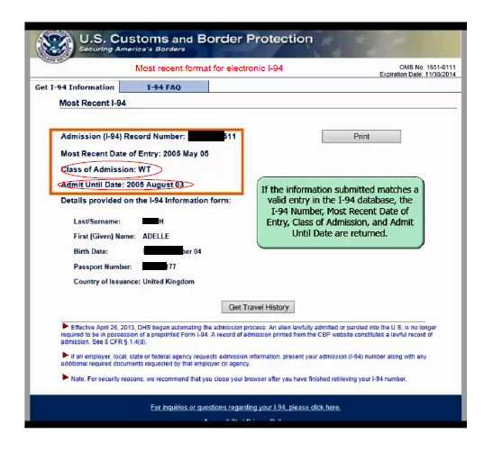

Slide 22
Sample completed I-9 (this is the paper version – the online version should match this one when it is completed)

Slide 25
I-9 – Hiring Manager Process
As the program Hiring Manager, House Officers will have to supply the Program Coordinator, in person, with original documents (i.e. passport or SSN card with State ID) to be color copied, uploaded to the HireRight system, and Section 2 of the I-9 to be completed by the coordinator.
–Color copies of identifying documents are to be included in the House Officer New Hire packet to keep on file with GME records.
–Hiring Managers will be added to the I-9 system on by April 1. House Officers will receive their email to complete Section 1 at that time. They can turn in their photo documents in person after that to be uploaded by program coordinators. June 1st emails to House Officers on Visas.
–For LSU Students entering Baton Rouge, Bogalusa, Lake Charles, or Lafayette programs, GME can complete I-9 documentation verification process in lieu of traveling to the program office.

Slide 26
I-9 Forms
Most common acceptable documents include:
Driver's License, State ID or School ID and unrestricted social security cared
U.S. Passport
Permanent Resident (Green) Card (I-551)
Foreign Passport, I-94 or I-94A and DS-2019 (List A combination for J-1 holders)
For others, please see list of acceptable Documents located at
https://www.uscis.gov/i-9-central/form-i-9-acceptable-documents

Slide 27
I-9 Forms
Documents must be valid through July 1, 2022
The names on the documents should match
Include memos and documentation (if provided by house officer) for maiden names on documents versus married names or if there are slight variances.
Information should generally match but there are instances where it can be accepted with proper justification
Original documents must be presented in person to Program Coordinator
For LSU Students entering Baton Rouge, Bogalusa, Lake Charles and Lafayette programs, the GME office can complete I-9 documentation verification process in lieu of traveling to the program office.
Copies of documents are NOT acceptable to view

Slide 28
I-9 Forms
I-9 forms are initiated by the GME Office; incoming residents are emailed a link (to the email address in New Innovations) to complete their form
I-9 forms will be sent to US citizens the week of April 5th; I-9 forms for foreign nationals will be sent on June 1st
Once the form is complete, the resident must present documents to verify their identity/eligibility to work to the Program Coordinator
Program Coordinator will make color copies of documents
Program Coordinator will complete Section 2 of the I-9

Slide 29
Criminal Background Check
Human Resources will import the list of incoming house officers into HireRight to initiate the Email to Incoming House Officers (on or around April 15, 2022)
Incoming House Officers should look for the Email from HireRight
Incoming House Officers complete the information in HireRight for the Background Check
Incoming House Officers have 7 days from Receipt of the HireRight Email to complete the information
Human Resources will forward a copy of the Background Check 'Clear for Hire' Email to the Coordinator
Coordinator includes the Background Check Email 'Clear for Hire' in the New Hire Packet

Slide 30
Drug Testing
Drug Testing Process - New Vendor APPLYA - Training by Scott Embley to

Slide 31
Malpractice Form and Spreadsheet
Malpractice Form can be found on Knowledge Base
Malpractice Spreadsheet can be found in the Appointment Form System
Attach the Spreadsheet to the completed Malpractice form
Follow Cynthia's instructions and submit the paperwork to the GME Office for Dr. Hilton to sign. The GME Office will route the paperwork to Cynthia Scott
For questions, please reach out to Cynthia Scott 504-568-4801

Slide 32
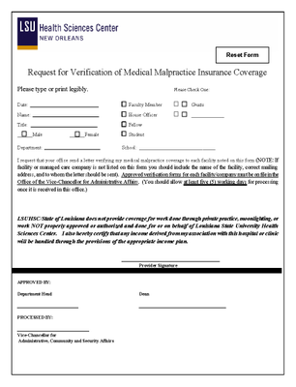
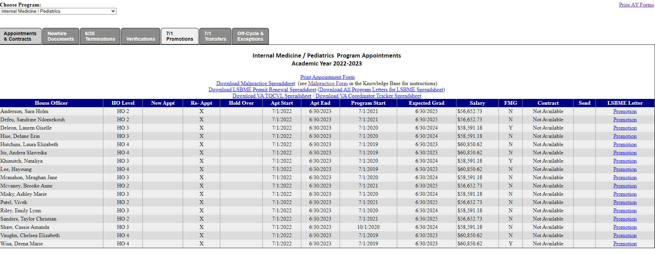
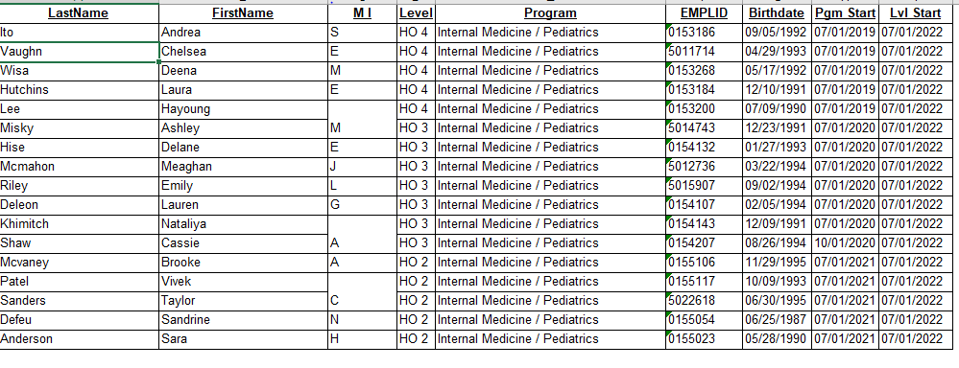
Malpractice Form & Spreadsheet

Slide 33
LSBME – US Medical Graduates (PGY)
To Start the Application Process:
Go to the LSBME website www.lsbme.la.gov (select Apply for new license/permit, follow instructions for physicians – US Medical Graduate PGY)
House Officer logs into LaMed DashBoard
House Officers will need to download the following documents and mail to LSBME:
Oath or Affirmation (must be notarized, applicant mails to LSBME)
Third Party Authorization (must be notarized, applicant mails to LSBME)
Certificate of Dean/Registrar (Complete, attach recent passport photo. The form is sent from House Officer's Medical school; LSU SOM N.O. Student Affairs Office will send the form with a copy of their Medical School diploma after graduation)
Background Check (follow instructions on LSBME website)
Provide Documents required to LSBME: (Certified Birth Certificate, Diploma, passport)
FedEx is the safest route to send the documents

Slide 34
LSBME – International Medical Graduates (GETP)
To Start the Application Process:
Go to the LSBME website www.lsbme.la.gov (select Apply for new license/permit, follow instructions for physicians – Training Permit – International Medical Graduate)
House Officer logs into LaMed DashBoard
House Officers will need to download the following documents and mail to LSBME:
Oath or Affirmation (must be notarized, applicant mails to LSBME)
Third Party Authorization (must be notarized, applicant mails to LSBME)
Certificate of Dean/Registrar (Complete, attach recent passport photo. The form is sent from House Officer's Medical school)
Background Check (follow instructions on LSBME website)
Provide Documents required to LSBME: (valid Visa, Original certificate of)
FedEx is the safest route to send the documents

Slide 35
Match 2022
Match: All Programs have filled
International Medical Graduates (IMG/FMG)
ECFMG – TPL (Training Program Liaison) – Contact Yolanda Lundsgaard

Slide 36
COVID / Immunization Releases
Sent out Friday 3/18
ONLY sent to HOs continuing for 2022-2023 academic year
250 of 671 already completed
3 / 671 have declined to allow us to release their info
Completed releases available in GME Resident Files https://ome-ccalla-serv.master.lsuhsc.edu/gme_files/ (Immunization / COVID Status Release Form)
Tracking
Short term https://www.medschool.lsuhsc.edu/medical_education/graduate/appointments/Health_Release_Form_Status.xlsx
Long Term? Custom Data Field in NI?

Slide 37
New Hire Documents
Incoming HOs may begin completing forms today
All instructions and IDs / PIN Codes are in the Appointment Forms system on the Newhires tab.
Updated packets have not yet been received for
Lafayette General
VA – New Application Packet

Slide 38
New Hire Data Needed ASAP
By the end of the day on April 4th
SSNs (NOT imported from ERAS)
Birthdates
Address
Phone Number

Slide 39
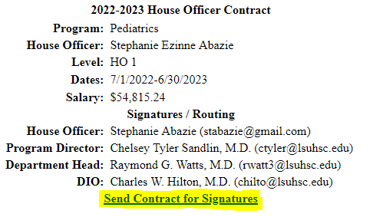
Electronic Contracts
Should be available by end of day today
Verify ALL data before initiating contract
No info may be changed after contract is initiated

Slide 40
Electronic Contracts
When contract is signed by all parties, coordinators will be emailed a copy
Completed contracts will also be available online in GME Resident Files https://ome-ccalla-serv.master.lsuhsc.edu/gme_files/
Coordinators are now able to send reminders with new links for outstanding contracts
Can only be sent once per week

Slide 41
Not Yet Available
GME Tracking System – for tracking
New hire packets
Appointment packets
Program Exit Packets
Electronic Appointment Packets
Driver Safety Forms
Immunization Records

Slide 42
Orientation Dates
LSU-NO: Monday, June 27, 2022 & Tuesday, June 28, 2022
LCMC: June 29, 2022, pick-up. Online modules required. Virtual Orientation sessions available TBD.
EPIC Training for LCMC: Virtual. Online modules required.
LSU-BR: Thursday, June 27, 2022

Slide 43
Upcoming Dates & Reminders
Daniels Lecture - May 13, 2022 – 12pm Keynote Speaker: ACGME Chief Diversity, Equity and Inclusion Officer
2022 QI Forum – June 8, 2022 – Keynote Speaker: Dr. Brian Wong, MD, FRCPC
Submissions - https://app.oxfordabstracts.com/stages/3960/submitter
TB testing March 28, 2022-April 8, 2022
Student Login (supersaas.com)
Due March 31, 2022 – Appointment Form, Spreadsheets, & PER 3s (if applicable)
Resident Scheduler:
BOM Reports – April Report Due April 1, 2022; send March report if not already sent
EOM Reports – February Report is due now; March Report is due April 6, 2022

Slide 44
Welcome
Cheryl Hoehn!
OME Coordinator

Slide 45
Thank You !

