Slide 1
Coordinator Meeting
April 16, 2024

Slide 2
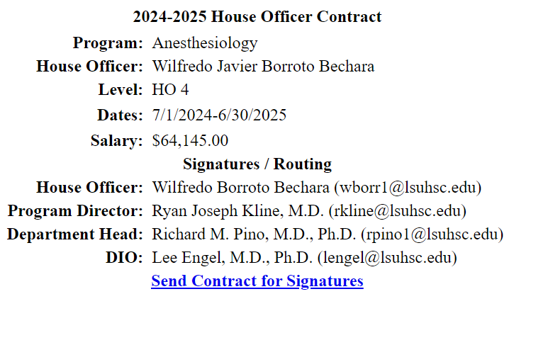
CONTRACTS
Contracts are ready to be initiated!
AY Form
Do you see "Contact GME"?
Email Sara, Chris, and Yolanda!

Slide 3
Appointment "Packet"
Contract
TB- LSUHSC FORM will not be sent to them. They need a valid TB test (PPD/QuantiFERON) from March 2024-June 30, 2024).
GME initiated via email:
LSBME Release
FCVS Release
Moonlighting
Immunization/Health Records
Immunization/COVID Release Form

Slide 4
Orientation Portal
"Opens" May 15th. Incoming House Officers must complete orientation by June 15th.
Email sent from GME to incoming House Officers with Orientation/Onboarding information in May
Coordinator View
Sign Up for Onboarding Day Session (1 hour blocks)
Benefits Session
Must sign up for one Benefits session with HR (virtual)
June 21st will be focused on Foreign Nationals

Slide 5
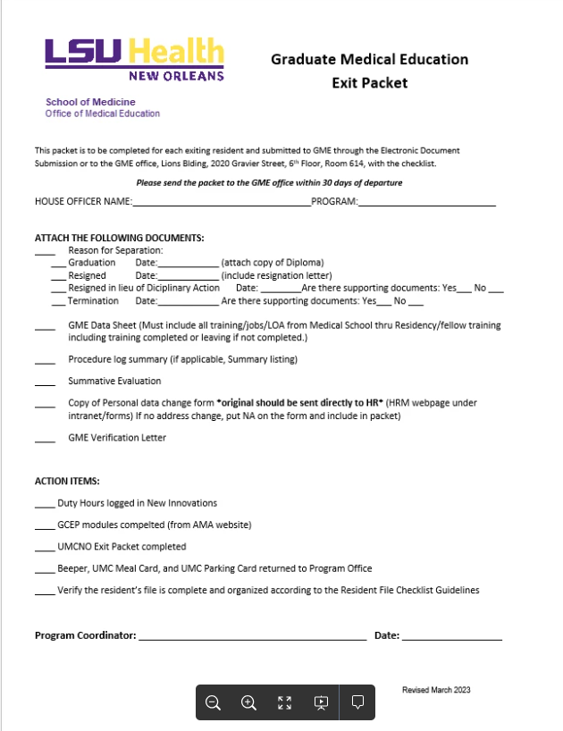
Exit Packets
Exit Packet
Attachments:
Diploma/Resignation Letter/Supporting Documents
GME Data Sheet
Procedure Log
Summative Evaluation
Template
Personal Data Change Form
AY Forms
Verifications Tab
Action items:
Duty Hour Monitoring Site
GCEP Modules @ AMA site
UMCNO Exit Packet
Returns
Resident File complete
CV**
***Due July 31, 2024***
***End of Year Survey and Exit Survey (For Graduates) are both out. Sent out by Ram through Survey Monkey***

Slide 6
TAGME
Applications open now through June
https://tagme.org/how-to-apply/
CE: 15 hours needed when first applying

Slide 7
Program Review check in
Program Documentation Review Form.pdf
Common Missing Documents:
Initiatives: track your programs progress with dates!
Multi source evals- need 2 at least twice a year
Goals and Objectives: site, rotation, level specific
AMA-GCEP modules- End of Year: tips and tricks for compliance, printing reports, etc.
Policies and procedures to ensure coverage and continuity during HO absences
Organization is key!!!

Slide 8
House Officer Binders
House Officer Photo
Application/CV/Contract (yearly)
New Hire Paperwork
LSU, Sites, yearly applications
License (dates in NI)
Evaluations (NI)
Research
Work hours (NI)
Pulled at the end of each year
Rotation Schedules (NI)
Yearly
Exam scores (NI)
ITE, boards, step 3, etc.
Case logs/procedure logs (NI)
Campus correspondences/other

Slide 9
ERAS 2024-2025
What's Coming in the 2025 ERAS Season
Program Signaling and Interview Invitations & Specialty Opt-In reminder
Individual Residency Programs in participating specialties must Opt-in to receive program signals when registering for the 2025 ERAS Application Season in ERAS program Management (EPM), beginning April 15, 2024 - June 30, 2024
December Cycle specialty societies and programs can indicate their intent to use program signals for 2024-2025 Application season later this year. More information to come.
https://vimeo.com/915735345 New ERAS Content Updates for the ERAS 24-25 Application Season

Slide 10
NRMP Fellowship Programs
Radiology Fellowship Programs (Breast Imaging, Musculoskeletal & Neuroradiology)
April 17, 2024 –Rank Order List Opens
May 15, 2024 – Quota Change Deadline
Neurology-Epilepsy & Clinical Neurophysiology Fellowship
April 17, 2024 – Quota Change Deadline
May 1, 2024 – Rank Order List Deadline

Slide 11
BLS/ACLS info
Survey

Slide 12
Up and Coming Dates
May:
21st : Program Coordinator Meeting
22nd @ 10am-12pm - I-9 Walk Through
June:
11th @ 2pm – Block Scheduling Meet Up
12th @ 10: - Block Scheduling Meet Up
18th: Program Coordinator Retreat
24-25: LSU Onboarding
26- UMCNO Onboarding & LSU BR Onboarding
Mask Fit for promoting house officers: Schedule for Mask Fit Testing 2024 (supersaas.com)
June 10th
June 11th
June 17th
July: CORE

Slide 13
Reminders
Diplomas
Orders received after April 28, 2024 will not be processed until May 30, 2024 to Registrar.
VA- New Rotator Paperwork delayed- unsure of due date .
Background check emails were not sent yesterday, stay tuned!
New Hire Packets due to you May 1st
Incoming House Officer LSU ID Badges
March EOM reports due now!
Official Driving Records mailed to: LSUHSC Environmental Health and Safety Department, Stanislaus Hall Room 216, 450A S. Claiborne Avenue, New Orleans, LA 70112.

Slide 14
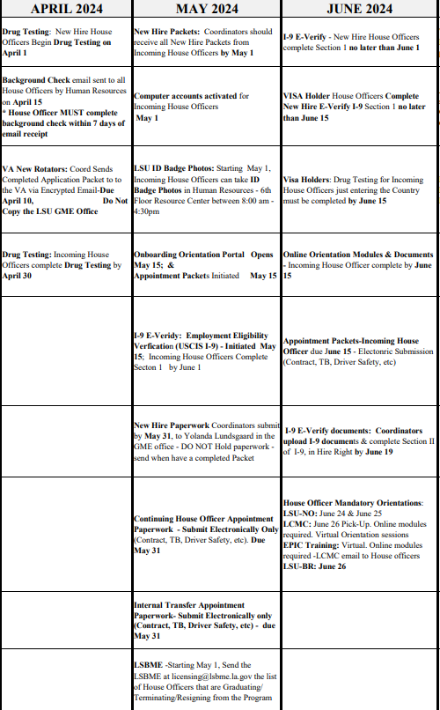
Reminders
Academic Year 2024-2025 Paperwork Time-Line.pdf
TB
Please name your House Officers when you are asking a specific question

Slide 15
CAG 24-25!!!
Sherilyn Munoz- Dermatology
Kat Dickens- Psychiatry
Krystal Fisher- Hematology/Oncology & Geriatrics
Dana Brian- Radiology (Residency & Fellowship)
Marcy Navarre – Emergency Medicine Baton Rouge
CAG Mentor: Cecilia Estep

Slide 16
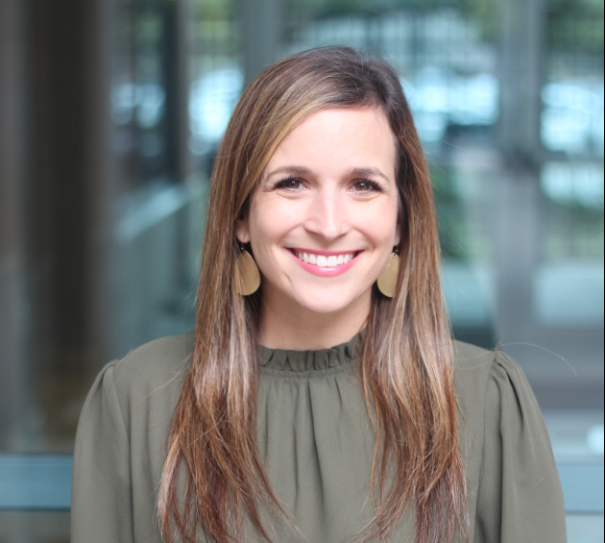
Marcy Navarre
Emergency Medicine Baton Rouge
Started in October 2016

Slide 17
Sherilyn Munoz
Dermatology
Started in January 2004

Slide 18
Dana Brian
Radiology Residency and Fellowship
12+ years experience

Slide 19
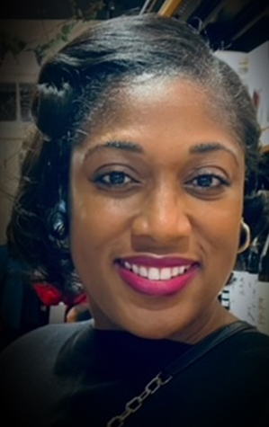
Krystal Fisher
Geriatrics and Hem/Onc
Started June 2022

Slide 20
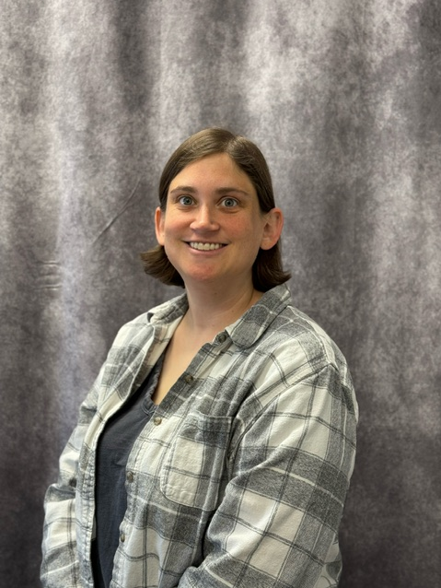
Kat Dickens
Psychiatry
3 years at LSU

Slide 21
Cecilia Estep
Pulmonary and Endocrinology
3+ years experience
CAG Mentor

