Slide 1
Coordinator Meeting
April 18, 2023

Slide 2
Welcome: Kevin Oufnac, Tammy Simien, Cynthia Scott
Malpractice coverage Q/A

Slide 3
TB/Mask Fitting Sessions
LSU TB Fair: https://www.medschool.lsuhsc.edu/medical_education/supersaas/?schedule=House_Officer_TB_Testing
May 1-3, May 8-10
May 4-5, May 11-12 Read Only
TB Form
Mask Fit: Supersaas link coming
June 12th AM
June 13th PM

Slide 4
Orientation Portal
"Opens" May 15th. Incoming House Officers must complete orientation by June 15th.
Email sent from GME to incoming House Officers with Orientation/Onboarding information in May
Coordinator View
Update
New Modules
Benefits Session
Must sign up for one Benefits session with HR (virtual)
June 21st will be focused on Foreign Nationals

Slide 5
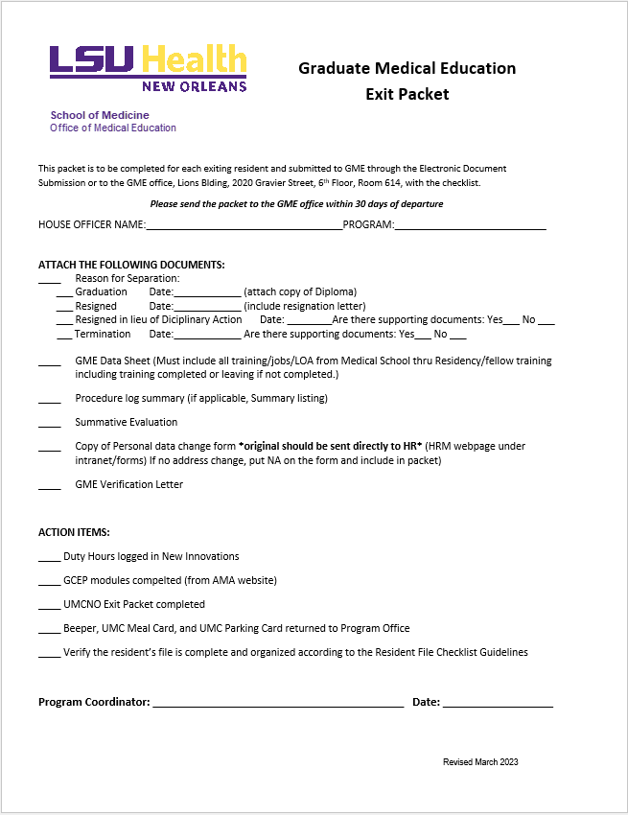
Exit Packets
Exit Packet
Attachments:
Diploma/Resignation Letter/Supporting Documents
GME Data Sheet
Procedure Log
Summative Evaluation
Template
Personal Data Change Form
AY Forms
Verifications Tab
Action items:
Duty Hour Monitoring Site
GCEP Modules @ AMA site
UMCNO Exit Packet
Returns
Resident File complete
Due July 31, 2023

Slide 6
House Officer Binders
House Officer Photo
Application/CV/Contract (yearly)
New Hire Paperwork
LSU, Sites, yearly applications
License
Evaluations
Research
Work hours
Pulled at the end of each year
Rotation Schedules
Yearly
Exam scores
ITE, boards, step 3, etc.
Case logs/procedure logs
Campus correspondences/other

Slide 7
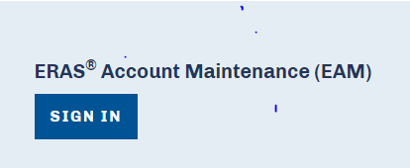
ERAS 2024 Registration
Register in ERAS Account Maintenance (EAM):
To Complete Registration
Verify information listed in the Program Contact Information section
Update Address to CALs Building
Programs can provide specific program requirements and links to the program's social media site(s) in the Program Requirements box
If the Applicant selection information is not already listed in the Program Information for Applicants box then add it, (by the expected training start date, only U.S. Citizens, Permanent Residents and J-1 Visa sponsored by ECFMG are eligible for medical residency or fellowship training at LSUHSC …)

Slide 8
New for ERAS 2024
MyERAS Application will be updated with lessons learned from the Supplemental ERAS Application
Residency Programs MyERAS application changes
No more supplemental ERAS Application
Updates to Applicant Experiences
Changes/Addition of Applicant Geographic Information
Addition of Program Signals for Participating Specialties & Programs only
Fellowship Programs MyERAS application Changes
Updates to Applicant Experiences
New Geographic Information from Applicant

Slide 9
ERAS: Program Signaling
A Process in which applicants express interest in a residency program at the time of application. Program signals are intended to be used by programs as one of many data points to consider when deciding whom to invite for interview.
Opt-in to Program Signaling:
Residency programs from specialties that a signed participation agreement by February 1, 2023 for program signaling for 2024 must opt-in to receive program signals from applicants.
More information about this process is found on the 2024 ERAS application Season Program Signaling Webpage: The 2024 ERAS Application Season Program Signaling webpage
Webinar May 4, 2023 1:00 pm CT: Q & A for Navigating the 2024 ERAS Application Update
Recorded Webinar on the research from the Supplemental ERAS Application to the plans for ERAS 2024: https://connect.aamc.org/viewdocument/supplemental-eras-application-resea

Slide 10
QI Forum – June 8, 2023
Submissions have been reviewed and final decisions are being made. Email notifications will be going out later this week to let the submitters know what category they have been chosen to present.
-Emails will include the category, deadlines for submitting the presentation/poster to the Forum, and instructions for the person(s) presenting.

Slide 11
Expired PLAs
Workshop – Tuesday, June 13th, 10:30-12:00 – Large Lecture Room.
Come with Word documents ready (saved on your computer/drive)
PD, Site Director, Affiliating Entity filled in
Make sure (residents/fellows) is corrected for what is appropriate for your program
Have Goals & Objectives saved on computer/drive as Word doc or PDF
Have email addresses for PD and Site Director and hospital admin (if not listed in KB).

Slide 12
Up and Coming Dates
April:
20th @ 2pm - CORE
21st @ 12 - Daniel's Lecture
25th @ 2pm - TAGME
May:
3rd @ 10am-1pm - I-9 Walk Through
16th @10am – Coordinator Meeting
June:
13th @ 9am – Block Scheduling Meet Up
13th @ 10:30 - PLA Meet Up
15th @ 1pm – Block Scheduling Meet Up
26-27 – LSU Onboarding
26- OLOL & LSU BR Orientation
28th – UMCNO Onboarding
July: Accreditation @ CORE
August:
CAG Networking Event - TBD

Slide 13
Reminders
Diplomas
Orders received after April 28, 2023 will not be processed until May 30, 2023 to Registrar.
VA- New Rotator Paperwork due April 17th.
New Hire Packets due to you May 1st
Incoming House Officer LSU ID Badges
Official Driving Records mailed to: LSUHSC Environmental Health and Safety Department, Stanislaus Hall Room 216, 450A S. Claiborne Avenue, New Orleans, LA 70112.

Slide 14
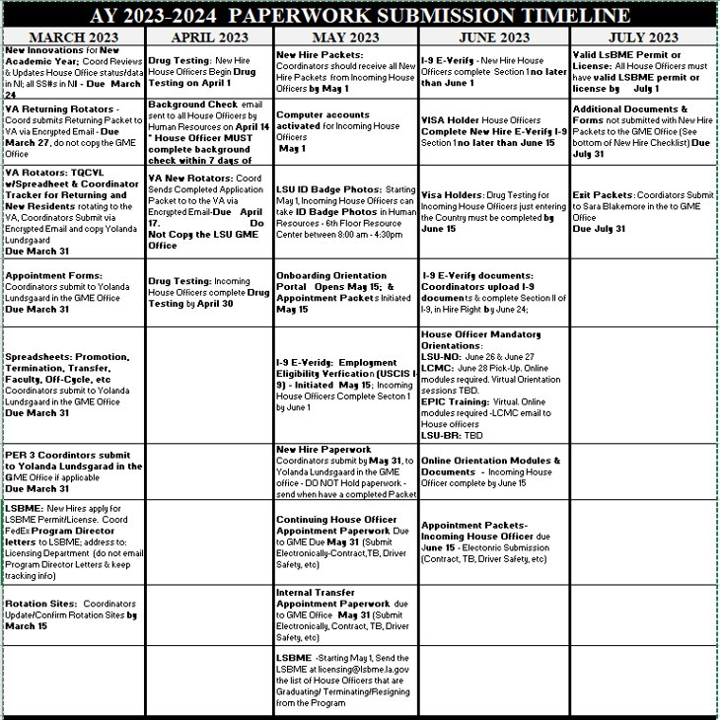

Slide 15
Q/A

