Slide 1
Coordinator Meeting
August 15, 2023

Slide 2
Recruitment
Pre-Recruitment Checklist
Ensure program website is updated** Natalie
Create Social Media posting Calendar
Plan and Schedule Pre-Recruitment Activities
Including virtual Q&A sessions and virtual Residency Fairs
Select Interview Dates
Select Interviewers
Select Virtual Interview Platform
Secure Interview Locations
Ensure program has the appropriate technology
Review all ERAS applications
Train Faculty/Residents on Interview techniques and technology
LSUHSC Zoom Documentation Site
Select and communicate with interview candidates
Create an interview candidate agenda
Create interview rotation schedule
Ensure applicants have all necessary paperwork sent, completed, and filed
KB- House Officer Recruitment and Selection
KB- House Officer Recruitment
Best Practices for Conducting Residency Program Interviews | AAMC
Discussion:
How does your department recruit?
Do you have resources/methods you can share with the group?

Slide 3
Interviews- NRMP Policies
Read the Match Participating Agreement
All parties involved in the applicant interview, selection and Match process MUST BE familiar with the Match Participation Agreement and Match Policies
Review the Rules governing the Matching Process – Important Policies to Review:
NRMP Code of Conduct
NRMP All in Policy
NRMP Privacy Statement
NRMP Professional Behavior
Restrictions on Persuasion
Provide applicants with complete, timely, accurate information (Contract they will sign, pre-employment drug screen & background check, VISA Status: J1 sponsored by ECFMG
Applicant Match History – look up applicants
Determine whether an applicant is eligible for appointment to LSUHSC programs prior to offering interviews or if they have a NRMP waiver/violation history
Ensure Program Director/Coordinator and public contact information is updated in NRMP and in ERAS: address, email, program website

Slide 4
Interviews
KB- House Officer Selection
Eligibility-
NRMP Eligibility
Program Eligibility
LSU Criteria:
US Citizens
Permanent Residents of the United States
J1 Sponsored by ECFMG
ECFMG Certificate Required for all non US Medical School Graduates
Applicant Requirements
Applicant Information Sheet
Sample Contract
Interviewee Acknowledgement Form
Selection (ERAS, NRMP, Main Match, San Francisco Match, AUA, Applicant Requirements)

Slide 5
ERAS Interview Scheduler & Thalamus Core
ERAS Programs will have the option to switch to Thalamus Core for the ERAS 2024 Season beginning in summer 2023 for fellowship and fall 2023 residency.
For the ERAS 2025 Season, Thalamus Core will replace ERAS Interview Scheduler as the main interview management platform for all applicants and programs
There is no costs to programs. Beginning in 2023 ERAS participating programs will receive complimentary access to Thalamus Core and Itinerary as well as Cerebellum.
For more information: FAQs: https://www.aamc.org/services/eras-institutions/faqs-aamc-thalamus
For ERAS Questions, Contact ERAS support; for Thalamus Questions, Contact the Thalamus Success Team
Are you switching to Thalamus for the ERAS 2024 Season? Let Yolanda Know.

Slide 6
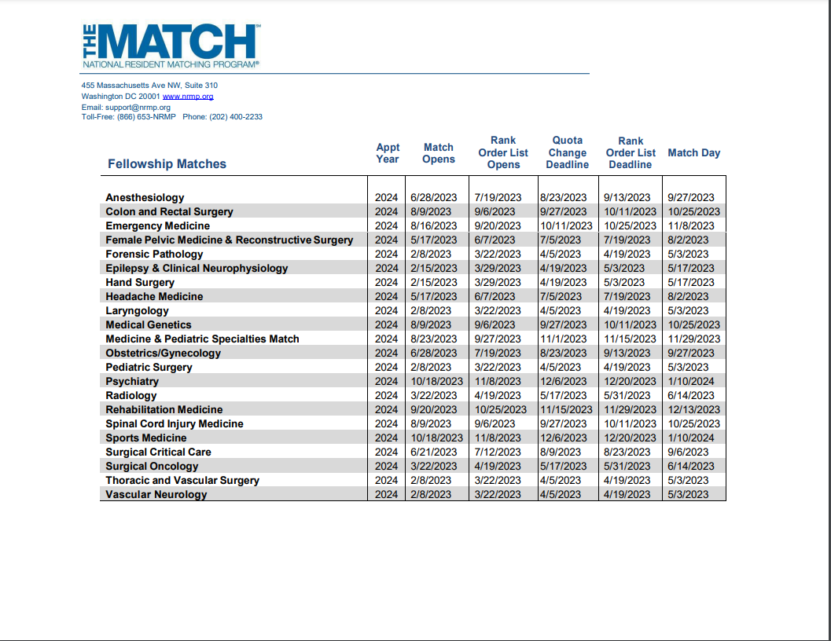
Fellowship Calendar
NRMP Introduction to the Fellowship Match Webinar Recording
Fellowship Match Program Checklist

Slide 7
NRMP Main March Match
Match Opens September 15, 2023
Main Residency Match Program Checklist
Important Dates
September 27, 2023 – Applications available in ERAS system (ERAS system and Match are separate organizations with separate systems)
January 31, 2024 – NRMP: Quota Change, Withdrawal & SOAP Participation Status Deadline 10:59 pm Central Time
February 1, 2024 – NRMP: Ranking Opens 11:00 a.m. Central Time
February 28, 2024- NRMP: Rank Order List Certification Deadline 8:00 pm Central Time
March 11, 2024- NRMP: Match Week (all Central Time):
8:30 a.m. Unmatched Applicants report available
9:00 a.m. applicant match status and program fill status available, SOAP begins
10 a.m. SOAP applications can start preparing applications in ERAS
March 15, 2024- NRMP: Match Day
11:00 a.m. Central Time application Match results available by email.

Slide 8
2023 National GME Census in GME Track
GME Track | AAMC
OneAAMC | Sign in
Complete the Program Survey and Resident Survey before the next Deadline: September 29, 2023
Username and Password is the same username and password for ERAS-PDWS
If there are no residents/fellows, listed for the program, there is a box to check to confirm.
If there are residents/fellows this year add the residents/fellows.
If you have any questions, or if you need to request access to complete the survey for the program (you did not complete the survey for the program last year), contact GME Track
Data Contacts:
GME Track Help Desk:(202) 862-6171 or
GME Census Hotline (800) 866-6793
gmetrack@aamc.org
Survey Deadlines:
May 17, 2023: Survey Opens
July 14, 2023: August FREIDA Deadline
July 26, 2023: Resident Roster Certification Opens
September 29, 2023: October FREIDA Deadline
December 15, 2023: Final GME Track Deadline

Slide 9
Reminders
ADS Updates and APE
Exit Packets Due- Trackers
Visiting House Officer Packets- LCMC AA update
BOM/EOM Reports
September BOM Reports are due September 1, 2023
Enter September schedules in Resident Scheduler ASAP
July EOM Reports are past due
August EOM Reports are due September 6, 2023
CSOF Per 3s are due when EOM Reports are due
All House Officers must have a signed contract that includes 2023-2024 training dates
AY FORMS
Submit Off-Cycle Promotion PER 3s a month before Promotion date

Slide 10
Reminders
Onboarding/Orientation Survey for Program Coordinators
CAG Networking Event: August 22nd!!!
RSVP Due Today!
Potluck RSVP

Slide 11
We appreciate you!

