Slide 1
Coordinator Meeting
August 23, 2022
ACGME Leave, Interviews & Recruitment, NRMP, TAGME Information, Reminders, Virtual Showcase

Slide 2
Human Resource Management
HRMFMLA@lsuhsc.edu
Extended Medical, Parental, Caregiver Leave
Effective July 1st, 2022
Human Resource Management determines eligibility
HRMFMLA@lsuhsc.edu should be notified as soon as you are made aware
FMLA process will help determine eligibility for ACGME
Program Coordinators track the leave
ACGME, like FMLA, may run concurrent to the usage of sick + vacation leave
Allows for up to an additional six (6) weeks of leave + the possibility of one (1) week personal leave
Eligibility is only one(1) time per program
ACGME can be taken in a lump sum, segment of time or intermittently
ACGME can be designated by Human Resource Management and does not require a House Officer to request
When in doubt, reach out to HRMFMLA@lsuhsc.edu
*Sick leave may be used for a House Officer or immediate family member defined as a spouse, parent, or child of the House Officer*

Slide 3
www.tagme.org
Susan Lenoir, C-TAGME
swack@lsuhsc.edu

Slide 4
2022 TAGME TIMELINE
Timeline for 2022 Application Cycle:
1. Application submission –> April 1 through June 1 2. Application review and notification –> Rolling through June 30
3. Assessment scheduling –> Beginning July 5 (upon application approval)
4. Assessment completion –> July 11 through December 2 5. Retake completion –> Through December 16

Slide 5
INITIAL TAGME CERTIFICATION CRITERIA
Currently employed as a GME professional
Completed 2 consecutive years in this role by application submission
Completed 20 Education Credits within the previous 3 years (11 of these 20 must be directly focused on GME topics & outside the usual scope of duties)
*CCC & PEC Meetings, Routine GME Meetings, etc. DO NOT COUNT

Slide 6
INITIAL CERTIFICATION CRITERIA
What Does Count Toward Certification?
National, Regional or State Conferences
Core Meetings (FREE)-October 20, 2022, January 19, 2023 & April 20, 2023
Daniels Lectureship (FREE)
Grand Rounds focusing on GME topics (FREE)
ACGME Learn (FREE)
Academy of Program Coordinators (FREE)
National Society of Academic Medical Administrators (FREE) (More options with $100 annual membership)

Slide 7
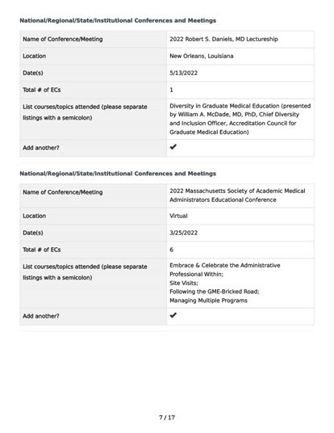
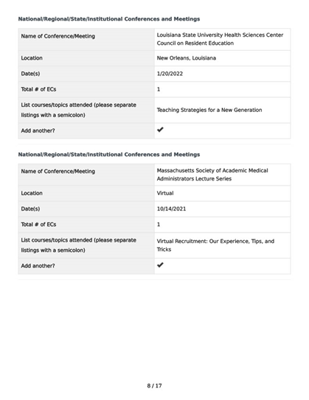
APPLICATION

Slide 8
WHY SHOULD I CERTIFY?
According to TAGME:
Improve skill level and content knowledge
Prepare for greater on-the-job responsibilities
Reflect achievement and commitment to goals
Recognize certified vs. non-certified training administrators as a qualifying factor for promotion and/or higher salary
Enhance the training administrator/program coordinator image
Promote visibility of the profession

Slide 9
WHY SHOULD I CERTIFY?
According to TAGME:
Improve skill level and content knowledge
Prepare for greater on-the-job responsibilities
Reflect achievement and commitment to goals
Recognize certified vs. non-certified training administrators as a qualifying factor for promotion and/or higher salary
Enhance the training administrator/program coordinator image
Promote visibility of the profession

Slide 10
SURVEY RESULTS – 30 Respondents
How long have you been in your role as a Residency, Fellowship or GME Coordinator at LSUHSC?
< 1 year | 6.67% 2
1 year - 5 years | 33.33% 10
5 years - 10 years | 40.00% 12
10 years - 15 years | 6.67% 2
15 years - 20 years | 6.67% 2
> 20 years | 6.67% 2
TOTAL | 30

Slide 11
SURVEY RESULTS
I am TAGME Certified
Yes | 3.33% 1
No | 96.67% 29
TOTAL | 30

Slide 12
SURVEY RESULTS
If the answer to #2 is "Yes", please let us know how certification has been beneficial to you and your career.
I was TAGME certified, but I let the certification lapse in Dec 2021. It was not really beneficial in any way, except validating my knowledge.
Other than self-satisfaction, it has not benefitted me with regards to a higher salary, a promotion or a change in title.

Slide 13
SURVEY RESULTS
If the answer to #2 is “No", please let us know why you have chosen to not certify.
This certification has never been offered directly but I am very interested in becoming certified.
I wasn't aware that this certification existed.
The cost/effort involved is too high for no tangible benefit (i.e. pay raise, etc.).
Will retire in the near future.
Not sure if it would be beneficial.
I wasn't aware of this type of certification until recently. It might be something I want to pursue.
It will offer no benefit in my current role, will not give me an increase in salary.
I don't know what this is.
I was TAGME certified (expired 12/2021), but chose not to re-certify. Certification is good for 5 years.
Don't know much about it.
I've never been certified and don't know what the process entails.
Financial and no guarantee to promotion.
Haven't given it much thought or heard much about it.
Not able to attend meetings which were required.

Slide 14
SURVEY RESULTS
If the answer to #2 is “No", please let us know why you have chosen to not certify.
Undervalued certification at institution.
I have no idea what TAGME is - but I'll look it up!
Do not think it will help me in my job or salary. Cost and maintenance.
I heard TAGME certification should be obtained after two years and I haven't met that threshold yet.
I am not sure that I have seen it offered and if so, I have missed it!
I wasn't aware there was a certification. Please send me more information.
Costs, too expensive.
Never had the opportunity.
Have not had time to do the necessary requirements.
Don’t know much about the process.
I just don’t feel that I would make any more money.
No compensation.
Haven’t had the chance to but am interested.
Didn't think I had enough CME.

Slide 15
SURVEY RESULTS
I may be interested in TAGME initial or recertification in the future.
Definitely Yes | 20.00% 6
Yes | 16.67% 5
Maybe | 53.33% 16
No | 6.67% 2
Definitely No | 3.33% 1
TOTAL | 30

Slide 16
SURVEY RESULTS
Comments
Absolutely interested!
Fairly new coordinator.
I would be interested in finding out more information.
I would need to know more about this certification; how often must I recertify and the cost.
Best practices for preparing for TAGME certification?
Please send me information about the certification. Thanks!!

Slide 17
FEES
Initial Certification | $350
Maintenance of Certification | $350
Retake | $150
Reschedule a canceled appointment | $80
Don't be afraid to ask for reimbursement to cover the cost!!

Slide 18
The Residences at LSU Health
https://www.liveattheresidenceslsu.com/
Contact Information:
(504) 527-4100
https://www.liveattheresidenceslsu.com/
info@LiveAtTheResidencesLSU.com
Twitter: @ResidencesAtLSU

Slide 19
Interviews
Applicant Information Sheet
Interviewee acknowledgement form
House Officer Selection and Recruitment
Selection (ERAS, NRMP, Main Match, San Francisco Match, AUA, Applicant Requirements)
Notes:
Interviews will be virtual again this year.
Programs will need to ensure interviewed applicants receive the applicant information sheet which has been updated and they will need to sign the Interviewee acknowledgement form. The acknowledgement form should be kept for all applicants.
The Knowledge Base is a good resource for interview information and guidance. Each section should house all of the information needed to help the program to navigate virtual interviews.

Slide 20
Interviews – NRMP Policies
Read the Match Participating Agreement
All parties involved in the applicant interview, selection and Match process MUST BE familiar with the Match Participation Agreement and Match Policies
Review the Rules governing the Matching Process – Important Policies to Review:
Code of Conduct
All-In Policy
Restrictions on Persuasion
Provide applicants with complete, timely, accurate information (Contract they will sign, pre-employment drug screen & background check, VISA Status: J1 sponsored by ECFMG
Applicant Match History – look up applicants
Determine whether an applicant is eligible for appointment to LSUHSC programs prior to offering interviews or if they have a NRMP waiver/violation history
Ensure Program Director/Coordinator and public contact information is updated in NRMP and in ERAS: address, email, program website

Slide 21
NRMP
Upcoming NRMP Webinar: Introduction to the 2023 Main Residency Match
Date: Tuesday, September 13, 2022
Time: 12:00 – 1:00 pm Central TimeRegistration Link: https://us02web.zoom.us/webinar/register/WN_oGcQX4LDTyCg9XBVPbwF2A (Email from NRMP 8/16/2022.
- Space is limited, reserve your spot now. A recording will be posted at www.nrmp.org after the webinar.
- Questions about the webinar or assistance with the Match is available from the NRMP Support Staff Monday – Friday from 7:30am – 4:30pm central time, by email support@nrmp.org or calling 202-653-6767
Main Match Registration opens September 15, 2022

Slide 22
Recruitment
Pre-Recruitment (Websites, Social Media, Social Medica Platforms, Pre-Recruitment Checklist, Pre-Recruitment Activities)
Recruitment (Rules for Interviews, Recruitment Resources, Interview Scheduling Platforms, Zoom Interviews)
AAMC Best Practices for Conducting Residency Program Interviews: https://www.aamc.org/media/44746/download
Post Recruitment (Match Deadlines and Post Interview Communication)
Discussion:
How does your department recruit?
Do you have resources/methods you can share with the group?
Notes:
Interviews will be virtual again this year.
Programs will need to ensure interviewed applicants receive the applicant information sheet which has been updated and they will need to sign the Interviewee acknowledgement form. The acknowledgement form should be kept for all applicants.
The Knowledge Base is a good resource for interview information and guidance. Each section should house all of the information needed to help the program to navigate virtual interviews.

Slide 23
Work Hours
We will be monitoring Work Hours more closely this AY.
Make sure your residents are logging hours.
Check violations – have residents correct.
New Ways to Monitor: https://ome-ccalla-serv.master.lsuhsc.edu/ResidentDataStatus/DutyHours.aspx (On campus or Citrix/VPN only)
Reports will be sent quarterly to Program Directors & Program Coordinators.
Direct your questions to Chris or Julie.

Slide 24
PLAs via Adobe Sign
Requires you, the coordinator, to be licensed. Contact Julie if you are not.
Eliminates the need for 3 original copies.
Tracks document for you.
Automatically sends everyone listed a fully executed copy of the PLA, or document, once all signatures have been obtained.
Always check Knowledge Base for the latest updates/email addresses.
https://lsugme.atlassian.net/wiki/spaces/ACGME/pages/26525780/PLA+Signatories
ORDER to enter email addresses
Program Director
Site Director (you are responsible for obtaining email address)
Dr. Hilton
Approver (if one is listed)
Clinical site/Hospital signatures
**CC Julie – jcain2@lsuhsc.edu
Contact Julie for any questions!

Slide 25
GCEP AMA Modules
Everyone should have access to AMA by now.
Double check your program roster to make sure all residents/fellows are listed correctly. Let Julie know if any corrections need to be made.
You can check progress on your residents/fellows at any time.
Quarterly reports will be sent to your PD as well as to you.
Contact Julie for any questions.

Slide 26
2022 National GME Census in GME Track
Complete the Program Survey and Resident Survey before the next Deadline:
September 30, 2022
Username and Password is the same username and password for ERAS-PDWS
If there are no residents/fellows, listed for the program, there is a box to check to confirm.
If there are residents/fellows this year add the residents/fellows.
If you have any questions, or if you need to request access to complete the survey for the program (you did not complete the survey for the program last year), contact GME Track
GME Track Help Desk:(202) 862-6171 or
GME Census Hotline (800) 866-6793
gmetrack@aamc.org
Survey Deadlines:
September 30, 2022 – October FREIDA Upload Deadline
December 16, 2022 – Final Deadline
Past Dates: July 15, 2022 - August FREIDA Upload Deadline
July 27, 2022 – Resident Survey Opens

Slide 27
Reminders
ADS Updates and APE
Exit Packets Due
Visiting House Officer Packets due
Associate Ombuds Office (lsuhsc.edu)
ANNUAL UPDATE DUE DATE (ACGME)​ | DUE TO DR FREY​
AUGUST 26**​ | AUGUST 10​
SEPTEMBER 23**​ | SEPTEMBER 7​
** see notes section below
Notes:
Exit Packets are due to the GME office within 30 days of the house officers departure.
Programs please collect your house officers COVID Cards and send them to the GME office if you have not already.
Any programs that have regular visiting house officers please ensure packets are submitted for the entire year.
COVID Reporting needs to be done in two areas. The house officer should self report on the LSU website but the program should report on the GME reporting form.
House Officers should be entering their work hours into New Innovations regularly. I have linked how to enter work hours.
AMA should start sending out welcome emails to the incoming house officers on August 18, 2021.

Slide 28
Reminders
BOM/EOM Reports
September BOM Reports are due September 1, 2022
Enter September schedules in Resident Scheduler ASAP
July EOM Reports are past due
August EOM Reports are due September 6, 2022
CSOF Per 3s are due when EOM Reports are due

Slide 29
Notes:
Exit Packets are due to the GME office within 30 days of the house officers departure.
Programs please collect your house officers COVID Cards and send them to the GME office if you have not already.
Any programs that have regular visiting house officers please ensure packets are submitted for the entire year.
COVID Reporting needs to be done in two areas. The house officer should self report on the LSU website but the program should report on the GME reporting form.
House Officers should be entering their work hours into New Innovations regularly. I have linked how to enter work hours.
AMA should start sending out welcome emails to the incoming house officers on August 18, 2021.

