Slide 1
Coordinator Meeting
February 20, 2024

Slide 2
ACGME requirement check ins
Schedules coming soon- there will be resources given prior.
Where are you saving your program's documents?
Department T-drive is a shared drive
NI
Hard Copies

Slide 3
LSBME – Permit Application
Types of Training Permits
U.S. Medical Graduate (PGY) Initial Licensure-Internship Permit
PGY 1
Issued to graduates of a Medical School in the U.S., Puerto Rico, and Canada
For first year internship
Valid for up to 12 months
Initial Fee is $50.00
PGY 2
Issued to graduates of a Medical School in the U.S., Puerto Rico and Canada, Resident or Fellow
Can be issued to graduates of a Medical School that have not taken Step 3
If applicant has not previously received an LSBME-issued PGY 1 permit (i.e. moving to LA from out-of-state & applying for a PGY 2 permit), applicant completes application and provide letter from PGY 2 program director
Valid for up to 12 months
Initial Fee is $100.00
International Medical Graduate (IMG/FMG) – Graduate Education Temporary Permit (GETP)
Issued to an international medical graduate (a graduate of a medical school located outside of the U.S., Puerto Rico, and Canada), Resident or fellow
ECFMG Certificate
Commitment from an accredited Louisiana medical school, college or other accredited medical institution
Possess a doctor or medicine degree duly issued by a medical school approved by the board. Diploma must be in English, if not, must be accompanied by a certified translation into English
Initial fee is $200.00
To apply for a PGY, PGY 2 permit or GETP, follow instructions on the LSBME website https://www.lsbme.la.gov/content/application-instructions-initial-licensure-internship-registration

Slide 4
LSBME – Permit & License Renewal
Licensure – Fellows that are eligible for a Full License can apply for a Full License -See LSBME website for qualifications
Process should start at least 6 months, preferably more, before start date
Initial Fee $382.00 not refundable
Fellowship training Permit –NOT for Fellows in Accredited Training Programs
Issued, at the Board's discretion, for the purpose of participating in an unaccredited post graduate fellowship training, at the minimum level of PGY 4
Only renewed for a 2nd year at the board's discretion. NOT renewed for more than 2 years
Fee is $100.00 not refundable
Some Fellows may have a Permit and not a full license, and they may not have been included in the January and February Permit Renewal mailings off to LSBME.
Check to be sure all residents and fellows with a permit that will be renewed have completed the following
Paid the invoice
Program Director Letter submitted to LSBME
Opioid Training Completion Certificate sent to LSBME (first renewal only)
Mail Program Director Letter and Opioid Certificate, if applicable, to: LSBME Licensing Department 630 Camp Street, N.O., LA 70130 – Keep mail Tracking receipt
License Renewal
House officers with a Full License must submit the following to the LSBME for their License Renewal (license expiration dates are their birth month)
CME Exemption Request Form (found on the LSBME website) uploaded into CE Broker
Program Director Letter
Mail the Exemption Request Form and Program Director Letter, 30 days before the renewal date, to the attention of Ms. Rosa Burton, Licensing Renewals, LSBME 630 Camp St., N.O. LA 70130

Slide 5
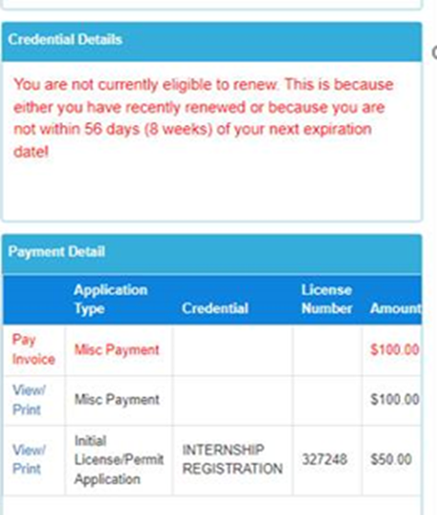
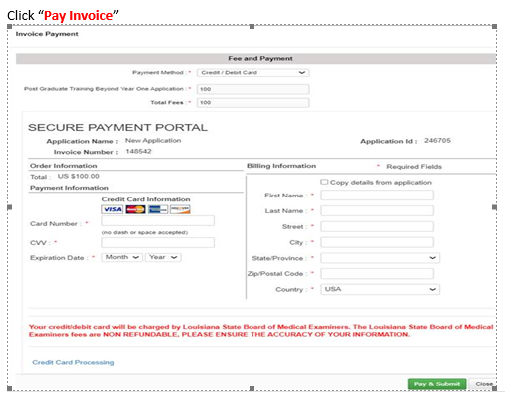
LSBME – Permit Renewal Invoicing
House Officers must log into their LSBME LaMed Dashboard https://online.lalsbme.org/#/ to pay the Permit Renewal Fee.
Ignore the message in the Credential Details box that states "not eligible to renew because it is not within 56 days (8 weeks) of your next expiration date"
The invoice should be included in the Payment Detail box
Select Pay Invoice
Enter payment information in the Fee & Payment Box

Slide 6
NRMP Fellowship Programs
Fellowship Match Openings for 2024-2025 Appointment
February 7, 2024
Laryngology
Vascular Surgery
February 14, 2024
Epilepsy & Clinical Neurophysiology (New to NRMP Match)
March 20, 2024
Radiology –Breast Imaging, Musculoskeletal, Neuroradiology
Webinar: Introduction to the Fellowship Match – held February 6, 2024, is available on the NRMP website:
https://www.nrmp.org/about/news/2024/02/nrmp-hosts-introduction-to-the-fellowship-match-webinar-for-programs-and-institutions-2/

Slide 7
NRMP 2024 Main March Match & SOAP
February 28, 2024 8:00 p.m. CT: Rank Order Certification Deadline
March 11, 2024 9:00 a.m. CT
Match & SOAP Week Schedule: https://www.nrmp.org/wp-content/uploads/2023/06/2024-Match-Week-and-SOAP-Schedule.pdf
SOAP Begins
Did My Program Fill – Notified by Email and R3 System
March 14, 2024
7:55 a.m. - 8:00 p.m. CT: SOAP Rounds 1 – 4
1:00 p.m. CT: Program Confidential Roster of Matched Applicants available (by email & R3 system)
Match Day: March 15,2024 11:00 a.m. CT
Students Receive Email from NRMP
LSU Match Day event is limited to students and families only. LSU Students will connect with their LSU Match Program after Match week.
Programs CANNOT Contact Matched Applicants until after 11:00 a.m. CT on March 15, 2024

Slide 8
What to do after your Match?
Communicate with your new matched house officers: Not before Noon on Match Day
Phone call, zoom, etc.
Provide resources: Checklist of Actions for Incoming HOS, Guide to Onboarding, etc.
***CBD
Priority's:
Licensure and NPI
AY Forms -> New Hire Documents
NI- import or add
SSN***

Slide 9
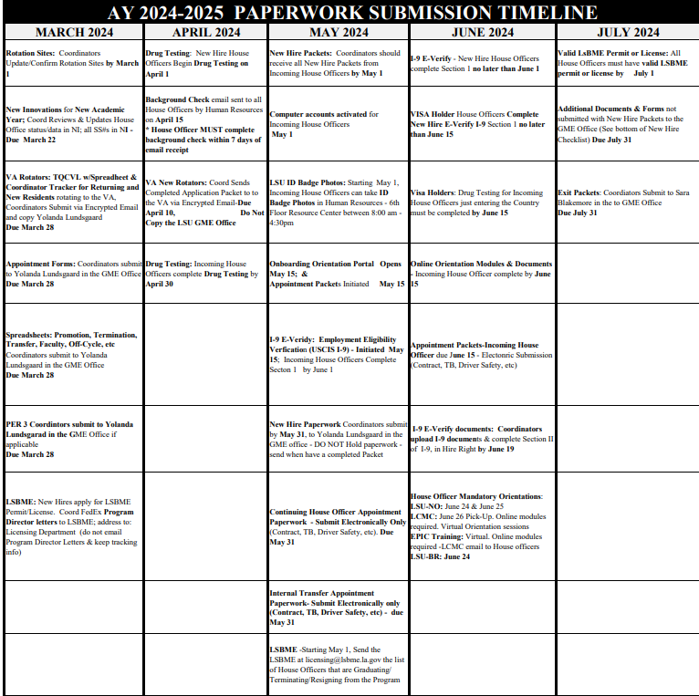
Academic Year 2024-2025 Paperwork Time-Line.pdf

Slide 10
Transfer Applicant Data from ERAS to NI Due March 15, 2024 @ 11:00 am CT Select the "Will Start" status for each applicant after Match results are received **Programs that used Thalamus will have different instructions that will be shared later**
Step 1: Log into PDWS; Navigate to the Dashboard
Step2: In the Stats Box select Reviewed Applicants The list of applicants will load
Step 3: Click on the box to the left of the name of each applicant that Matched and Will Start. The Status box will highlight and show the number of applicants selected.
Step 4: Select the drop-down arrow in the Actions (Applicants#) box; Select Update Status; Scroll down to select the Will Start Status
Step 5: Click Assign in the will start status; Click the Save button.
Applicants will now be included in ERAS data Transfers to NI
**Add SSN in NI by March 24th @ 11am**

Slide 11
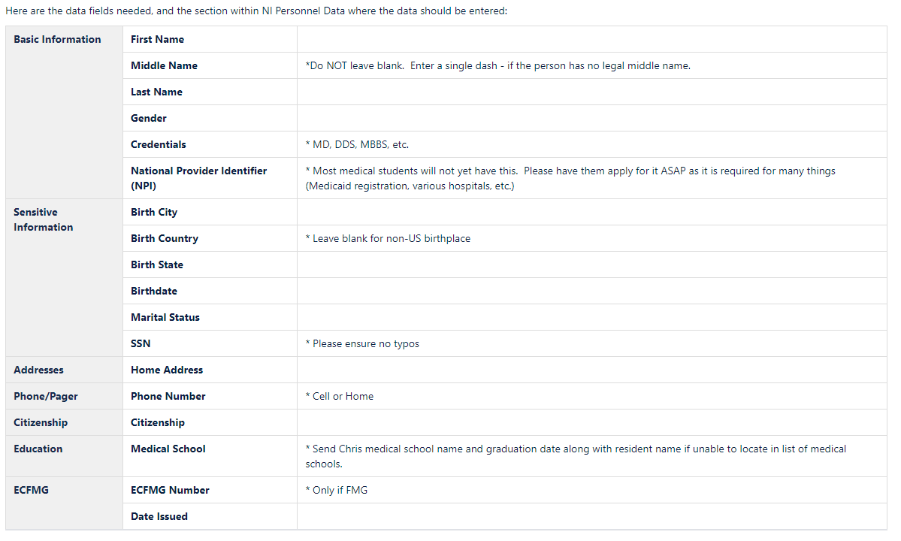
Not Importing from ERAS Instructions
**Due March 22 @ 11am in NI**
**new- Natalie/Chris will add in your new hire if not using ERAS
Same for training record.

Slide 12
New Innovations Training Record Additional info Special Situations
Appointment forms and spreadsheets are updated nightly to reflect changes made in New Innovations.
Contact Chris Callac for
–Setting up gratis appointments
–Unusual promotion or demotion
–Appointment Form or spreadsheet is incorrect and you are unsure why
–Changes made in New Innovations not reflected on appointment form

Slide 13
Missing Data in New Innovations
Missing Data in New Innovations
Review data for all residents, including incoming
Some data may not get imported from ERAS

Slide 14
GME Rotation Sites
Rotation sites for the 2024-2025 Academic Year need to be updated/confirmed online by March 1st
GME Rotation Sites
Rotation sites set determine which new hire packets are available as part of the New Hire Forms automatically generated
If unsure about a new site, email ccalla@lsuhsc.edu with info
Rotation sites can be changed later if necessary

Slide 15
GME Rotation Sites
A few things to remember:
This list will not contain all rotation sites you may rotate to. It consists primarily of our larger partner sites. If you rotate to sites which are not listed, that is OK and we do not need to be notified.
If your sites are not properly updated for the academic year, your incoming house officers will not receive the correct hospital appointment packets when they download their new hire paperwork.
University Hospital and Clinics IS NOT University Medical Center - New Orleans. University Hospital and Clinics refers to the facility in Lafayette.
Additional information is in the Knowledge Base- GME Rotation Sites.
Be sure to click “Save” at the bottom, even if you are not changing anything.
**Lakeview Regional Medical Center (LRMC) & Tulane Medical Center (TULANE) need responses from everyone **

Slide 16
Webinars
AHME: Balancing Act: Battling Burnout and the Art of Self-Care for Program Coordinators
Register online now at www.ahme.org
Thursday, Feb. 29, 2024 1pm-2pm Eastern
AHME Members: Only $75 by February 15 -- $100 after 02/15/24
Non-Members: Only $100 by February 15 -- $125 after 02/15/24
Building a Strong Foundation: Professional Development for GME Program Coordinators, with Natasha Brocks, C-TAGME
Register Here
Apr 2, 2024 12:00 PM
Description
Gain invaluable knowledge, skills, and insight into effective organizational practices, honing leadership, abilities, and fostering collaborations. This presentation is a gateway to empowering the GME community with the tools needed for success.

Slide 17
Webinars/Conferences Cont.
AAMC Webinars and Online Courses: New ERAS Content Updates for the ERAS 2024-2025 Application Season - February 21 (commpartners.com)
NRMP & ERAS Joint Webinar on March 6, 2024, at noon central time
TAGME- Applications open on April 1st.
NSAMA Conference is on April 5th
https://www.nsama.org/annual-conference
$99 and includes yearly membership

Slide 18
Payroll and W2s
House Officers 2nd February paycheck will be slightly less then they usually receive because February is a short month. The Pay period is February 16-29 - 14 days.
W2s are available through the PeopleSoft Self Service Portal
The forms are accessed in the same manner that a check stub is accessed
For those that did not consent to electronic delivery, the paper forms were mailed out January 31, 2024.
If you have questions, contact the payroll office at noacctpayroll@lsuhsc.edu

Slide 19
Upcoming Dates
February 27, 2024 – LSBME Permit Renewal Paperwork due to GME
February 28, 2024 - NRMP Rank Order List Certification Deadline 8:00 pm CT
February 28, 2024 – LSBME Permit Renewal Paperwork final mailing to LSBME
February 29, 2024 – VA New Rotators Applications due to the VA – Crystal Cruz
Due NOW! - January EOM Reports
Mach 1, 2024 – March BOM Reports Due
March 7, 2024 – February EOM Reports Due
March 11 – 15, 2024 - NRMP – Match Week
March 14, 2024 – SOAP Rounds 1-4 – all day, 7:55 am – 8:00 pm
March 15, 2024 – Match Day
March 5 & 26 – Coordinator Meetings
April 1-June 1- TAGME applications open.

Slide 20
Orientation/Onboarding Dates
LSU Online Orientation- May 15-June 15
LSU Onboarding: June 24-25
LSU BR-June 24
UMC: June 26

Slide 21
Sending VA Paperwork
Returning Packets due February 29, 2024
TQCVL with Spreadsheet & Coordinator Tracker due
March 28, 2024
New Rotator Packets due April 10, 2024
How to Submit paperwork to the VA:
VA Onboarding Process Instructions
Sending Encrypted Emails

Slide 22
TQCVL and Resident Tracker Spreadsheet Download
Prefilled TQCVL Spreadsheet and Coordinator Tracker spreadsheets can be downloaded from the GME Online Appointment Forms site. The TQCVL Spreadsheet must be attached to the completed TQCVL form
Only resident levels expected to rotate will be included on the spreadsheets.
Rotation sites must be updated for 2024-2025 academic year before downloading.**

