Slide 1
Coordinator Meeting
February 28, 2023

Slide 2
Welcome Dr. Lee Engel!

Slide 3
ACGME House Officer Survey

Slide 4
Coordinator Advisory Group (C.A.G)
Name
GME Coordinator Advisory Group <GMECAG@lsuhsc.edu>
Meeting Attendance

Slide 6
LA Medicaid Portal Registration
All outstanding residents were emailed on 1/20/23
Deadline – March 31st
As of 2/15/23
Completed - 312
Not Completed - 140
Not Required - 500
Registration status can be looked up using NPI at https://www.lamedicaid.com/apps/portalenrollmentstatus/Search

Slide 7
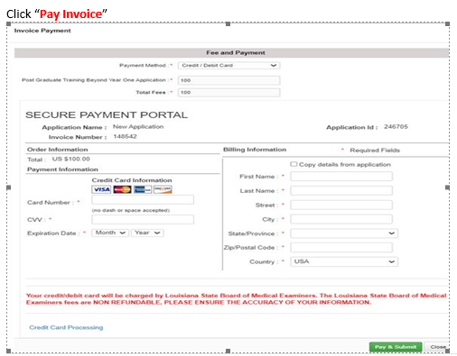
LSBME – Permit Renewal Invoicing
House Officers should receive an Email from the LSBME to pay the invoice.
House Officers log into their LSBME LaMed Dashboard https://online.lalsbme.org/#/
No response from LSBME on why Program Coordinators are receiving the pay invoice email for some House Officers.
Ignore the message in the Credential Details box that states "not eligible to renew because it is not within 56 days (8 weeks) of your next expiration date"
The invoice should be included in the Payment Detail box
Select Pay Invoice
Enter payment information in the Fee & Payment Box

Slide 8
NRMP Fellowship Programs
Fellowship Match Openings for 2024 Appointment
February 8, 2023
Laryngology
Vascular Surgery
February 15, 2023
Epilepsy & Clinical Neurophysiology (New to NRMP Match)
March 22, 2023
Radiology –Breast Imaging, Musculoskeletal, Neuroradiology
Webinar: Introduction to the Fellowship Match – Available on the NRMP website:
https://www.nrmp.org/about/news/2023/02/nrmp-hosts-introduction-to-the-fellowship-match-for-programs-and-institutions

Slide 9
NRMP 2023 Match & SOAP
March 1, 2023 8:00 p.m. CT: Rank Order Certification Deadline
March 3, 2023 Noon – 1pm CT: NRMP & ERAS Webinar: Navigating Match Week and SOAP – Register for the Webinar, space is limited, it will be posted on the NRMP Website after March 3, 2023.
March 13, 2023 9:00 a.m. CT
Match & SOAP Week Schedule: https://www.nrmp.org/wp-content/uploads/2023/02/2023-Match-Week-and-SOAP-Schedule-FINAL-Printable-2.pdf
SOAP Begins
Did My Program Fill – Notified by Email and R3 System
March 16, 2023
7:00 a.m. - 8:00 p.m. CT: SOAP Rounds 1 – 4
1:00 p.m. CT: Program Confidential Roster of Matched Applicants available (by email & R3 system)
Match Day: March 17, 2023 11:00 a.m. CT
No In-person Match Ceremony for Programs to attend
Students Receive Email from NRMP
Programs CANNOT Contact Matched Applicants until after 11:00 a.m. CT on March 17, 2023

Slide 11
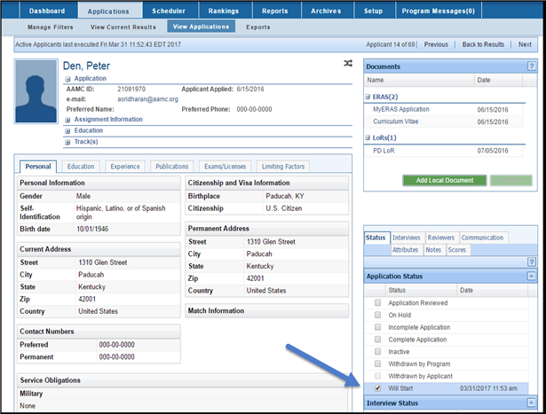
Transfer Applicant Data from ERAS to NI Due March 17, 2023 @ 11:00 am CT Method 1: Select the "Will Start" status individually for each applicant
Step 1: Log into the PDWS
Step 2: Navigate to the View Applications page of the matched applicant you want to include in the data transfer.
Step 3: Go to the Status Tab and mark the Will Start checkbox
This applicant will now be included in ERAS data transfers to NI
**Add SSN in NI by March 24th @ 11am**

Slide 12
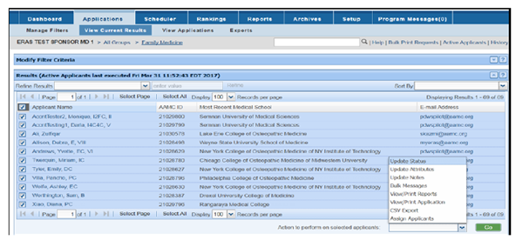
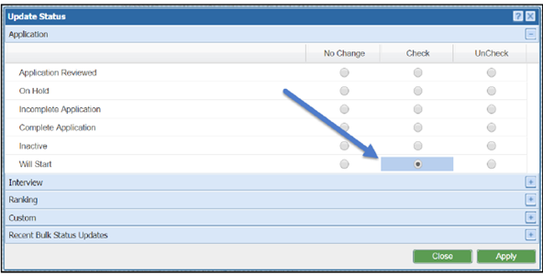
Transfer Applicant Data from ERAS to NI Due March 17, 2023 @ 11:00 a.m. CT Method 2: Select the "Will Start" status for multiple applicants at once
Step 1: Log into PDWS
Step 2: Apply a filter which includes matched applicants who should be included in the ERAS data transfer
Step 3: Mark the check box(s) next to applicant(s) in the View Current Results
Step 4: Scroll down to select Update Status in the bulk actions dropdown
Step 5: Mark the 'Check' radio button for Will start. Click Apply. (this will mark the will start status for all selected applicants within the filter)
You may use the 'Will Start' System-Defined filter to verify the applicants who have the Will Start status. These applicants will be included in the ERAS data transfer to NI
**Add SSN in NI by March 24th @ 11am**

Slide 13
Not Importing from ERAS Instructions
Click the Add Person at the top of the Personnel Records screen

Slide 14
Not Importing from ERAS Instructions
**Due March 24th @ 11am in NI**

Slide 15
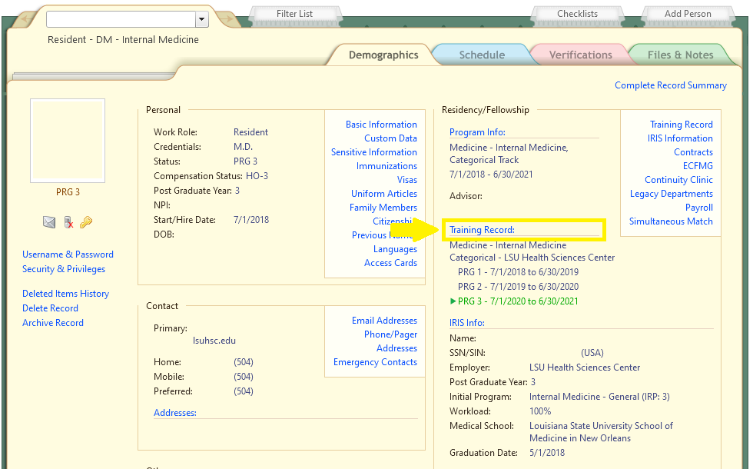
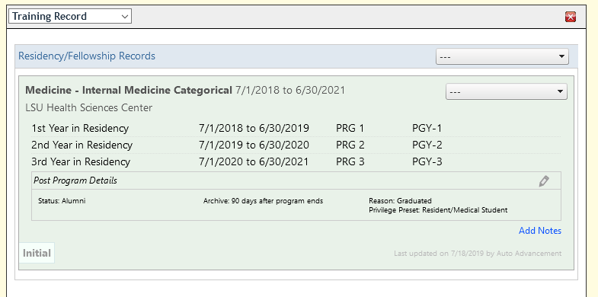
New Innovations Training Record
Add next program (internal transfer) Set by outgoing coordinator (1) Add Training Record
Extend training year (2) Adjust Training Dates
Add Chief year (2) Add Post Training Chief
Terminate early (2) End Training
Set Early Termination Reason (3) Reason
Add research year (2) Research Year
Set Termination Reason (3) Reason
Continuing as Faculty (3) Work Role and Status both set to Faculty
1
2
3

Slide 16
New Innovations Training Record Additional info Special Situations
Appointment forms and spreadsheets are updated nightly to reflect changes made in New Innovations.
Contact Chris Callac for
–Setting up gratis appointments
–Unusual promotion or demotion
–Appointment Form or spreadsheet is incorrect and you are unsure why
–Changes made in New Innovations not reflected on appointment form

Slide 17
Missing Data in New Innovations
Missing Data in New Innovations
Review data for all residents, including incoming
Some data may not get imported from ERAS

Slide 18
GME Rotation Sites
Rotation sites for the 2023-2024 Academic Year need to be updated/confirmed online by March 15th
GME Rotation Sites
Rotation sites set determine which new hire packets are available as part of the New Hire Forms automatically generated
If unsure about a new site, email ccalla@lsuhsc.edu with info
Rotation sites can be changed later if necessary

Slide 19
GME Rotation Sites
A few things to remember:
This list will not contain all rotation sites you may rotate to. It consists primarily of our larger partner sites. If you rotate to sites which are not listed, that is OK and we do not need to be notified.
If your sites are not properly updated for the academic year, your incoming house officers will not receive the correct hospital appointment packets when they download their new hire paperwork.
University Hospital and Clinics IS NOT University Medical Center - New Orleans. University Hospital and Clinics refers to the facility in Lafayette.
Additional information is in the Knowledge Base- GME Rotation Sites.
Be sure to click “Save” at the bottom, even if you are not changing anything.

Slide 20
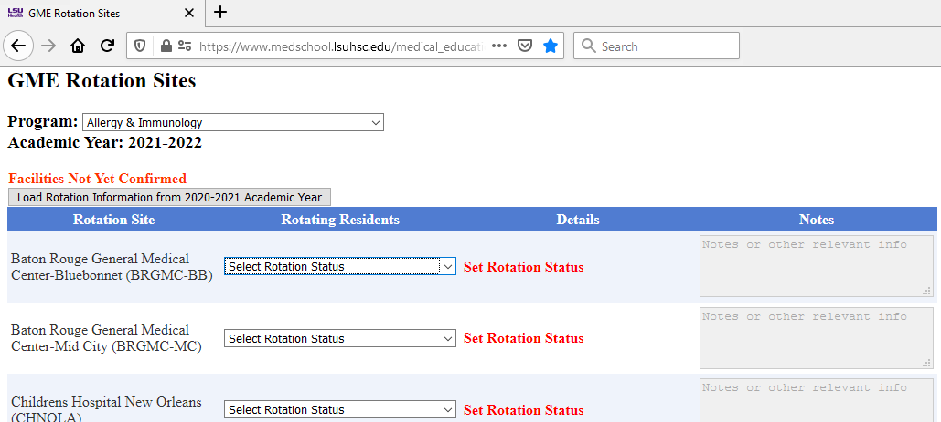
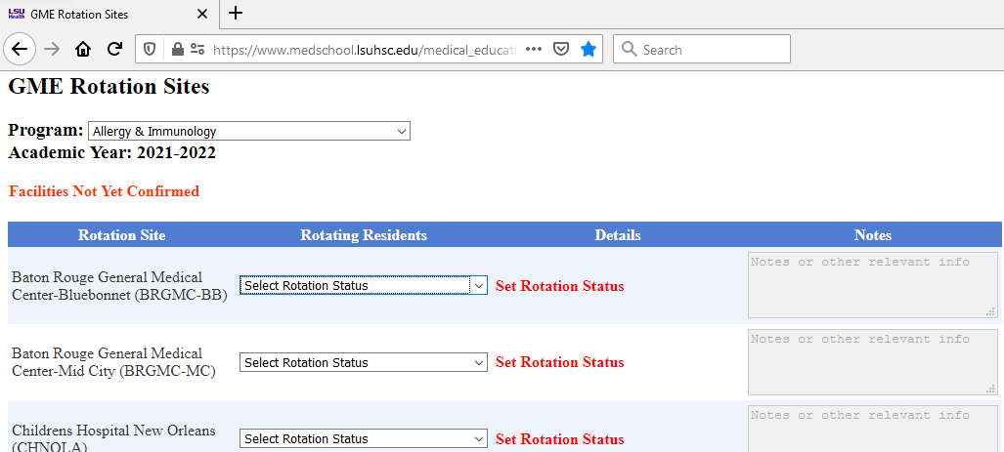
GME Rotation Sites

Slide 21
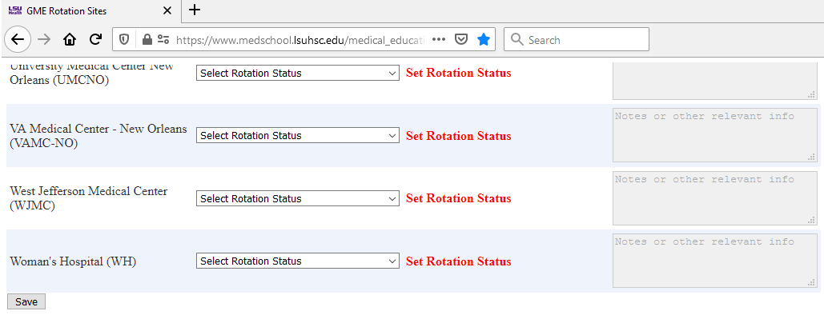
GME Rotation Sites

Slide 22
PLA Update
New Templates with Dr. Engel's signature line added to KB
PLAs should have 2-1-2023 or later as beginning date.
If you have PLAs that renew 6-30-2023, you will be receiving an email in April as a reminder.
Adobe Sign Tutorial - also located in Knowledge Base.

Slide 23
Importing GME Calendar
GME Calendar
Subscribe to GME Calendar via Outlook Online

Slide 24
Sending VA Paperwork
Returning Packets due March 27, 2023
TQCVL with Spreadsheet & Coordinator Tracker due
March 31, 2023
New Rotator Packets due April 17, 2023
How to Submit paperwork to the VA:
Sending Encrypted Emails

Slide 25
TQCVL and Resident Tracker Spreadsheet Download
Prefilled TQCVL Spreadsheet and Coordinator Tracker spreadsheets can be downloaded from the GME Online Appointment Forms site. The TQCVL Spreadsheet must be attached to the completed TQCVL form
Only resident levels expected to rotate will be included on the spreadsheets.
Rotation sites must be updated for 2023-2024 academic year before downloading.**

Slide 26
Announcements
LSBME Permit Renewals
Last LSBME Drop off today, February 28, 2023
House Officers check LaMed Dashboard to pay Invoice
NI Onboarding Wellness Training: March 9, 2023
House Officer February 28 Check – 13 days in the Pay Period, (February 16-28). The check amount will be smaller than usual due to the number of days in the pay period.
ACGME Leave Actions and Check Box added to Resident Scheduler – more information will be shared later. If you have questions, contact Yolanda Lundsgaard

Slide 27
Upcoming Dates
March 1, 2023 - NRMP Rank Order List Certification Deadline 8:00 pm CT
March BOM Reports Due
March 6, 2023 – February EOM Reports Due
Mar. 13 – 17, 2023 - NRMP – Match Week
Mar 16, 2023 – SOAP Rounds 1-4 – all day, 7:00 am – 8:00 pm
Mar. 17, 2023 – Match Day
Mar. 21 & 28, 2023 – Coordinator Meeting
Mar. 29, 2023- EOM Reports Due

Slide 28
Orientation Dates
LSU Online Orientation- May 15-June 15, 2023
LSU Onboarding: June 26-27, 2023
UMC: June 28, 2023
LSU BR- TBD

