Slide 1
Program Coordinator Meeting
March 21, 2023
Drug Testing, Spreadsheets, New Hire Paperwork,

Slide 2
Drug Testing
Scott Embly

Slide 3
Natalie Worsham
Information Management Specialist

Slide 4
LSBME Permit Application If the Incoming Resident/Fellow is not sure what permit or application to complete, they should contact their analyst at the LSBME
Types of Training Permits
U.S. Medical Graduate (PGY) Initial Licensure-Internship Permit
PGY 1
Issued to graduates of a Medical School in the U.S., Puerto Rico, and Canada
For first year internship
Valid for up to 12 months
Initial Fee is $50.00
PGY 2
Issued to graduates of a Medical School in the U.S., Puerto Rico and Canada, Resident or Fellow
Can be issued to graduates of a Medical School that have not taken Step 3
If applicant has not previously received an LSBME-issued PGY 1 permit (i.e. moving to LA from out-of-state & applying for a PGY 2 permit), applicant completes application and provide letter from PGY 2 program director
Valid for up to 12 months
Initial Fee is $100.00
International Medical Graduate (IMG/FMG) – Graduate Education Temporary Permit (GETP)
Issued to an international medical graduate (a graduate of a medical school located outside of the U.S., Puerto Rico, and Canada), Resident or fellow
ECFMG Certificate
Commitment from an accredited Louisiana medical school, college or other accredited medical institution
Possess a doctor or medicine degree duly issued by a medical school approved by the board. Diploma must be in English, if not, must be accompanied by a certified translation into English
Initial fee is $200.00
To apply for a PGY, PGY 2 permit or GETP, follow instructions on the LSBME website https://www.lsbme.la.gov/content/application-instructions-initial-licensure-internship-registration
Fellowship training Permit –NOT for Fellows in Accredited Training Programs
Issued, at the Board's discretion, for the purpose of participating in an unaccredited post graduate fellowship training, at the minimum level of PGY 4
Only renewed for a 2nd year at the board's discretion. NOT renewed for more than 2 years
Initial fee is $100.00
Licensure – Fellows that are eligible for a Full License can apply for a Full License -See LSBME website for qualifications
Process should start at least 6 months, preferably more, before start date
Initial Fee $382.00

Slide 5
LSBME Permit & License Renewal
Some Fellows may have a Permit and not a full license, and they may not have been included in the January and February Permit Renewal drop-off to LSBME.
Check to be sure all residents and fellows with a permit that will be renewed have completed the following
Paid the invoice
Program Director Letter submitted to LSBME
Opioid Training Completion Certificate sent to LSBME (first renewal only)
Mail Program Director Letter and Opioid Certificate, if applicable, to Licensing Department with Tracking information
License Renewal
House officers with a Full License must submit the following to the LSBME for their License Renewal (license expiration dates are their birth month)
CME Exemption Request Form (found on the LSBME website)
Program Director Letter
Mail the Exemption Request Form and Program Director Letter to the Attention of Ms. Rosa Burton in License Renewals, 30 days before the renewal date. Mail with tracking information.

Slide 6
TPL Educational Commission for Foreign Medical Graduates (ECFMG) Training Program Liaison with J-1 Physicians in training program
If Program Coordinator is not a TPL with ECFMG, and a J-1 physician matched to the training program, contact Yolanda Lundsgaard in the GME Office
TPL is responsible for coordinating the sponsorship application process on behalf of the TPL's Institution with both prospective & current J-1 physicians.
TPL works with both ECFMG and J-1 physicians to ensure that the host training site and its J-1 trainees are in compliance with federal requirements for participation
TPL Roles & Responsibilities https://www.ecfmg.org/evsp/roles.html

Slide 7
APPOINTMENT FORM & SPREADSHEETS
Appointment Form & Spreadsheets are due to Yolanda Lundsgaard by March 31, 2023
•Appointment Forms and Spreadsheets are downloaded here: AY Forms
Appointment Form – Lists All House Officers in the Program for the Academic Year
•House Officer Data is Auto-Populated into the Appointment Form and into the Spreadsheets from New Innovations
•Spreadsheets lists House officers and Action
Promotion
Off-Cycle
Transfers
Internal Transfers
External Transfers
Terminations
House Officers Becoming Faculty

Slide 8
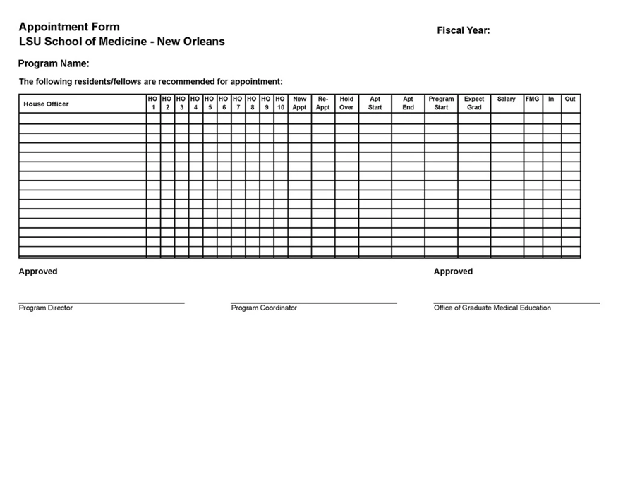
Appointment Form Appointment Form is Due to Yolanda Lundsgaard by March 31, 2023
AY Forms
House Officer Training Record is correct in New Innovations
The Appointment Form Lists All the House Officers in the Training Program any time between July 1 & June 30 for the Academic Year
Print in Landscape Format ONLY

Slide 9
Appointment Form Cont'd
Appointment form MUST:
Include House Officers Starting Promoting, and Terminating Off-Cycle (not July 1 Start and not June 30 Termination)
Include first year residents/fellows and all House Officers appointed outside a Match
Print in Landscape Format. Forms submitted in Portrait format are not accepted.
House Officers continuing in the same program July 1 – June 30 will have status of 'Re-Appointment' on the Form
Incoming House Officers, and Transfers from another LSU program will have status of 'New Appt' on the Form
House Officers that are NOT Promoting July 1, will be listed twice on the form Once with current HO level & status will have 'Hold-Over' with the dates at that HO level; and on the next line with the promoted HO level & status will have 'Re-Appointment' with the dates at that HO level
Review the Appointment form and confirm all the information is correct
Download, Print, Sign and Submit the signed Appointment Form to Yolanda Lundsgaard in the GME Office by the due date.
If there are changes, anytime during the Academic Year, to a Program's Roster of House Officers, or changes to a House Officer's training dates, update New Innovations and send an updated and signed appointment form to Yolanda Lundsgaard in the GME Office, (form can be printed the day after the change is made in New Innovations)

Slide 10
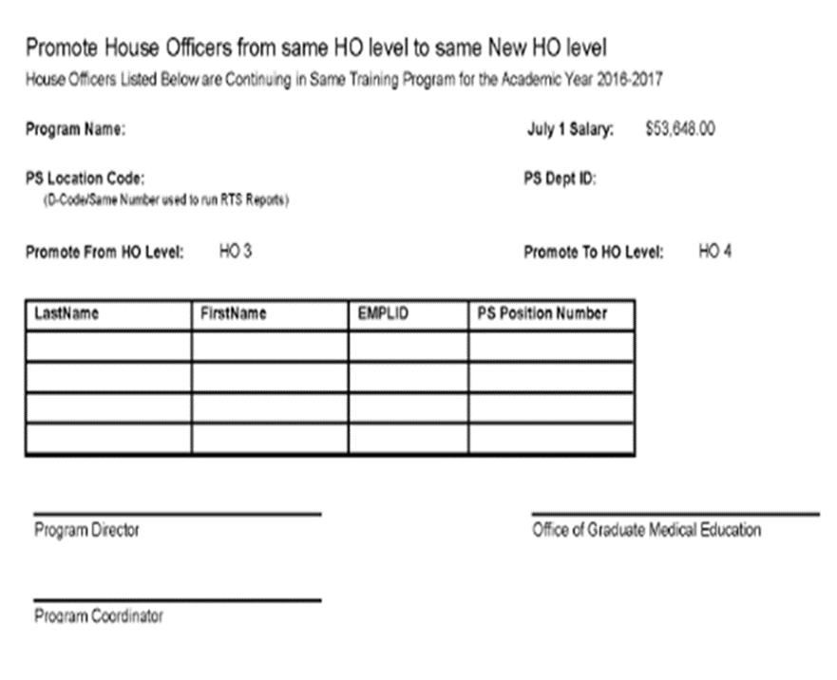
Promotion Spreadsheet
Promotion Spreadsheet is Due to Yolanda Lundsgaard by March 31, 2023
AY Forms
House Officer Training Record is Correct in New Innovations
The Promotion Spreadsheet is used to check that all House Officers promoting July 1 from one House officer Level to the Next House Officer Level are included in the PS automated Promotion Process
Print Spreadsheet in Portrait Format ONLY

Slide 11
Promotion Spreadsheet Cont'd
Includes All House Officers promoting from their current House Officer Level to the Next House Officer level.
Each Promotion level is listed on a separate page
House Officers that Don't Promote July 1, will not be included on the Promotion Spreadsheet
July 1 Promotions for All House Officer Levels 1 – 6 will be completed automatically in the PS Automated Promotion Process, only if they are included on the Promotion Spreadsheet. No Paper PER 3 is needed for July 1 Promotions.
Gratis House Officers (House Officer paid by the Military):
Gratis House Officers that promote July 1, will not appear on the Promotion Spreadsheet, they will appear on the Exception List with the July 1 promotion date and House Officer Level
A paper PER 3 is required to promote a Gratis House Officer. They cannot be included in the automated promotion process for July 1 due to their Gratis Status.
Review the spreadsheet and confirm that the House Officers listed on the Promotion Spreadsheet will promote July 1
Download, Print, Sign and Submit the signed Promotion Spreadsheet to Yolanda Lundsgaard by the due date.
If a House Officer is listed on the Promotion spreadsheet, but should not promote July 1, and the Automated Promotion Process has been completed, a PER 3 will be required 3 to correct the error. Contact Yolanda Lundsgaard in the GME Office.

Slide 12
Off-Cycle Spreadsheet Off-Cycle & Exceptions Tab Off-Cycle & Exceptions Spreadsheet is Due to Yolanda Lundsgaard by March 31, 2023
AY Forms
The Off-Cycle & Exceptions tab will show all House Officers who are Off-Cycle or need to be manually promoted/transferred/terminated.
Print this page in Landscape Format.

Slide 13
Off-Cycle & Exceptions Tab Cont'd
House Officers that will be listed when the Off-Cycle & Exceptions Tab is select are:
House Officers Promoting Off-cycle (do not Promote July 1)
House Officers Terminating Off-Cycle (do not terminate June 30)
House Officers Transferring Without Promoting (House Officer level remains the same or changes to a lower House Officer level)
House Officers Graduating without Termination (becoming Faculty appointed Chief Resident or other Faculty appointment).
The Off-Cycle Spreadsheet is not a downloadable Spreadsheet like the Promotion and Termination Spreadsheet. It is a list of the House Officers in the Program that fit one of the criteria above
Print the list of off-cycle House Officers that is generated in Landscape Format, sign, and submit the List to Yolanda Lundsgaard, in the GME Office, by the due date.

Slide 14
Off-Cycle & Exceptions Cont'd
Contracts for Off-Cycle House Officers Must match the training dates for each house Officer level he/she will be during their training time
Paper PER 3s are Required for these Off-Cycle House Officers:
House Officers Promoting Off-Cycle (not promoting July 1)
House Officers Transferring and Promoting, or Transferring and Not Promoting Off-cycle (Action is not for July 1)
Electronic PER 3s for House Officers Terminating Off-Cycle:
Request Department/Section Business Manager Submit an Electronic PER 3 in the PS HCM Production Database
All PER 3s for Off-Cycle House Officers MUST be submitted at least ONE MONTH before their Off-Cycle Promotion, Transfer or Termination Date (Includes Paper & Electronic PER 3s)

Slide 15
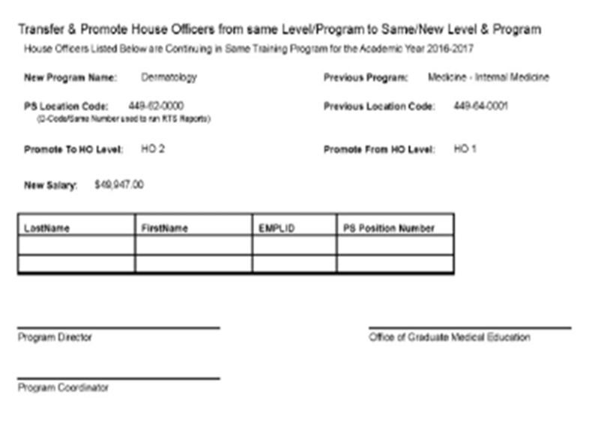
Transfer Spreadsheet – Internal Transfers Transfer Spreadsheet is Due to Yolanda Lundsgaard by March 31, 2022
AY Forms
House Officer Training record is correct in New Innovations
Transfer Spreadsheet includes All House Officers Transferring from one LSU Program to another LSU Program, with or without promotion on July 1
Only Transfers INTO your program are shown
Print Spreadsheet in Portrait Format ONLY

Slide 16
Transfer Spreadsheet Cont'd
Internal Transfers include House Officers in Programs in New Orleans, Baton Rouge, Bogalusa, Lafayette, and Lake Charles
House Officer Transfers not effective July 1, Require a paper PER 3 to Transfer and Promote or Change Title
Paper PER 3s MUST be submitted to Yolanda Lundsgaard at least ONE MONTH prior to Transfer and/or Promotion Date
Internal Transfer Check list is found in Knowledge Base

Slide 17
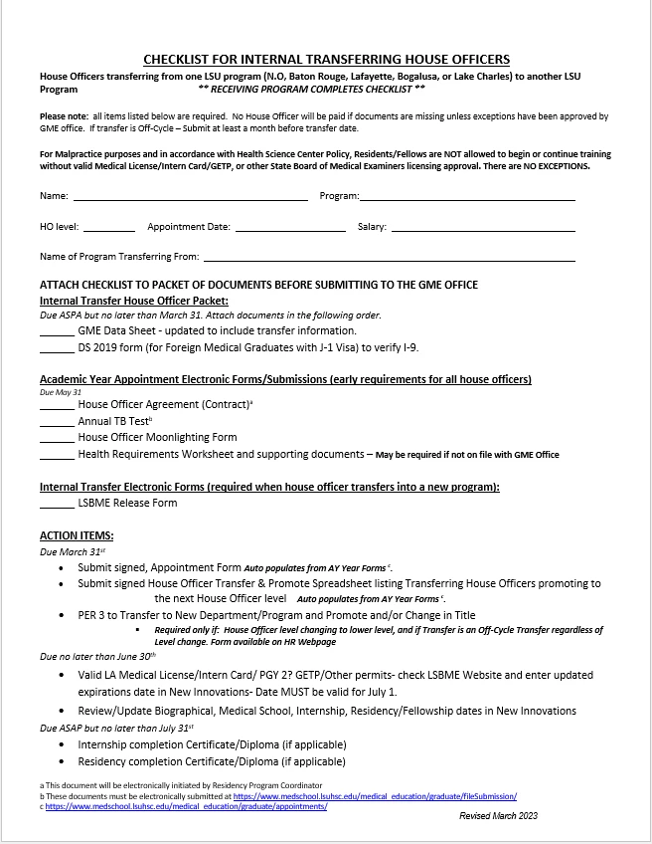
Internal Transfer Checklist
Internal Transfer Checklist - Knowledge Base
Updated for 2023-2024
Due May 31, 2023

Slide 18
Transfer- External Transfers
External Transfers Include: Applicants transferring from a non-LSU Training Program to an LSU Training Program
Transfer could be into same Specialty or into different specialty
External Transfer Applicants that are not accepted to an LSUHSC Training Program in a Match or SOAP process, must complete the DIO Transfer Packet found in Knowledge Base
https://lsugme.atlassian.net/wiki/spaces/FORMDOCS/pages/37191681/DIO+Transfer+Approval+Packet
If Program Director is interested in an external transfer applicant: Contact Dr. Becky Frey, Yolanda Lundsgaard or Dr. Engel before downloading the DIO Transfer Packet and "Release of Information to LSU" form
External Transfer Applicant must sign and give to the LSU program Director or Program Coordinator, the 'Release of information to LSU' form for each contact that the LSU program Director will reach out to and request the applicants training record. The form is found in Knowledge Base
The Completed DIO Transfer Packet is Submitted to the GME Office for Review (submit to Dr. Becky Frey and Yolanda Lundsgaard)
Programs Cannot offer the position to an External Transfer until Dr. Engel has approved the DIO Transfer Packet
Once Approved, the GME Office will notify the Program Director and Coordinator and an offer letter can be sent to the Applicant

Slide 19
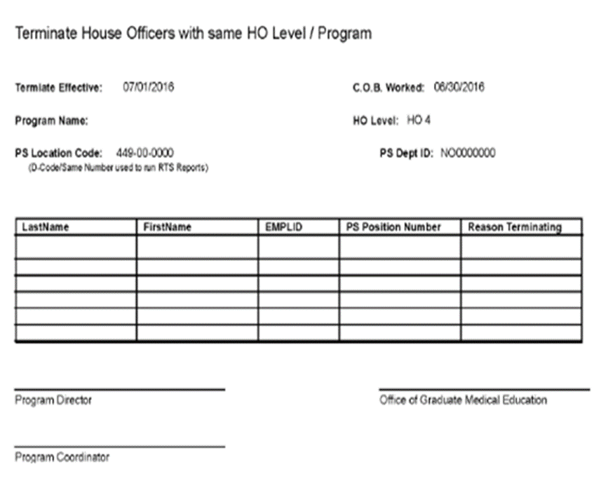
Termination Spreadsheet Due to Yolanda March 31, 2023
AY Forms
House Officer Training record is correct in New Innovations
The Termination Spreadsheet is used to check that all House Officers Terminating June 30 are included in the PS automated Termination Process
Print Spreadsheet in Portrait Format ONLY

Slide 20
House Officers Becoming Faculty Spreadsheet House Officer Becoming Faculty Spreadsheet is Due to Yolanda Lundsgaard by March 31, 2023
https://lsugme.atlassian.net/wiki/spaces/FORMDOCS/pages/2031762/House+Officers+Becoming+Faculty+Spreadsheet
Coordinator Completes the Spreadsheet found in the Link above in Knowledge Base 'House Officers Becoming Faculty Spreadsheet‘
Training Record in New Innovations should reflect outgoing status of “Faculty”
House Officers Becoming Faculty are also included on the Termination Spreadsheet.
Termination Reason on Termination Spreadsheet MUST be: 'Graduated Con't as Faculty' (populates on the spreadsheet when the status in New Innovations is updated correctly)
House Officers becoming faculty will be included in the Do Not Promote list in PS, so they do not promote before the faculty appointment paperwork is processed, (names entered in PS by Yolanda Lundsgaard in the GME office)

Slide 21
House Officers Becoming Faculty Cont'd
Business Manger submits an electronic Termination PER 3 to terminate the House Officer appointment
Electronic PER 3 must note that the House Officer will be re-hired as faculty and the date if known.
Business Managers submit Faculty appointment paperwork to the School of Medicine Dean's Office
House Office should contact the LSU Benefits department to confirm benefits will continue with No break in service
Notify MS Computer Support and Brenda Galle, of the Faculty Appointment, including effective date of Appointment, and request to keep their Email account activated so they can continue to receive Emails and have Emails received during training available
Faculty Appointment dates can be delayed due to approval of Hospital Credentialing Packets and Dean's Office approval. If this happens, the House Officer can have a break in service which will affect Email access and benefits.

Slide 22
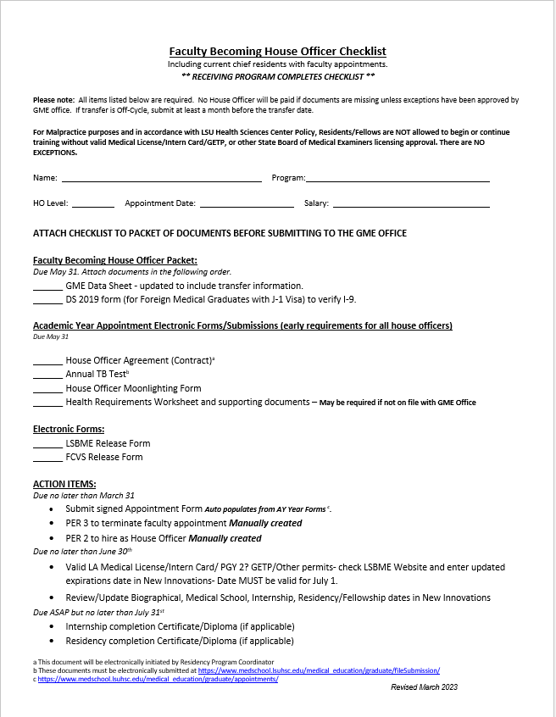
Faculty Becoming House Officers
Faculty Becoming House Officers - Knowledge Base
A Physician with a Faculty Appointment going into a residency or fellowship program
LSU Chief Resident with a faculty appointment entering a Fellowship Training Program
An LSU Physician with a Faculty appointment entering a Fellowship Training program
There is NO Spreadsheet that auto-populates the data for LSU Faculty becoming House Officers
Paperwork needed is listed on the 'Faculty Becoming House Officer Checklist

Slide 23
New Hire Paperwork
New Hire Checklist, PER 2, and login information for incoming House Officers available in the Academic Year Forms system
AY Forms
New Hire Forms are available today, Tuesday, March 21nd
Appointment "Packets" will be initiated from GME to House Officer Email
TB test (April-TBD), Moonlighting, Immunization Records, COVID/Immunization Release, etc.
GME Process Tracker

Slide 24
New Hire Paperwork
Changes for 2023-2024 Academic Year Onboarding
Updated New Hire, Internal Transfer, and Exit Checklists
FCVS and LSBME Release Form converted to electronic forms
HCN Break Glass and Mask Fit Medical Forms removed

Slide 25
New Hire Packet
Sample completed packet available in the Knowledge Base (updated for 2023-2024 AY onboarding) Sample New Hire Packet - New Hires - GME Knowledge Base (atlassian.net)
Incoming House Officers submit the completed and signed New Hire Paperwork Packet to their Program Coordinator by May 1, 2023

Slide 26
New Hire Packet
Coordinator reviews the New Hire Packet Received
Print the New Hire Check List for each New Hire Packet Received
Print the PER 2 for each New Hire Packet received (the Original & Dean/Dir page)
Check that all forms listed under the New Hire Packet section on the Checklist are included and signed where noted
Electronic Signatures are NOT Accepted
GME Data Sheet must account for all time from Medical School Graduation through the start date of the LSU Training Program, with no gaps longer than 1 month – Very Important.
Tax forms must be completed and signed – wet signature
Social Security Card must be signed (wet signature), by the Incoming House Officer and a readable color copy must be included.
Out-of-Country Incoming House Officers that don't have a Social Security Card, must submit the Letter/Receipt they received from the Social Security Office when they applied
This Letter/Receipt must be included in the New Hire Packet
Once they receive their Social Security Card, a Color copy must be sent to the GME office and to Human Resources
Incoming House Officers will have to resubmit, to Program Coordinator, any forms that are not included in the Packet; any forms that are incomplete; and any forms that do not have a wet signature (electronic signatures not accepted)

Slide 27
New Hire Packet
Program Coordinators send the reviewed, completed, and signed New Hire Packet to the Yolanda Lundsgaard in the GME Office before or by May 31, 2023
Tape any Voided Checks to the separate "Direct Deposit Cancelled Check" page (if not taped) - Do not paperclip or staple to the Direct Deposit Form. A Completed bank direct deposit form is accepted in lieu of a voided check.
Do Not Hold completed packets, send packets to the GME office once the packet is completed – DO NOT wait until the last week or last day in May to send multiple packets.

Slide 28
Contracts
Department Heads
Mailbox set up
NI Train Record
Incoming- email addresses
Due to GME by June 15th

Slide 29
Tracker
GME Process Tracking System
LSBME and FCVS Release Added

Slide 30
New Hire Paperwork – Site Onboarding
Packets available automatically for:
VA
Updated packets still needed by GME:
Lafayette General
Baton Rouge General
Our Lady of the Angels
North Oaks
Women’s

Slide 31
New Hire Paperwork – Site Onboarding
No physical packets needed for:
Ochsner
Lafayette General / UHC (Ochsner)
Our Lady of the Lake
LCMC
UMC New Orleans
Children’s Hospital
East Jefferson
West Jefferson
Touro

Slide 32
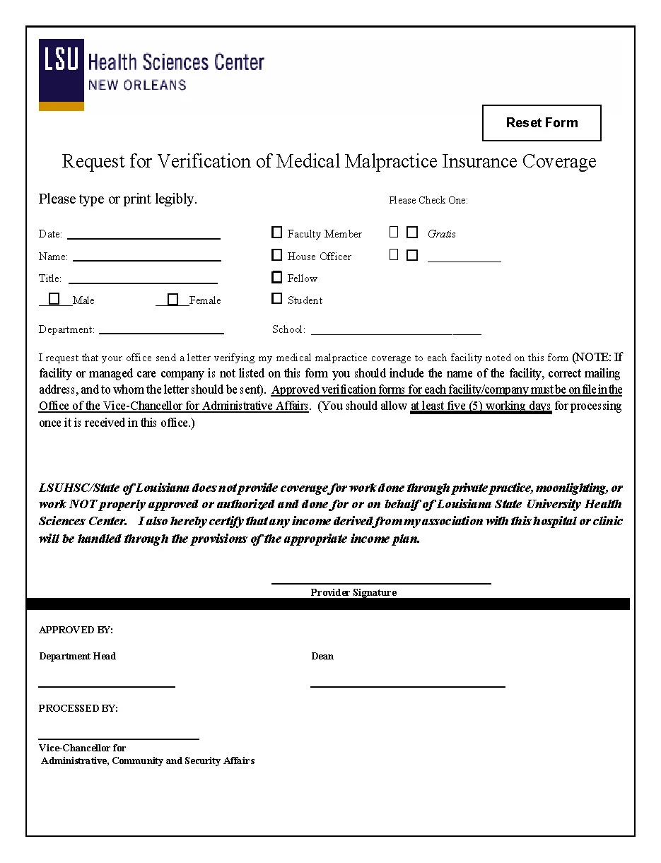
Malpractice Coverage
Due to Cynthia Scott April 1:
Malpractice Form - Forms & Documents - GME Knowledge Base (atlassian.net)
Cover sheet only
Name: Program Name
AY Forms - Malpractice Spreadsheet
Excel spreadsheet of a COMPLETE listing of all sites your house officers will rotate at for 23-24 AY.

Slide 33
Diplomas
For guaranteed release in May 2023, certificate orders can be emailed immediately to registrar@lsuhsc.edu. Please include Certificate Order and your department on the subject line of the email. The coordinator and business manager will receive an email informing them when the order is ready along with the IT form for the transaction. Certificates cannot be released until the signed IT form is returned to the Registrar’s Office. The IT form may be returned by email, campus mail or in person.
Certificate requests will be processed in the order in which they are received. The timeframe for processing is 3 to 4 weeks. Orders received after April 28, 2023 will not be processed until May 30, 2023.
Certificate Order Form - Knowledge Base
NOTE: Please adhere to the example format provided on the first line of the order form. Do not write over the example line. Incorrect orders will be sent back to make necessary corrections and will delay the processing time. There will be an additional $30 reprint fee for error submitted by the department coordinator i.e. misspellings, incorrect dates, etc. Each department will be responsible for obtaining the appropriate signatures and sending the certificates to their final destination.

Slide 34
GME Rotation Sites
Programs Not Confirmed as of yesterday
Child Neurology
Clinical Neurophysiology
Emergency Medicine
Emergency Medicine - Hyperbaric
Epilepsy
Family Medicine - Kenner
Family Medicine - Lake Charles
Hospice and Palliative Medicine - Baton Rouge
Internal Medicine / Emergency Medicine
LSU School of Dentistry
Neurology
Neurosurgery
Neurotology
Obstetrics and Gynecology
Ophthalmology
Ophthalmology - Retina (Non Accred)
Orthopaedic Surgery
Pediatric Orthopaedics
Pediatrics/Emergency Medicine
Psychiatry - Consultation/Liaison
Psychiatry - Forensic
Surgery
Surgery - Critical Care
UHC - Family Medicine
UHC - Geriatrics
UHC - Internal Medicine
UHC - Sports Medicine

Slide 35
Spring Training Calendar
April: TAGME (TBD)
April 20th: CORE in Person!
May 3, 2023, 10am-12pm: HR I-9 walk through
June: PLA and Block Scheduling meet ups
13th: 9am-10:30- Block Scheduling
13th: 10:30-12: PLA
15th: 1-2pm: Block Scheduling
July20th: Accreditation @ CORE
Potluck w/ CAG
August: Networking event

Slide 36
Reminders
**SSN due March 24th in NI
Payroll Lockout is Monday, March 27, 2023 for March 1-16
Check Un-assigned/Under Assigned
March BOM Reports are due NOW !
February EOM Reports are due NOW!
March EOM Reports are due April 6, 2023

Slide 37
Orientation Dates
LSU-NO: June 26 and June 27, 2023
LCMC: June 28 pick-up. Online modules required. Virtual Orientation sessions available TBD.
LSU-BR: TBD
EPIC Training for LCMC: Virtual. Online modules required.

