Slide 1
Coordinator Meeting
May 16, 2023

Slide 2
Electronic Forms for Incoming House Officers
Initiated Yesterday!
HireRight I-9*
LSBME Release Form
Health Records Release Form
Immunization Records Form
Moonlighting Form
House Officer Manual Acknowledgement Form
HR Disability Self-Identification Form*
HR Veteran Status Self-Identification Form*
* These items will NOT be reflected in the GME Tracker

Slide 3
Orientation Dates
EPIC Training
–Beginning of June
Virtual
Ochsner Kenner
June 23, 2023, 8:30am-11am
Virtual
UMC Onboarding
–June 28, 2023
Baton Rouge Orientation
–June 26, 2023
LSU New Orleans Onboarding Days
–June 26, 2023 OR
–June 27, 2023

Slide 4
LSU Online Orientation
Live May 15, 2023
www.medschool.lsuhsc.edu/medical_education/graduate/virtualorientation/
Residents can
View progress of some new hire requirements
Complete modules
Sign up for Onboarding Day day/time
Sign up for Benefits session with HRM
Coordinators can:
View progress for all residents
View all modules and presentations
View list of new hire requirements
See which onboarding day residents have registered for

Slide 5
LSU Orientation
Benefits Overview:
Links to sign up in on the Orientation Portal after watching Benefits video
MANDATORY
House Officers can attend a virtual session with HR for support and Q/A
Dates:
June 1 @ 1pm
June 7 @ 10am
June 16 @ 11am
June 21 @ 2pm – Foreign Nationals

Slide 6
LSU New Orleans Onboarding Days
Volunteers Needed!
House Officers must attend one of the onboarding dates.
June 26, 2023 or June 27, 2023
1 hour appointment
Mask Fitting will be available in their allotted 1-hour appointment session
Sign-Up link available in the Orientation Portal
House Officer will need to bring the following items:
Marriage Certificate (if applicable)
Birth Certificate for dependents (if applicable)
Social Security Card for dependents (if applicable)
US or Foreign Passport
Driver's License
Visa (if applicable)
DS 2019 (if applicable)
I-94 (if applicable)

Slide 7
UMC Onboarding
Correction from slides- Wednesday, June 28th for Pick Up
The deadline for all orientation module and EPIC Training module completion for LSU residents and fellows is set for 6.28.23.
incoming residents/fellows MUST submit their BADGE ID photo directly to LCMC Academic Affairs by Friday, June 2nd deadline.
“Incoming Learner Badge Photo Submission Form”
https://lcmchealth-drshh.formstack.com/forms/incoming_learner_photo_submission_form

Slide 8
REMINDERS: QI FORUM – Thursday, JUNE 8, 2023 from 11:00AM – 4:30PM – Encourage your programs to participate for the afternoon

Slide 9
IHI Modules
Quality Improvement & Patient Safety Modules
https://lsugme.atlassian.net/wiki/spaces/POLICY/pages/668565505/IHI+Quality+Safety+Curriculum
Code: 63460
Send screenshot or copies of certificates to equip@lsuhsc.edu
QI 101, 102, 103, 201
PS 101, 102, 105, 201
Due by June 15th!

Slide 10
AMA Modules
To be completed during 1st, 2nd, and 3rd year of training
Res 1, Res 2, Res 3+/Fel 1, Fel 2
These are required for your Exit Packets and are MANDATORY for promotion to the next HO Level and graduation.
To access courses/curriculum to go AMAGMEOnline.org
Click the "Sign In" button – If you are logging in for the first time, you may be asked to activate your account with a secure code. Request a code by submitting your LSU email. Check your email and enter the code into the box.

Slide 11
EQuIP Rotation 2023-2024
If you are interested in involving any of your residents in the EQuIP experience, please contact Julie Cain at 504-568-2092 (jcain2@lsuhsc.edu ) or the EQuIP Rotation Director, Dr. Fred Rodriguez, at 504-201-5489 (frodri@lsuhsc.edu).
We have 2- and 4-week rotations available
Meets ACGME and CLER requirements for Quality Improvement and Patient Safety for participation in interdisciplinary QI and PS programs at clinical sites

Slide 12
Mask Fit Sign up for Current House Officers
Dates:
6/12 @ 8am-12pm
6/13/23 @ 12pm- 4:30pm
6/19/23 @ 8am-12pm
Location: Lion's Building, 6th floor, Conference Room 7
Sign Up Link: Schedule for Mask Fit Testing 2023 (supersaas.com)

Slide 13
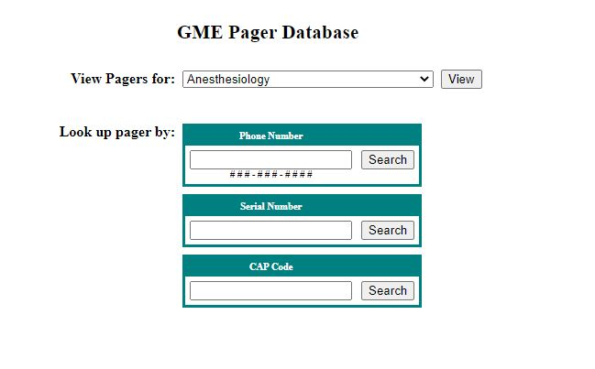
Pager Management
HOs leaving your program should return pagers to you to assign to incoming HOs.
Any pager not returned requires payment of the $55.20 lost pager fee.
Reassign pagers to new users before July 1st in the GME Pager Database. Changes will be accepted July 1.
Step-by-step instructions are available in the Knowledge Base.
If additional pagers are needed, contact Sara by the end of May.
Return any pagers no longer needed to Sara.
Contact Sara if any residents moving to fellowships wish to keep their existing pager number.
Pager Audit will take place in July!
Any pagers not assigned to current residents will be shut off on August 1st and the department will be charged the $55.20 lost pager fee.

Slide 14
New Hire Paperwork
Review the paperwork before forwarding New Hire Paperwork to the GME Office
GME Data Sheet Must include everything the House Officer has done after Medical School Graduation through starting LSU Residency/Fellowship Training, (include unemployed or studying for licensing exams, traveling, working, etc). There should not be any gaps between Medical School graduation and starting LSU residency/fellowship training program for 2023-2024
Forms - HR must be originals, no copies, and all forms requiring a signature must be signed by the incoming House Officer- Wet Signatures
Social Security Card
Name must match name on New Hire paperwork
Card must be signed by House Officer – sign the card, don't sign on the paper next to, or under the card
Copy included with new hire paperwork must be readable, not too dark or too small. Color copy is best.
DS-2019 – J-1 VISA Holders
LSUHSC-N.O. Training Program must be listed on the form
Valid Training dates for LSU Training program must be correct
Tax Documents
W-4: Wet signature required
L-4: Include # of exemptions, dependents, or 0
Wet signature required
Tape to a separate page if not on a full page

Slide 15
TRANSFER PAPERWORK Internal Transfers
The GME Data sheet must include the LSU program name and training dates for the program the house officer is transferring into
The GME Data sheet must include the LSU program name and training dates of LSU program transferring from.
The GME Data Sheet must also include everything the House Officer has done after Medical School Graduation through starting the first training program at LSU (the program transferring from).
LOA/LWOP dates must be included on the GME Data Sheet
All contact information on the GME Data Sheet must be up-to-date

Slide 16
Off-Cycle Continuing House Officers
An updated GME Data Sheet is needed for Continuing House Officers that have become off-cycle due to time on LOA/LWOP during their training which caused their training dates to be extended.
An updated GME Data Sheet is needed for continuing House Officer that have been away on Research or training year was extended or repeated.

Slide 17
Graduating/Terminating House Officers
Email will be disabled on July 1, for House Officers graduating/terminating June 30.
If the house officers want to keep any emails, they should forward the emails to their personal email accounts.
If the house officers will not be able to sign/certify the June EOM Report before they leave, have them sign the June BOM Report on or after June 15, 2023, and attach the signed pages to the EOM Report all other House Officers will sign/certify

Slide 18
Resident Scheduler
When House Officer schedules are completed for 2023-2024, they can be entered in Resident Scheduler for the new academic year.
House Officer promotions, transfers, terminations cannot be updated in PS or Resident Scheduler until all house officers have been paid for June.
Resident Scheduler training session is planned for June. Calendar invites to come

Slide 19
ERAS News
Register for ERAS 2024
Strategic Collaboration with Thalamus
Complimentary Access for upcoming season
PDWS Scheduler will still be available
Updating MyERAS Appplication
May 4, 2023 Webinar
https://aamc.elevate.commpartners.com/products/program-staff-qa-webinar-for-navigating-the-2024-eras-application-update-may-4?force_login=1

Slide 20
BOM & EOM Reports
BOM Reports
May BOM Reports are due now if not submitted
June BOM Reports are due June 1, 2023
EOM Reports
April EOM Reports are Due Now. Late reports delay sending invoices and LSU recouping funds.
Initiate electronic change in Source of Funds PER 3s (CSOF) when submitting the EOM Report.
Send missing House Officer Responses from Past Months
May & June Reports MUST be sent as close to the Due Date as possible. May & June have year-end closing deadlines in Accounting and for some hospitals to pay invoices.
Payroll – May 16-31, 2022
Lockout: Thursday, May 25, 2023

Slide 21
Reminders
Block and PLA session in June- check your calendars!
Due May 31st:
New Hire packets
Continuing House Officer Appointment Paperwork (TB, contracts, etc.)
Internal Transfer Appointment Paperwork
Due June 15th:
IHI Module Completion
Orientation Completion
Visa Holders- complete section 1 of I-9 & Drug Testing
Appointment Packets due
Due June 30th:
Valid LSBME Permit or License!
Due July 31st: Exit Packets
Driver Safety!
TB- Form
TAGME Study Guide 2023: https://tagme.org/what-we-do/how-to-apply/

Slide 22
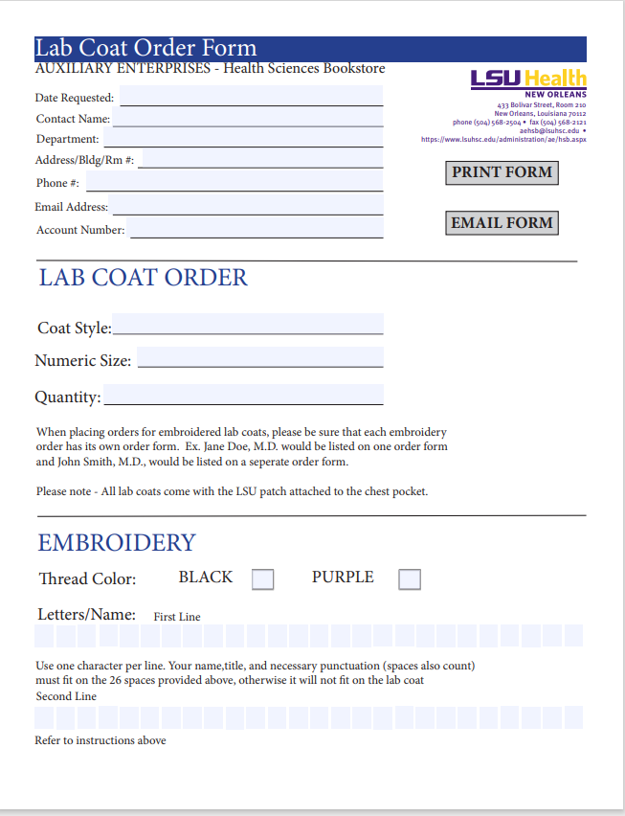
CAG Events
Potluck: July 7th
Networking Event: August 22nd
Calendar invites to come
White Coats: https://www.landau.com/fit-guide

