Slide 1
Coordinator Meeting
October 17, 2023

Slide 2
NI Implementation
Natalie presenting at CORE this Thursday (2pm in the large lecture room).
What's in it for you? Don't be afraid, we are here for you!
3 Phases of Implementation
Hybrid meet up for Phase 1 first week in November:
Nov 8th @ 2pm-3pm , Nov 9th @ 10am-11am
Large Lecture room
**Bring your laptops**

Slide 3
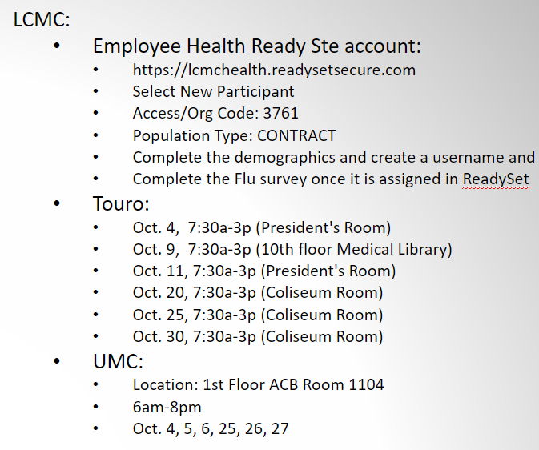
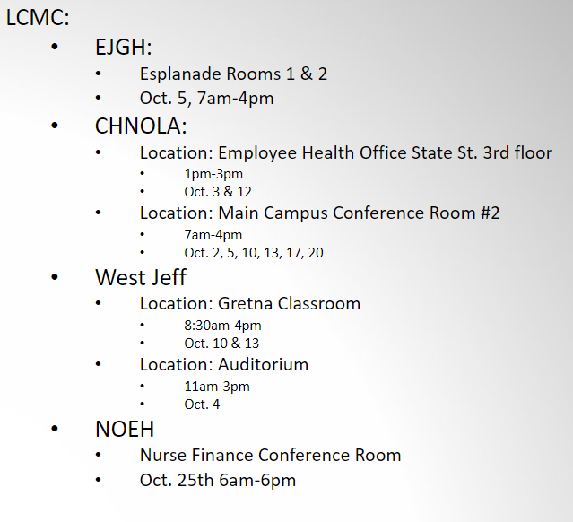
Flu Shots
Received as of this morning: 117
GME Electronic Document Submission
LSU HSC Flu Fair: 10/19, 10/25, 10/26, 11/2

Slide 4
CDS/Opioid Training Update
As of 10/11/23:
Outstanding: 94
What next?

Slide 5
Beeper Audit
GME Pagers
# beepers unaccounted for:
IM: 4
Neurosurgery: 4
ENT: 3
Addiction Psych: 1
Child Psych: 3
Surgery: 5
Plastics: 1

Slide 6
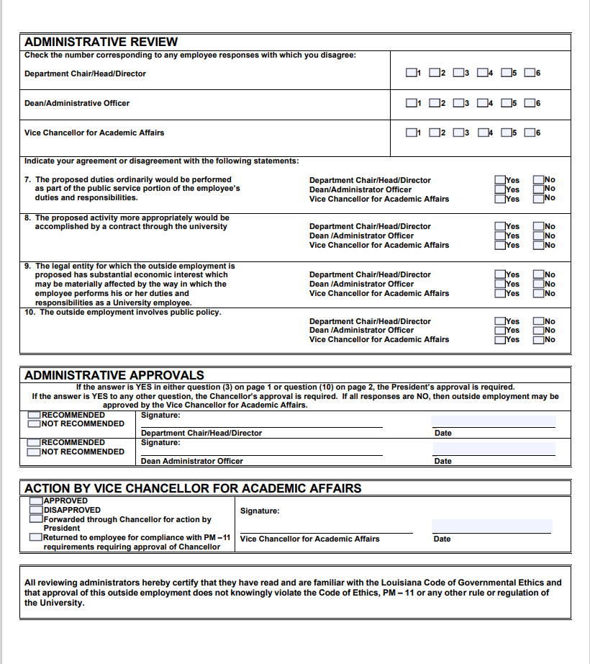
PM-11 Form
Department Head must fill out questions 7-10 on page 2.
Dean's Office
VCAA for ultimate approval

Slide 7
CAG Pearls
Only work should be logged as duty hours
PSLF forms must go to HR nohrm@lsuhsc.edu
Update resident physical address at least annually in the case that there is an emergency.
Residents access ERAS applications unless they are doing formal interviews (ex: chiefs)
Introductions for zoom interviews
Consider pros and cons of using timers on zoom
Pay attention to "preferred names" in ERAS
O drive v T drive
Use only the email address listed in ERAS for communication with applicants.
SHOUT OUTS!

Slide 8
Reminders
CORE this Thursday in the large lecture room **in-person attendance highly encouraged
Exit Packets: 23 missing
UMC Tour Confidentiality Agreement and Release:
2023
BOM Reports
October BOM Reports Due Now
November BOM Reports - Due November 1, 2023
September EOM Reports – Due Now
Submit CSOF electronic PER 3s if applicable when submitting EOM Reports
Quarterly Review:
Review if House Officer Leave is recorded correctly in Resident Scheduler between July – September 2023
Send Missing House Officer Responses that were not included with for July – September 2023 EOM Reports
Payroll
Payroll Locks

Slide 9
Savannah Thibodeaux: sthib6@lsuhsc.edu EQUiP coordinator

