Slide 1
Coordinator Meeting
October 18, 2022
Coordinator Subgroup, Flu Shots, Opioid/CDS Certificates, PM-11, Beeper Audit, Duty Hours, Reminders

Slide 2
Coordinator Meeting/Training Planning Group
Purpose: Improve communication between program coordinators and GME staff relating to meeting and training content, create meeting agendas and GME led training calendars for program coordinators, and to create best practices regarding program coordinator tasks.
Goals:
Ensure meeting content quality by reviewing information provided, timing of information, and method of information sharing.
Create training calendar for the year (monthly GME/subgroup led trainings)
Structure:
Length of commitment
Year 1: Start in January 2022- 1.5 commitment
January 2022- July 2023
# Members:
6 total- 1 GME member and 5 program coordinators
Monthly/quarterly meetings?
Once a month with intention of transitioning to quarterly
Agendas provided by GME member
Meeting and training topics for the year
Set action plans, deadlines, and group expectations in first meeting.
Membership Criteria: Each of the following criteria must be filled by one of more of the group members:
GME member(s)
3 Residency Program Coordinators
2 Fellowship Program Coordinators
Length of position
Under 3 years in program coordinator role.
3+ years in program coordinator role.
Program coordinator from outside the New Orleans area (i.e. Baton Rouge, Lake Charles, Bogalusa)

Slide 3
Meeting/Training Planning Coordinator Group Cont.
Member Selection:
All five coordinator positions will be peer nominated. GME will provide a nomination method and program coordinators will nominate the peer(s) they wish to participate in the group. GME will select members based off membership criteria. GME will offer membership positions once all five positions are selected. If a nominated coordinator does not wish to participate in the group GME will select another member based off criteria mentioned above.
Group Expectations:
Group Members may be expected to present topics at the monthly program coordinator meetings and trainings should that member feel comfortable doing so and have a good grasp of topic knowledge.
Group members will agree on best practices for certain aspects of the program coordinator role and share these at meetings.
Group members will be invited to certain meetings the GME office has, internally and externally, throughout the year to provide program coordinator insight.

Slide 4
Meeting/Training Planning Coordinator Group Cont.
Timeline
November: peer nominations
December: group selection
January: first group meeting (TBD)

Slide 5
Flu Shots
Complete: about 113
GME Electronic Document Submission
VA:
Walk-ins at the Vaccine Center- 1A 301-302. First floor main hallway next to the PERC (Patient Education Resource Center).
Childrens: walk-ins:
9:30-11am: 9/19/22, 9/20/22, 9/21/22, 9/27/22
7:30-10:30am: 9/28/22
LCMC:
Wed, October 19: 6 am-9 pm
NOEH Main Conference Room – First floor
Fri, October 21: 9 am–1 pm
Touro Coliseum Room
Mon, October 24: 7:30 am–3 pm
Touro Coliseum Room
Tues, October 25: 6:30 am-8 pm
UMC Conference Center Room C
Wed, October 26: 6:30 am-8 pm
UMC Conference Center Room C

Slide 6
CDS/Opioid Training Update
As of 10/14/22:
Completed: 38
Outstanding: 189!
Resets: 3
Requested resets not yet done: 2
Yes, the system knows if they fast-forward and not complete the full 3 hours.
Due by November 15!!!
This is a state mandated requirement for ALL LA renewals. CME has made this available free of charge for LSU house officers.

Slide 7
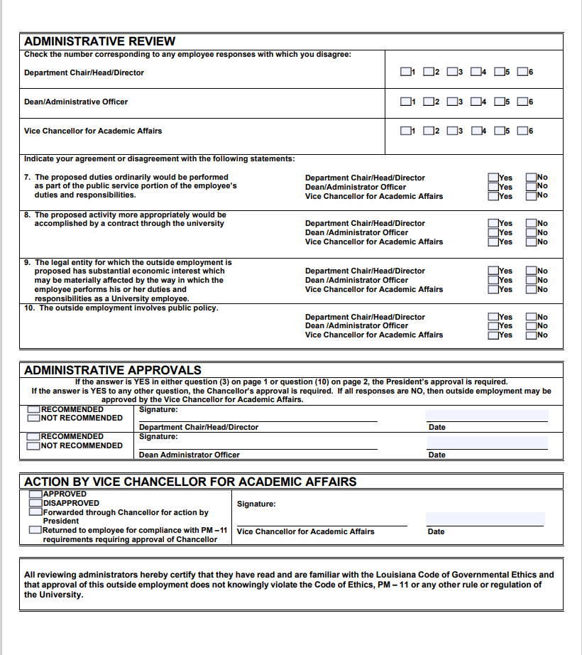
PM-11 Form
Department Head must fill out questions 7-10 on page 2.
Dr. Hilton signs
VCAA for ultimate approval

Slide 8
Beeper Audit
GME Pagers
# beepers unaccounted for
Program | Number of Pagers
Internal Medicine NOLA | 5
Med/Pediatrics | 2
Neurosurgery | 3
Ophthalmology | 1
OMFS | 2
PM&R | 5
Psychiatry-Child | 3
Surgery | 24
Surgery - Colorectal | 1
Surgery - Critical Care | 2
Surgery - Plastics | 8
Surgery - Vascular | 4

Slide 9
Work Hours
134 Violations (7/1 - 10/18/22)
682 logs NOT up-to-date
Mid-month – logs and violations
End of the month – violations
Questions - email or call Julie @ jcain2@lsuhsc.edu or 568-2092.

Slide 10
Reminders
LCMC Physician Recruitment Event:
UMC-NO Conference Room J
Thursday, November 10th
3:30-5:30pm
BOM Reports
October BOM Reports Due Now
November BOM Reports - Due November 1, 2022
September EOM Reports – Due Now
Submit CSOF electronic PER 3s if applicable when submitting EOM Reports
Quarterly Review:
Review if House Officer Leave is recorded correctly in Resident Scheduler between July – September 2022
Send Missing House Officer Responses that were not included with for July – September 2022 EOM Reports
Payroll
Payroll Locks Wednesday, October 26, 2022, for October 16-31,2022 Payroll

