Slide 1
Coordinator Meeting
September 19, 2023

Slide 2
CDS/Opioid Training 2023
https://www.medschool.lsuhsc.edu/medical_education/cme/cds_opioid_training.aspx
Tracker
->My Documents->CDS CME Opioid Training
As of 9/15/23: 211 Outstanding (68 complete)
****Due 10/15/23****

Slide 3
Flu Season
Process:
GME Electronic Doc Submission
**Need name and date of vaccination
Tracker
LSU HSC Flu Fair: 10/19, 10/25, 10/26, 11/2
VA: sign up with employee health here https://outlook.office365.com/owa/calendar/SLVHCSEmployeeFluVaccineAppointments@DVAGOV.onmicrosoft.com/bookings/
There will also be vaccination in areas with mobile carts and flu champions

Slide 4
Flu Season Cont.'
LCMC:
Employee Health Ready Ste account:
https://lcmchealth.readysetsecure.com
Select New Participant
Access/Org Code: 3761
Population Type: CONTRACT
Complete the demographics and create a username and password
Complete the Flu survey once it is assigned in ReadySet
Touro:
Oct. 4, 7:30a-3p (President's Room)
Oct. 9, 7:30a-3p (10th floor Medical Library)
Oct. 11, 7:30a-3p (President's Room)
Oct. 20, 7:30a-3p (Coliseum Room)
Oct. 25, 7:30a-3p (Coliseum Room)
Oct. 30, 7:30a-3p (Coliseum Room)
UMC:
Location: 1st Floor ACB Room 1104
6am-8pm
Oct. 4, 5, 6, 25, 26, 27

Slide 5
Flu Season Cont.'
LCMC:
EJGH:
Esplanade Rooms 1 & 2
Oct. 5, 7am-4pm
CHNOLA:
Location: Employee Health Office State St. 3rd floor
1pm-3pm
Oct. 3 & 12
Location: Main Campus Conference Room #2
7am-4pm
Oct. 2, 5, 10, 13, 17, 20
West Jeff
Location: Gretna Classroom
8:30am-4pm
Oct. 10 & 13
Location: Auditorium
11am-3pm
Oct. 4
NOEH
Nurse Finance Conference Room
Oct. 25th 6am-6pm

Slide 6
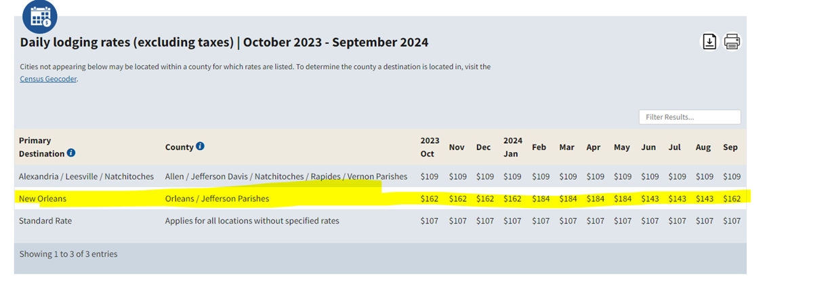
In-Person Event Resources
Event Resources - GME Knowledge Base (atlassian.net)
Panel Discussion with In Person Event Resources
Marriot: corporate code of L7S

Slide 7
Interview Resources Available
KB- House Officer Selection
Eligibility-
NRMP Eligibility
Program Eligibility
LSU Criteria:
US Citizens
Permanent Residents of the United States
J1 Sponsored by ECFMG
ECFMG Certificate Required for all non US Medical School Graduates
Applicant Requirements
Applicant Information Sheet
Sample Contract
Interviewee Acknowledgement Form
Selection (ERAS, NRMP, Main Match, San Francisco Match, AUA, Applicant Requirements)

Slide 8
NRMP Main March Match
Match Registration opened September 15, 2023; the Institution must register the institution and activate programs before programs can complete their NRMP registration
NRMP will probably send out a notification about upcoming webinars to help prepare for the 2024 Match.
Important Dates
September 28, 2023 – Applications available in ERAS system (ERAS system and Match are separate organizations with separate systems). This is not the date to start interviewing.
Some program societies have set a window of dates for Applicant interview invitations, Follow your specialty organization's guidelines for scheduling interviews
January 31, 2024 – Quota Change, Withdrawal & SOAP Participation Status Deadline 10:59 pm Central Time
February 1, 2024 – Ranking Opens 11:00 a.m. Central Time
February 28, 2024 – Rank Order List Certification Deadline 8:00 pm Central Time
March 11, 2024- Match Week (all Central Time):
8:30 a.m. Unmatched Applicants report available
9:00 a.m. applicant match status and program fill status available, SOAP begins
10 a.m. SOAP applications can start preparing applications in ERAS

Slide 9
NRMP Main March Match Cont'd
All Match Participants must electronically sign the Match Participation Agreement (MPA)as part of the registration process
Read the Match Participation Agreement
All parties involved in the applicant interview, selection, decision making, and Match process must be familiar with the Match Participation Agreement
Two new Match Policies
Interview Period Policy
Three-Year Medical Education Curriculum Policy
Review the rules governing the Matching Process - Important Policies to Review: All Parties involved in the applicant interview, selection, decision making, and Match process must be familiar with these and all Match Policies.
Code of Conduct
All-In Policy
Restrictions on Persuasion
Provide applicants with complete, timely, accurate information (Contract they will sign, pre-employment drug screening and background Check, VISA Status-J1 Sponsored by ECFMG, LSU GME Applicant Selection Sheet, LSU GME signed Acknowledgement form)
Applicant Match History
Determine whether an applicant is eligible for appointment prior to offering interviews or tf they have a waiver/violation history
Senior Students and applicants who have not participated in an NRMP Match will not appear in search results
Ensure program director/coordinator and public contact information is updated: address, email, website
Program information rolls over from the previous Match
Quota information rolls over from the previous Match
Reversions DO NOT roll over from the previous Match, it must be set every year
Program Director can set SOAP Participation indicator
There are Video resources and support guides on the NRMP website and the NRMP staff are also available to assist and answer questions

Slide 10
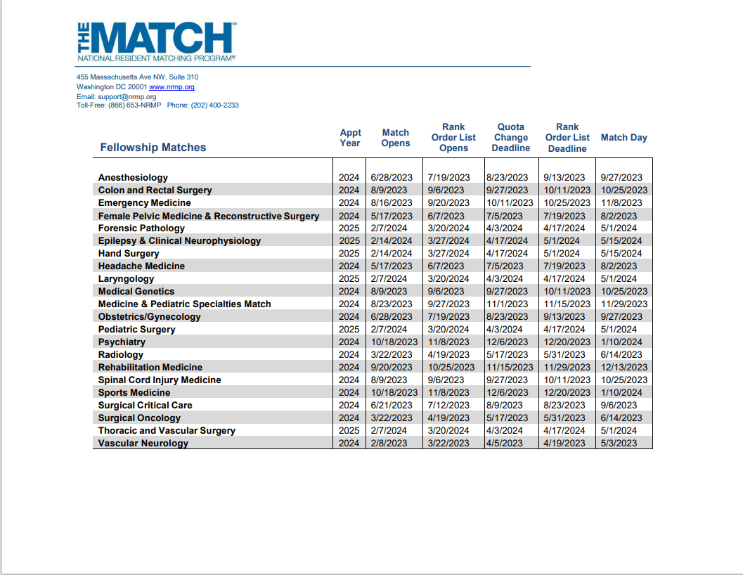
Fellowship Match

Slide 11
Compliance Audit
Returning House Officers: TB
Internal Transfers: 11 incomplete
Incoming House Officer Appointments: 36 incomplete
Exit Packets: 109 missing from 2022-2023
24 missing for 23 AY
Pagers: 40+ pagers assigned to Alumni
https://www.medschool.lsuhsc.edu/medical_education/graduate/pagers/
**need this reconciled asap

Slide 12
Student Loan Deferment
www.studentaid.gov -> Federal Student Aid -> Loan Forgiveness -> Apply for Forgiveness -> PSLF
Application will be routed to HR if they apply online
Manual form- they will need to route to HR

Slide 13
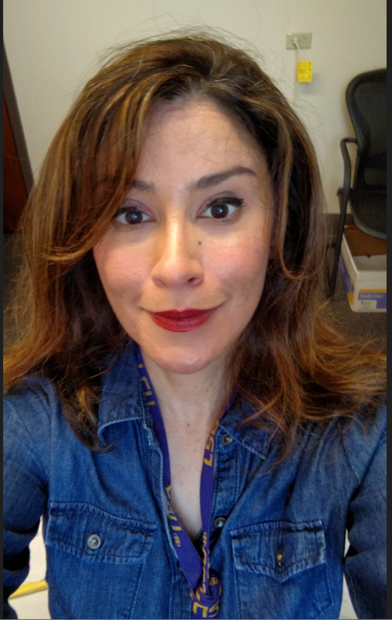
Sherilyn Munoz (smunoz@lsuhsc.edu
**gmecag@lsuhsc.edu

Slide 14
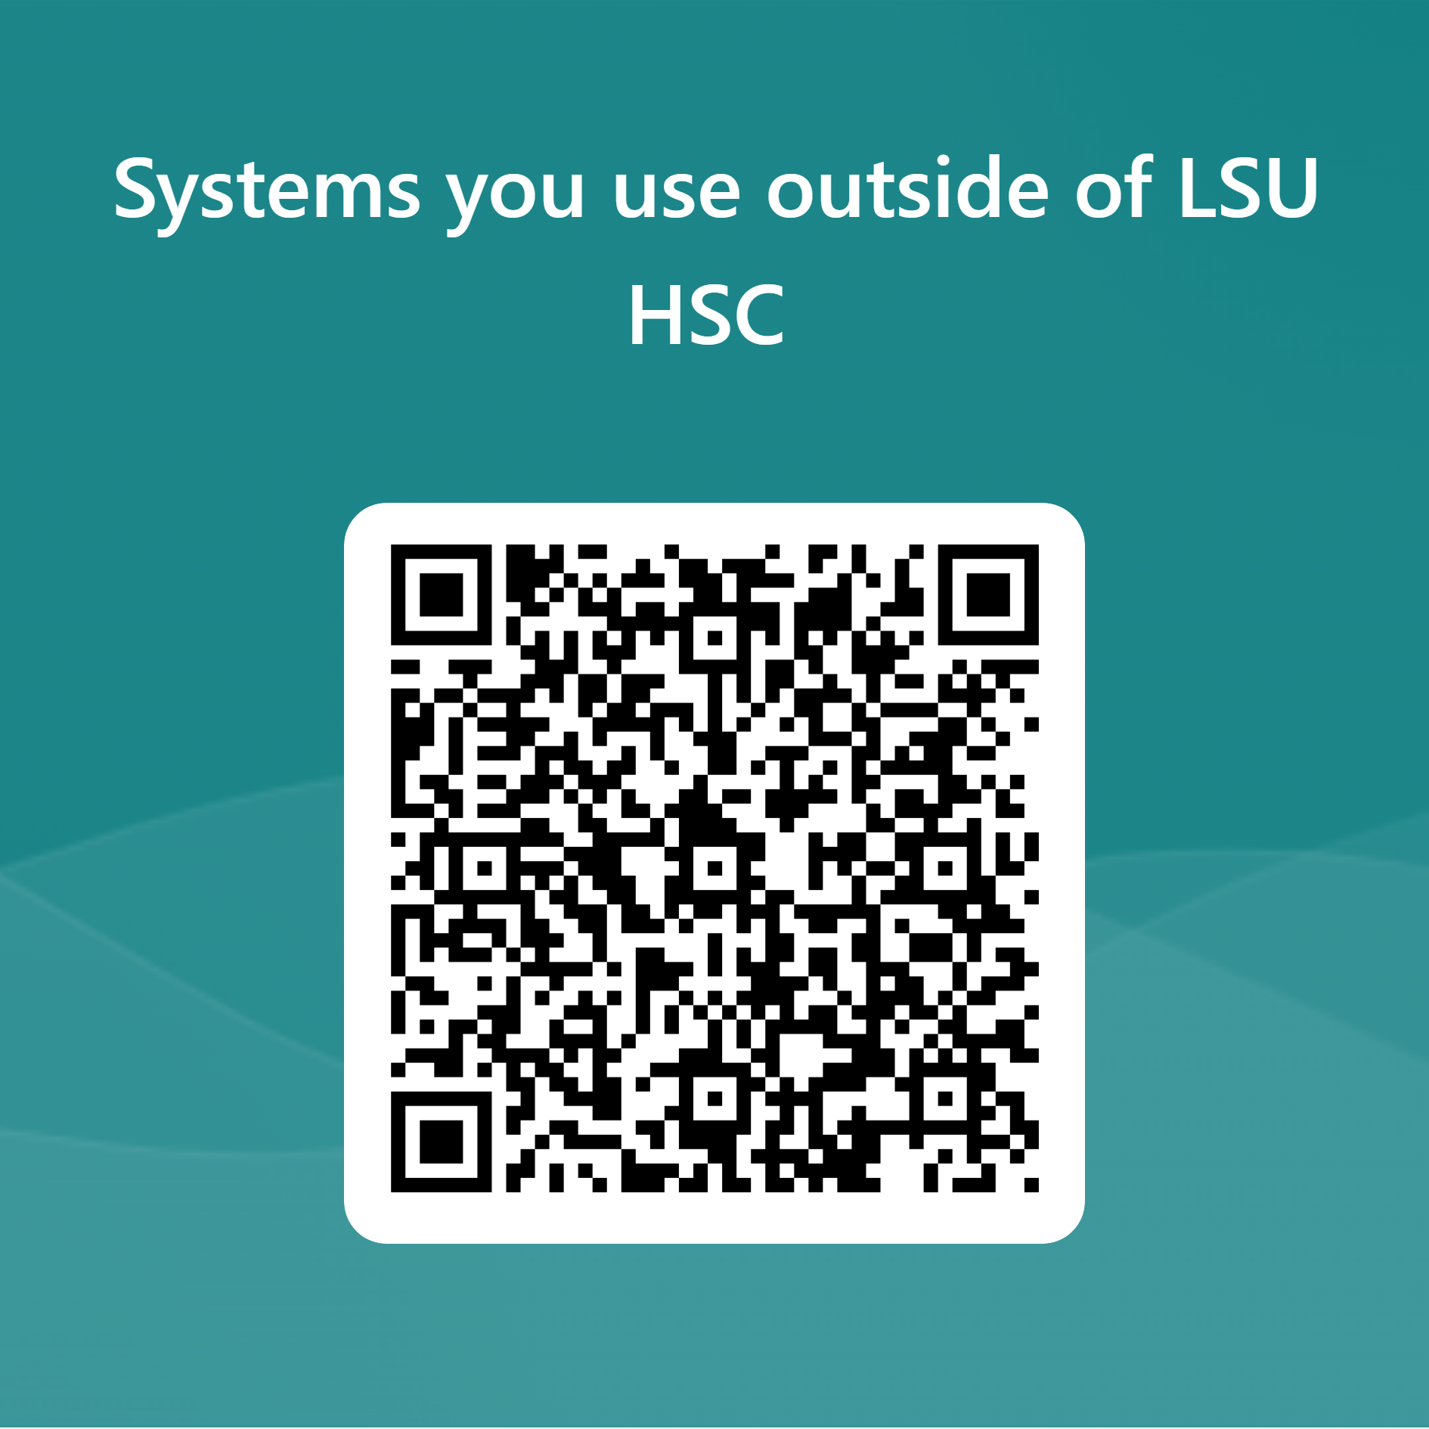
Systems outside LSU
Ex: AMION
Survey

Slide 15
Reminders
BOM/EOM Reports
August EOM Reports and CSOF PER 3s for August are due
August & September BOM Reports are Due
October BOM Reports are Due October 2, 2023
APE Reminder
GME Track Program Survey & Resident Survey
Survey Deadlines:
September 29, 2023 – October FREIDA Upload Deadline
December 15, 2023 – Final Deadline

