Slide 1
Coordinator Meeting
September 20, 2022
CDS/Opioid Training, Flu Season, Records, Interviewing, NRMP Match, AMA Training

Slide 2
CDS/Opioid Training
All Louisiana licensed physicians who prescribe controlled dangerous substances MUST complete a 3 hour LSBME APPROVED CME course prior to their 2023 license or permit renewal as mandated by the State of Louisiana.
These modules have been created by our LSU faculty and affiliates as a convenience to satisfy the training requirements.
LSU GME will include your certificate with your renewal paperwork and forward to the LSBME. LSBME will record that you have satisfied the Louisiana lifetime requirement for this training.

Slide 3
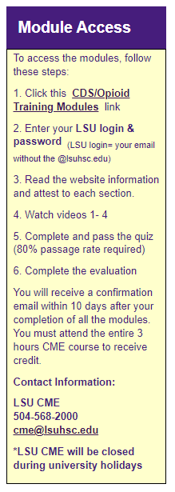
CDS/Opioid Training
Email to House Officers September 21, 2022 with instructions
***November 15, 2022 due date
CME: CDS/Opioids (lsuhsc.edu)
House Officer completes training
Certificates generated by Laura weekly
Sara uploads certificates to GME Resident Files weekly
Tracker updated weekly
Certificates printed and delivered to LSBME with Renewals in January
CME Transcripts

Slide 4
Flu Season
Flu Shot Policy- submit annually an Influenza Attestation Form or submit an Influenza Waiver/Declination Form.
Process:
GME Electronic Document Submission Login (lsuhsc.edu)
GME Process Tracking System: Login (lsuhsc.edu)
Under "Flu Shots"
GME Resident Files

Slide 5
Flu Season
LSU HSC NOLA: LSU Healthcare Network Campus Multispecialty Clinic – 478 S. Johnson Street, New Orleans. LA 70112
Wednesday, September 21st
Thursday September 22nd
UMC:
October 4th, 7th, 25th and 26th in the conference center for 6:30am-8pm all 4 days.
More information on the LCMC Intranet with ReadySet instructions coming
VA:
Walk-ins at the Vaccine Center- 1A 301-302. First floor main hallway next to the PERC (Patient Education Resource Center).
Childrens: walk-ins:
9:30-11am: 9/19/22, 9/20/22, 9/21/22, 9/27/22
7:30-10:30am: 9/28/22
Employee Health will be attending some Resident Conferences to do bulk shots

Slide 6
Request for Authority to Dispose of Records
Why not?
The process is easy
The work has already been done for you
Turn around time is brief
There are many bins around for record disposal
You wont have to pack and unpack it once you’re moved

Slide 7
Request to Dispose of Records Process
Review pages 12-13 (Graduate Education & Employment File Section) of the Records Retention Schedule
Complete Form SSARC-930 – Request for Authority to Dispose of Records
Submit completed form to the Records Officer
Hold documents until approval is received
Place documents in bin or shred them once approved
Complete Form SSARC- 933 – Certificate of Destruction

Slide 8
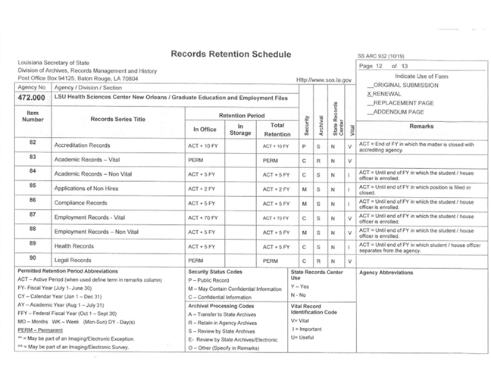
ERAS Records of Non-Hires
Review the Retention Period
Note Record Series Title
Note Item Number
Note page number

Slide 9
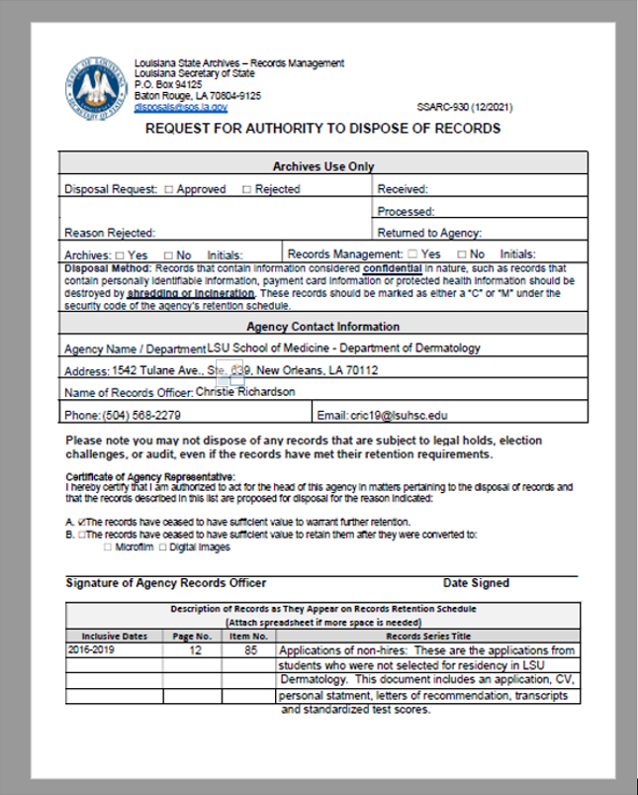
Request for Authority to Dispose of Records
SSARC-930
•Use department name and address under Agency contact name
List Christie Richardson as the Records Officer along with her phone and email
Be sure to check box A or B
Complete the table at the bottom of the page with information noted from schedule and document dates
Submit completed form to Christie Richardson at email address listed on the form
Wait for approval

Slide 10
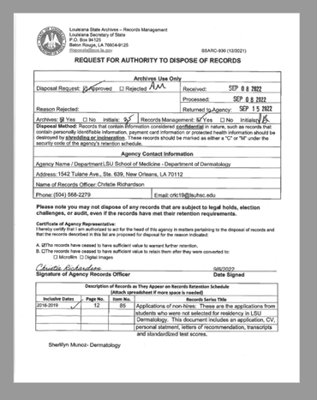
Approved Request
Quick turnaround – only 7 days to receive approved request

Slide 11
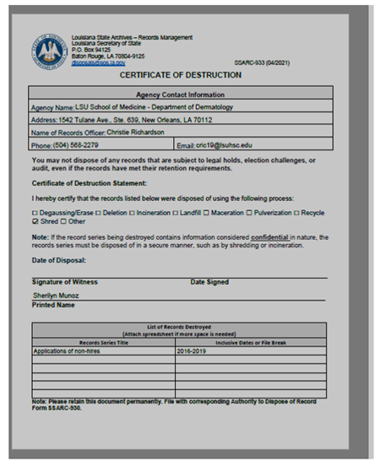
Certificate of Destruction
•If confidential information is being destroyed the only methods of destruction approved are incineration or shredding
•Certificate of Destruction must be retained with approved request
•If using a shredding bin provided by a shredding contractor, documents are considered destroyed once they are placed in the bin

Slide 12
Virtual Interviews Resources Available
The Knowledge Base has resources available to aid you in preparing for Virtual Interviews
This includes information on Pre-Recruitment, Recruitment, Post Recruitment and the Selection Process
House Officer Selection
This includes NRMP Policy links
Interviewee Acknowledgement Form
Feel free to reach out if you have questions about this process for your program.

Slide 13
NRMP Main March Match
Match Opened September 15, 2022
NRMP Hosts Introduction To The 2023 Main Residency Match Webinar For Residency Programs | NRMP with PP slides
Important Dates
September 28, 2022 – Applications available in ERAS system (ERAS system and Match are separate organizations with separate systems)
January 31, 2023 – Quota Change, Withdrawal & SOAP Participation Status Deadline 10:59 pm Central Time
February 1, 2023 – Ranking Opens 11:00 a.m. Central Time
March 1, 2023 – Rank Order List Certification Deadline 8:00 pm Central Time
March 13, 2023- Match Week (all Central Time):
8:30 a.m. Unmatched Applicants report available
9:00 a.m. applicant match status and program fill status available, SOAP begins
10 a.m. SOAP applications can start preparing applications in ERAS

Slide 14
NRMP Main March Match Cont'd
All Match Participants must electronically sign the Match Participation Agreement (MPA)as part of the registration process
Read the Match Participation Agreement
All parties involved in the applicant interview, selection, decision making, and Match process must be familiar with the Match Participation Agreement
Two new Match Policies
Interview Period Policy
Three-Year Medical Education Curriculum Policy
Review the rules governing the Matching Process - Important Policies to Review: All Parties involved in the applicant interview, selection, decision making, and Match process must be familiar with these and all Match Policies.
Code of Conduct
All-In Policy
Restrictions on Persuasion
Provide applicants with complete, timely, accurate information (Contract they will sign, pre-employment drug screening and background Check, VISA Status-J1 Sponsored by ECFMG, LSU GME Applicant Selection Sheet, LSU GME signed Acknowledgement form)
Applicant Match History
Determine whether an applicant is eligible for appointment prior to offering interviews or tf they have a waiver/violation history
Senior Students and applicants who have not participated in an NRMP Match will not appear in search results
Ensure program director/coordinator and public contact information is updated: address, email, website
Program information rolls over from the previous Match
Quota information rolls over from the previous Match
Reversions DO NOT roll over from the previous Match, it must be set every year
Program Director can set SOAP Participation indicator
There are Video resources and support guides on the NRMP website and the NRMP staff are also available to assist and answer questions

Slide 15
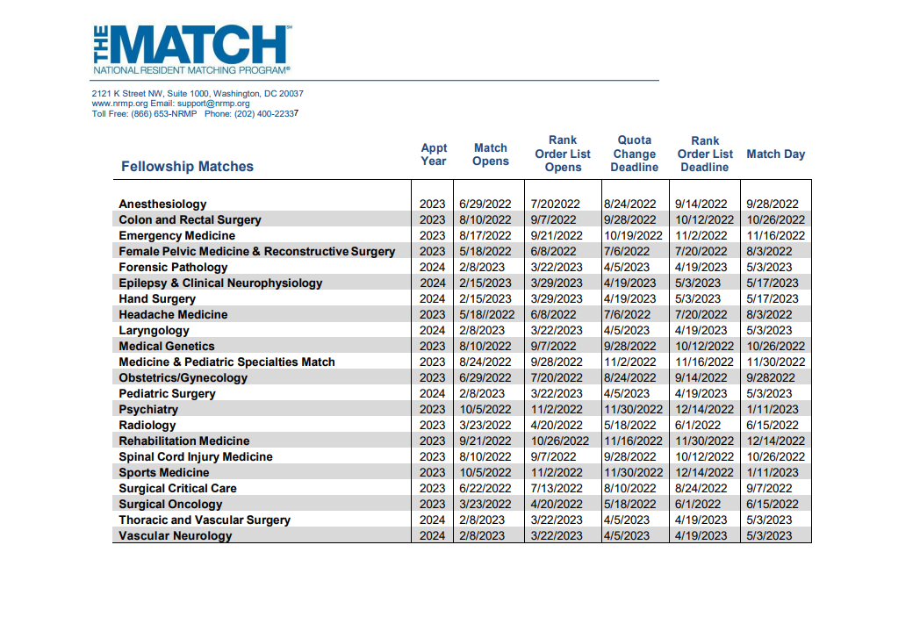
Fellowship Calendar

Slide 16
AMA Training
Dustin and Nicholas will be giving an AMA Training on Thursday, November 3, at 10 am. Be looking for an invite soon!
If there is something specific you would like for them to go over, please forward your request to Julie at jcain2@lsuhsc.edu by Friday, Sept. 30th.
**2 Modules have been added to all residents/fellows
Basics of Health Equity for GME
Racism in Medicine: An Introduction

Slide 17
Work Hours
The GME office is continuing to monitor Work Hours. Please check your program for:
*All residents/fellows logging hours
*Hours up-to-date (within 1-2 weeks)
*Schedules input into New Innovations
*Violations
Reports that can help you monitor
New Innovations Work Hours (Dashboard)
OR
Duty Hour Monitoring
Questions can be directed to Julie – jcain2@lsuhsc.edu

Slide 18
Reminders
LCMCAcademicAffairs@lcmchealth.org has officially replaced UMCAdacemicAffairs@lcmchealth.org
Exit Packets- 100+ outstanding
BOM/EOM Reports
August EOM Reports and CSOF PER 3s for August are due
August & September BOM Reports are Due
October BOM Reports are Due October 3, 2022
GME Track Program Survey & Resident Survey
Survey Deadlines:
September 30, 2022 – October FREIDA Upload Deadline
December 16, 2022 – Final Deadline

