Slide 1
Program Coordinator Meeting
March 26, 2024

Slide 2
Drug Testing
Scott Embley, CAP
Background check emails on April 15th

Slide 3
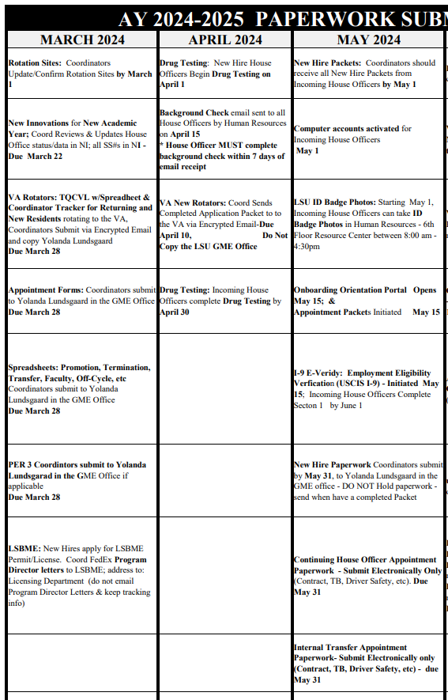
Past Due:
Rotation Site (missing Neurosurgery, EM Hyperbaric, and Interventional Radiology
NI Data
Due this week: Appointment forms, Spreadsheets to Yolanda, PER3
House Officers can apply for you NPI and Medical License/permit
Upcoming:
Drug testing and background tests
VA New Rotator Applications
New Hire Paperwork

Slide 4
ECFMG - TPL Educational Commission for Foreign Medical Graduates (ECFMG) Training Program Liaison with J-1 Physicians in training program
If the Program Matched or accepted an Applicant that will have a J-1 Visa sponsored by ECFMG:
The Program Coordinator must be added as a TPL with ECFMG. If the Program Coordinator is not already a TPL with ECFMG, contact Yolanda Lundsgaard in the GME Office
The TPL is responsible for coordinating the sponsorship application process on behalf of the TPL's Institution with both prospective & current J-1 physicians.
The TPL works with both ECFMG and J-1 physicians to ensure that the host training site and its J-1 trainees are in compliance with federal requirements for participation
TPL Roles & Responsibilities https://www.ecfmg.org/evsp/roles.html

Slide 5
New Hire Paperwork
New Hire Checklist and login information for incoming House Officers available in the AY Forms system.
***Per2 not available - TBD
New Hire Forms are available today, Tuesday, March 26
Appointment "Packets" will be initiated from GME to House Officer Email in May
TB test (April-TBD), Moonlighting, Immunization Records, COVID/Immunization Release, etc.
GME Process Tracker

Slide 6
New Hire Paperwork
Changes for 2023-2024 Academic Year Onboarding
Updated New Hire Checklist with 2 new HR forms
TB listed as annual. TB testing only required for incoming now by LCMC. Returning will need to do an annual "questionnaire" as part of LCMC Epic training.

Slide 7
New Hire Packet
Sample completed packet available in the Knowledge Base (updated for 2024-2025 AY onboarding) Sample New Hire Packet - New Hires - GME Knowledge Base (atlassian.net)
Incoming House Officers submit the completed and signed New Hire Paperwork Packet to their Program Coordinator by May 1, 2024

Slide 8
New Hire Packet
Coordinator reviews the New Hire Packet Received
Print the New Hire Check List for each New Hire Packet Received
Print the PER 2 for each New Hire Packet received (the Original page only)
Check that all forms listed under the New Hire Packet section on the Checklist are included and signed where noted
Electronic Signatures are NOT Accepted
GME Data Sheet must account for all time from Medical School Graduation through the start date of the LSU Training Program, with no gaps longer than 1 month – Very Important.
Tax forms must be completed and signed – wet signature
Social Security Card must be signed (wet signature), by the Incoming House Officer and a readable color copy must be included.
Out-of-Country Incoming House Officers that don't have a Social Security Card, must submit the Letter/Receipt they received from the Social Security Office when they applied
This Letter/Receipt must be included in the New Hire Packet
Once they receive their Social Security Card, a Color copy must be sent to the GME office and to Human Resources
Incoming House Officers will have to resubmit, to Program Coordinator, any forms that are not included in the Packet; any forms that are incomplete; and any forms that do not have a wet signature (electronic signatures not accepted)

Slide 9
New Hire Packet
Program Coordinators send the reviewed, completed, and signed New Hire Packet to the Yolanda Lundsgaard in the GME Office before or by May 31, 2024
Tape any Voided Checks to the separate "Direct Deposit Cancelled Check" page (if not taped) - Do not paperclip or staple to the Direct Deposit Form. A Completed bank direct deposit form is accepted in lieu of a voided check.
Do Not Hold completed packets, send packets to the GME office once the packet is completed – DO NOT wait until the last week or last day in May to send multiple packets.

Slide 10
Internal Transfer and Faculty Becoming House Officer Check Lists
Internal Transfer Check List
Faculty Becoming House Officer Checklist
24-25 Changes:
Physical Checklists not required to GME- checklists will serve as a guide
All items will be on the Tracker (GME Data Sheet, DS2019, LSBME Release, contracts, etc. etc.)
Submit GME Data Sheets and DS2019 (if applicable) on GME Electronic Document Submission
**DS 2019 required for all J-1 Visa's- being assigned in the Tracker
**GME Data Sheets missing being assigned in the Tracker

Slide 11
New Hire Paperwork – Site Onboarding
Updated packets still needed by GME:
Baton Rouge General
Our Lady of the Angels
Women’s

Slide 12
New Hire Paperwork – Site Onboarding
No physical packets needed for:
VA
Ochsner
Lafayette General / UHC (Ochsner)
Our Lady of the Lake
LCMC
UMC New Orleans
Children’s Hospital
East Jefferson
West Jefferson
Touro

Slide 13
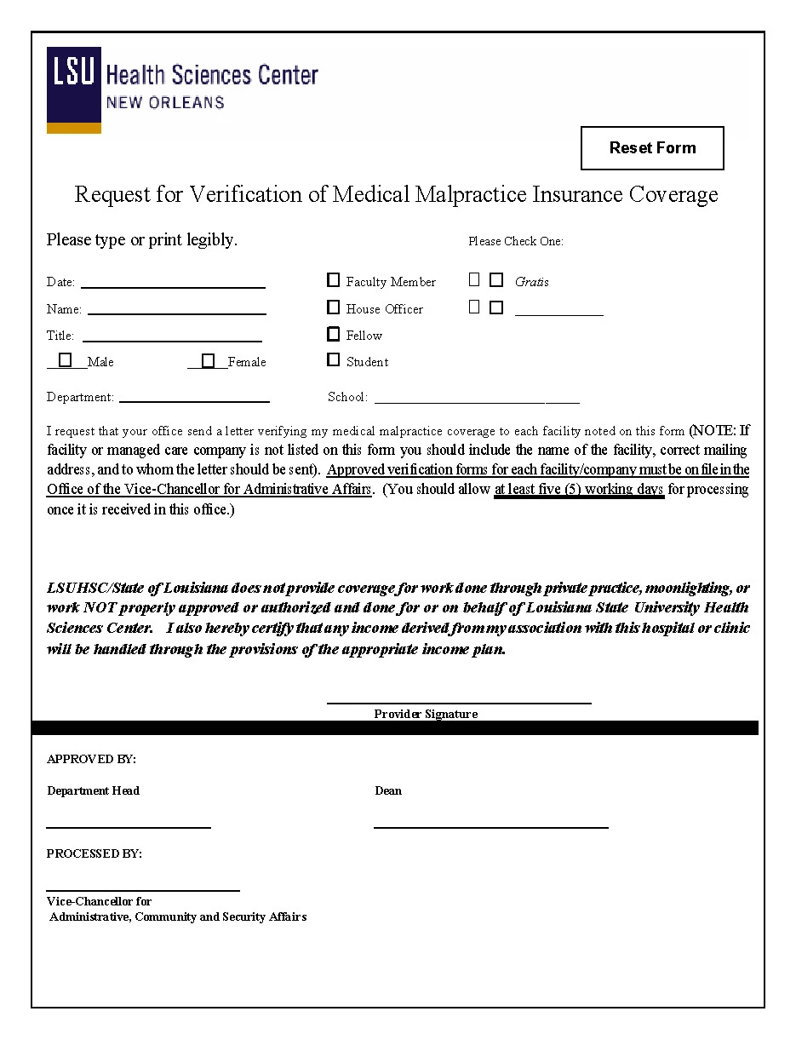
Malpractice Coverage
Due to Cynthia Scott April 1:
Malpractice Form - Forms & Documents - GME Knowledge Base (atlassian.net)
Cover sheet only
Name: Program Name
AY Forms - Malpractice Spreadsheet
Excel spreadsheet of a COMPLETE listing of all sites your house officers will rotate at for 23-24 AY.

Slide 14
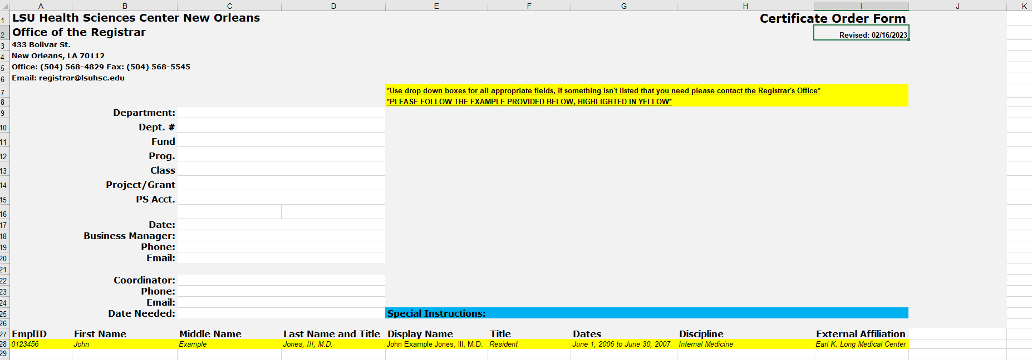
Diplomas
For guaranteed release in May 2024, certificate orders can be emailed immediately to registrar@lsuhsc.edu. Please include Certificate Order and your department on the subject line of the email. The coordinator and business manager will receive an email informing them when the order is ready along with the IT form for the transaction. Certificates cannot be released until the signed IT form is returned to the Registrar’s Office. The IT form may be returned by email, campus mail or in person.
Certificate requests will be processed in the order in which they are received. The timeframe for processing is 3 to 4 weeks. Orders received after April 28, 2024 will not be processed until May 30, 2024.
Certificate Order Form 2024

Slide 15
Leave: FMLA/ACGME & PM-20 Parental Care Leave
Reminder to please reach out to Yolanda and Mark Gele with leave questions. Every scenario is different!!!
PM-20 Revision to include Parental Care Leave – Parental Leave under PM-20 does not apply to House Officers. It only applies to employees in leave earning positions.

Slide 16
Confirm Site Directors
We need updated Site Director information for Supervisor/Liaison surveys
Confirm information here — LSUHSC Site Directors.xlsx
Reach out to Savannah (sthib6@lsuhsc.edu) with questions

Slide 17
BLS/ACLS/PALS
What does your specialty require?

Slide 18
Orientation/Onboarding
LSUHSC:
Orientation: May 15-16th virtual
Onboarding: June 24/25
LCMC: June 26 pick up
OLOL: June 26
Ochsner Kenner:
Orientation June 20th via Zoom

Slide 19
LCMC Onboarding Information
LCMC Pick Up Day is June 26th.
ID Badge Photo Submission – Incoming Residents/Fellows MUST submit this form and professional photo meeting all specifications by Wednesday, May 1st. Any forms and photos received after this date run the risk of delayed ID Badge printing and available pick-up, in time for the first LCMC rotation. https://lcmchealth-drshh.formstack.com/forms/lcmc_24_25_incoming_learner_photo
Complimentary Scrubs – Size Order Form – Scrub Size Request Form MUST be submitted by Wednesday, May 1st. Failure to do so may result in a resident not receiving free scrubs on pick-up days or not having access to their necessary size.
LCMC provides (2) free sets of scrubs to new Residents/Fellows at the start of the academic year. The Linen order for these scrubs must be made several week in advance of Resident Pick-up Days.
https://lcmchealth-drshh.formstack.com/forms/lcmc_24_25_incoming_scrub_order_form

Slide 20
New Coordinator Meetup Thursday
Topics:
Continuing house officer appointments: How to use the Tracker
New Hire Packets demonstration
Drug Testing walk through
General New Hire questions

Slide 21
Spring Training Calendar
May 22, 2024, 10am-12pm: HR I-9 walk through
June18th : Wellness Retreat!!!
June: Block Scheduling meet ups
TBD

Slide 22
External Trainings
NI: Insights from ACGME 2024: March 28 Registration
NSAMA New and Advanced Program Administrator Training Courses:
Learn More
Starts 4/16/24 for $199

