Slide 1
Program Coordinator Meeting
March 5, 2024

Slide 2
NRMP 2024 Main March Match & SOAP
March 1, 2024 – Email from the NRMP to Register to Join the Match & SOAP Match Week Listserv
March 11, 2024 9:00 a.m. CT​
Match & SOAP Week Schedule: https://www.nrmp.org/wp-content/uploads/2023/06/2024-Match-Week-and-SOAP-Schedule.pdf​
SOAP Begins ​
Did My Program Fill – Notified by Email and R3 System​
March 14, 2024 ​
7:55 a.m. - 8:00 p.m. CT: SOAP Rounds 1 – 4 ​
1:00 p.m. CT: Program Confidential Roster of Matched Applicants available (by email & R3 system)​
Match Day: March 15, 2024 11:00 a.m. CT​
Students Receive Email from NRMP ​
LSU Match Day event is limited to students and families only. LSU Students will connect with their LSU Match Program after Match week.​
Programs CANNOT Contact Matched Applicants until after 11:00 a.m. CT on
March 15, 2024​

Slide 3
Resources for you Incoming House Officers!
House Officer Guide to Onboarding (thanks Kat)!
House Officer Onboarding Calendar
2024 Actions for Incoming House Officers
^{KB page with PDF}

Slide 4
APPOINTMENT FORM & SPREADSHEETS
Appointment Form & Spreadsheets are due to Yolanda Lundsgaard by March 28, 2024
House Officer Data is Auto-Populated into the Appointment Form and into the Spreadsheets from New Innovations
•Appointment Form and Spreadsheets are downloaded here: AY Forms
Appointment Form – Lists All House Officers in the Program for the Academic Year
•Spreadsheets lists House officers and Action
Promotion
Off-Cycle/Exception
Transfers
Internal Transfers – Transferring from an LSU residency/fellowship to another LSU residency/fellowship
External Transfers – are New Hires and include residents at LSU Shreveport.
Terminations
House Officers not completing the Residency Program require an electronic PER 3 to terminate; reason is voluntary termination.
Other Spreadsheet – Available in KB to download, not in the Academic Year Appointment Form (AY Forms) System
House Officers Becoming Faculty- Includes Chief Residents appointed as Faculty.

Slide 5
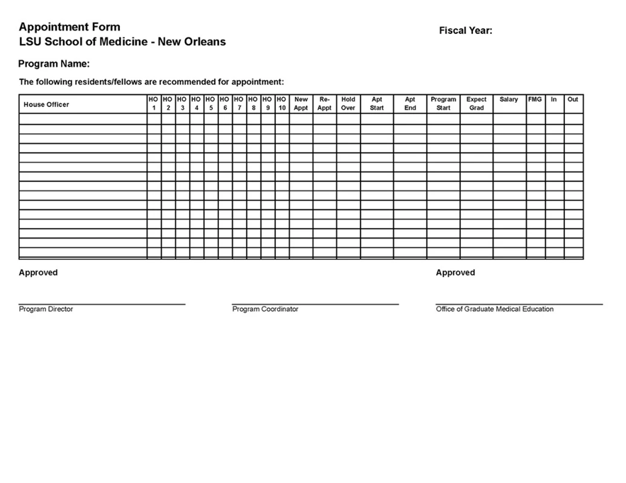
Appointment Form Appointment Form is Due to Yolanda Lundsgaard by March 28, 2024
AY Forms
House Officer Training Record is correct in New Innovations
The Appointment Form Lists All the House Officers in the Training Program any time between July 1 & June 30 for the Academic Year
Print in Landscape Format ONLY

Slide 6
Appointment Form Cont'd
Appointment form MUST:
Include House Officers Starting Promoting, and Terminating Off-Cycle ( Off-cycle includes House Officers starting after July 1, and House Officers not Terminating June 30)
Include first year residents/fellows and all House Officers appointed through a Match and appointed outside a Match
Print in Landscape Format. Forms submitted in Portrait format are not accepted.
House Officers continuing in the same program July 1 – June 30 will have status of 'Re-Appointment' on the Form
Incoming House Officers, and Transfers from another LSU program will have status of 'New Appt' on the Form
House Officers that are NOT Promoting July 1, will be listed twice on the form Once with current HO level & status will have 'Hold-Over' with the dates at that HO level; and on the next line with the promoted HO level & status will have 'Re-Appointment' with the dates at that HO level
Review the Appointment form and confirm all the information is correct
Download, Print, Sign and Submit the signed Appointment Form to Yolanda Lundsgaard in the GME Office by the due date.
If there are changes, anytime during the Academic Year, to a Program's Roster of House Officers, or changes to a House Officer's training dates, New Innovations must be updated. Contact Natalie or Chris to update the House Officer's Training Record. Once NI has been updated, the next day, download the form, sign the form, and send the updated and signed appointment form to Yolanda Lundsgaard in the GME Office

Slide 7
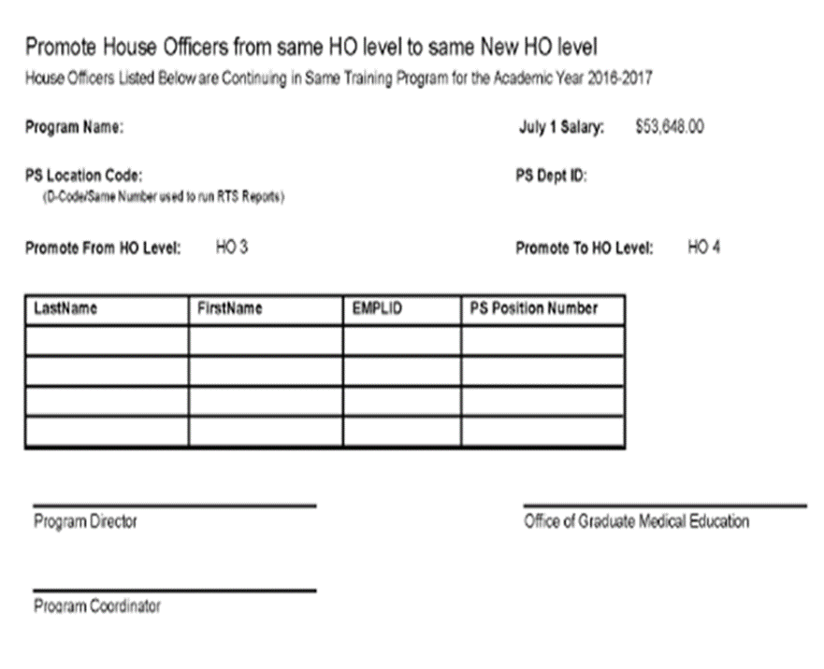
Promotion Spreadsheet
Promotion Spreadsheet is Due to Yolanda Lundsgaard by March 28, 2024
AY Forms
House Officer Training Record is Correct in New Innovations
The Promotion Spreadsheet is used to check that all House Officers promoting July 1 from one House officer Level to the Next House Officer Level are included in the PS automated Promotion Process
Print Spreadsheet in Portrait Format ONLY

Slide 8
Promotion Spreadsheet Cont'd
Includes All House Officers promoting from their current House Officer Level to the Next House Officer level.
Each Promotion level is listed on a separate page
House Officers that Don't Promote July 1, will not be included on the Promotion Spreadsheet
July 1 Promotions for All House Officer Levels 1 – 6 will be completed automatically in the PS Automated Promotion Process, only if they are included on the Promotion Spreadsheet. No Paper PER 3 is needed for July 1 Promotions.
Gratis House Officers (House Officer paid by the Military):
Gratis House Officers that promote July 1, will not appear on the Promotion Spreadsheet, they will appear on the Exception List with the July 1 promotion date and House Officer Level
A paper PER 3 is required to promote a Gratis House Officer. They cannot be included in the automated promotion process for July 1 due to their Gratis Status.
Review the spreadsheet and confirm that the House Officers listed on the Promotion Spreadsheet will promote July 1
Download, Print, Sign and Submit the signed Promotion Spreadsheet to Yolanda Lundsgaard by the due date.
If a House Officer is listed on the Promotion spreadsheet, but should not promote July 1, and the Automated Promotion Process has been completed, a PER 3 will be required 3 to correct the error. Contact Yolanda Lundsgaard in the GME Office.
Do Not sign and send a black spreadsheet. If there are no House Officer Promoting to the next level, no spreadsheet is needed.

Slide 9
Off-Cycle Spreadsheet Off-Cycle & Exceptions Tab Off-Cycle & Exceptions Spreadsheet is Due to Yolanda Lundsgaard by March 28, 2024
AY Forms
The Off-Cycle & Exceptions tab will show all House Officers who are Off-Cycle or need to be manually promoted/transferred/terminated.
Print this page in Landscape Format.

Slide 10
Off-Cycle & Exceptions Tab Cont'd
House Officers that will be listed when the Off-Cycle & Exceptions Tab is select are:
House Officers Promoting Off-cycle (do not Promote July 1)
House Officers Terminating Off-Cycle (do not terminate June 30)
House Officers Transferring Without Promoting (House Officer level remains the same or changes to a lower House Officer level)
House Officers Graduating without Termination (becoming Faculty appointed Chief Resident or other Faculty appointment).
The Off-Cycle Spreadsheet is not a downloadable Spreadsheet like the Promotion and Termination Spreadsheet. It is a list of the House Officers in the Program that fit one of the criteria above
Print the list of off-cycle House Officers that is generated in Landscape Format, sign, and submit the List to Yolanda Lundsgaard, in the GME Office, by the due date.
If there are no off-cycle House Officers in the program, no spreadsheet/list is needed.

Slide 11
Off-Cycle & Exceptions Cont'd
Contracts for Off-Cycle House Officers Must match the training dates for each house Officer level he/she will be during their training time
Paper PER 3s are Required for these Off-Cycle House Officers:
House Officers Promoting Off-Cycle (not promoting July 1)
House Officers Transferring and Promoting, or Transferring and Not Promoting Off-cycle (Action is not for July 1)
Electronic PER 3s for House Officers Terminating Off-Cycle:
Request Department/Section Business Manager Submit an Electronic PER 3 in the PS HCM Production Database
If the House Officer is resigning his/her position, a Resignation letter must be attached to the electronic PER 3.
All PER 3s for Off-Cycle House Officers MUST be submitted at least ONE MONTH before their Off-Cycle Promotion, Transfer or Termination Date (Includes Paper & Electronic PER 3s)

Slide 12
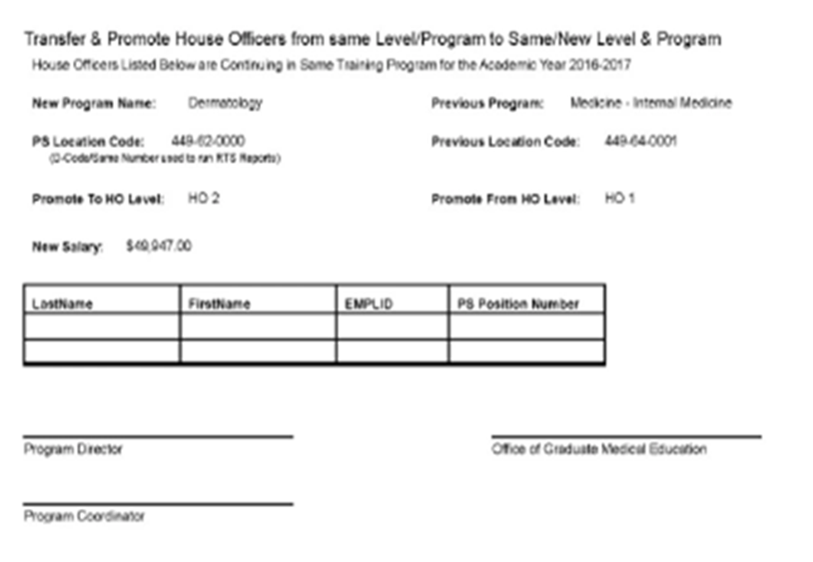
Transfer Spreadsheet – Internal Transfers Transfer Spreadsheet is Due to Yolanda Lundsgaard by March 28, 2024
AY Forms
House Officer Training record is correct in New Innovations
Transfer Spreadsheet includes All House Officers Transferring from one LSU Program to another LSU Program, with or without promotion on July 1
Only Transfers INTO your program are shown
Print Spreadsheet in Portrait Format ONLY

Slide 13
Transfer Spreadsheet Cont'd
Internal Transfers include House Officers in Programs in New Orleans, Baton Rouge, Bogalusa, Lafayette, and Lake Charles
House Officer Transfers not effective July 1, Require a paper PER 3 to Transfer and Promote or Change Title
Paper PER 3s MUST be submitted to Yolanda Lundsgaard at least ONE MONTH prior to Transfer and/or Promotion Date
Internal Transfer Check list is found in Knowledge Base
Do Not download, sign and send a blank spreadsheet. If there are no House Officers transferring to the program, no spreadsheet is needed.

Slide 14
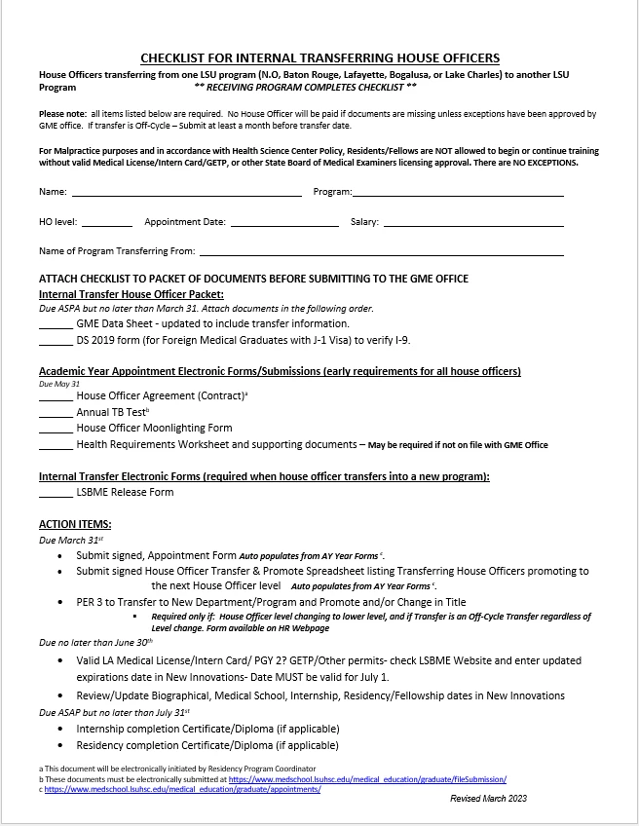
Internal Transfer Checklist
Internal Transfer Checklist - Knowledge Base
Due May 31, 2024
The Training Program the House Officer is transferring into is responsible for submitting the transfer paperwork

Slide 15
External Transfers
External Transfers Include:
Applicants transferring from a non-LSU Training Program into an LSU Training Program
Applicants that did not Match into a Training Program during a Match or Soap Process.
An External Transfer, that has previous residency/fellowship training could be entering into the same Specialty or into a different specialty
The DIO Transfer Packet Must be completed for External Transfers. The DIO Transfer Packet and Form to release information to LSU is found in Knowledge Base
https://lsugme.atlassian.net/wiki/spaces/FORMDOCS/pages/37191681/DIO+Transfer+Approval+Packet
If a Program Director is interested in an external transfer applicant: Contact Dr. Becky Frey, Yolanda Lundsgaard or Dr. Engel before downloading the DIO Transfer Packet and "Release of Information to LSU" form. Requests for an Exceptional Candidate must be discussed with Dr. Frey.
External Transfer Applicants must sign and give to the LSU program Director or Program Coordinator, the 'Release of information to LSU' form for each contact that the LSU program Director will reach out to and request the applicants training record. The form is found in Knowledge Base; https://lsugme.atlassian.net/wiki/spaces/FORMDOCS/pages/2031726/Release+Data+To+LSU+Form
The Completed DIO Transfer Packet is Submitted to the GME Office for Review (submit to Dr. Becky Frey and Yolanda Lundsgaard)
Programs Cannot offer the position to an External Transfer until Dr. Engel has approved the DIO Transfer Packet
Once Approved, the GME Office will notify the Program Director and Program Coordinator, and then an offer letter can be sent to the Applicant. Exceptional Candidate Applicants must also be approved by GMEC and the Partner Hospitals.

Slide 16
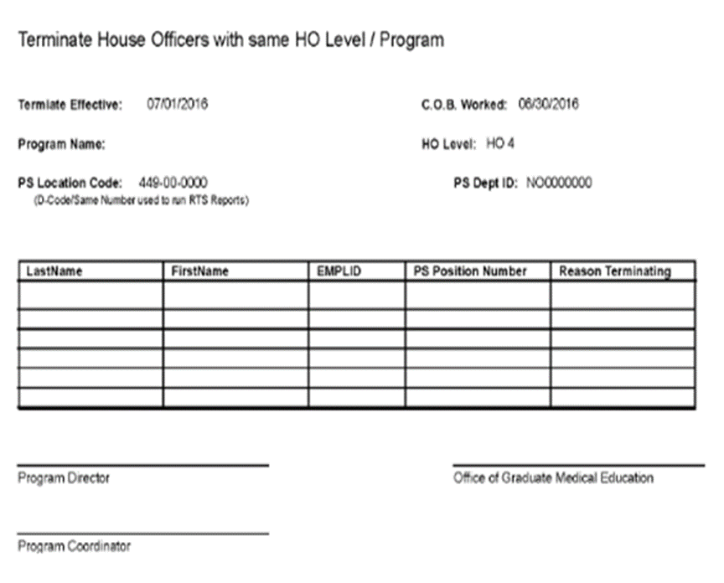
Termination Spreadsheet Due to Yolanda March 28. 2024
AY Forms
House Officer Training record is correct in New Innovations
The Termination Spreadsheet is used to check that all House Officers Terminating June 30 are included in the PS automated Termination Process
Print Spreadsheet in Portrait Format ONLY

Slide 17
House Officers Becoming Faculty Spreadsheet House Officer Becoming Faculty Spreadsheet is Due to Yolanda Lundsgaard by March 28, 2024
KB Page- House Officers becoming Faculty Spreadsheet
Coordinator Completes the Spreadsheet found in the Link above in Knowledge Base 'House Officers Becoming Faculty Spreadsheet‘
Training Record in New Innovations should reflect outgoing status of “Faculty”. Contact Natalie or Chris to set this up.
House Officers Becoming Faculty are also included on the Termination Spreadsheet.
Termination Reason on Termination Spreadsheet MUST be: 'Graduated Con't as Faculty' (populates on the spreadsheet when the status in New Innovations is updated correctly)
House Officers becoming faculty will be included in the Do Not Promote list in PS, so they do not promote before the faculty appointment paperwork is processed, (names entered in PS by Yolanda Lundsgaard in the GME office)

Slide 18
House Officers Becoming Faculty Cont'd
Business Manger submits an electronic Termination PER 3 to terminate the House Officer appointment
Electronic PER 3 must note that the House Officer will be re-hired as faculty and the date if known.
Business Managers submit Faculty appointment paperwork to the School of Medicine Dean's Office
House Office should contact the LSU Benefits department to confirm benefits will continue with No break in service
Notify Brenda Galle, BGalle@lsuhsc.edu, of the Faculty Appointment. Between June 1 – 14, 2024, send Brenda a copy of the completed House Officer Becoming Faculty Spreadsheet. Include in the notification that these house officers will become faculty and to keep their Email account activated so they can continue to receive Emails and have Emails received during their residency/fellowship training available
Faculty Appointment dates can be delayed due to approval of Hospital Credentialing Packets and Dean's Office approval. If this happens, the House Officer can have a break in service which will affect Email access and benefits.

Slide 19
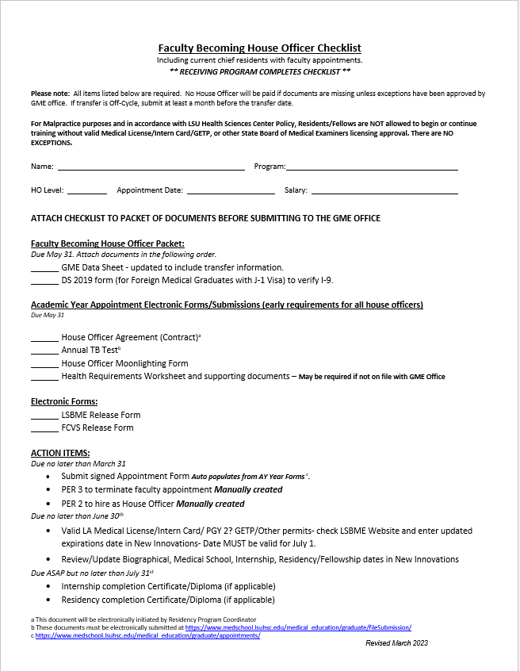
Faculty Becoming House Officers
Faculty Becoming House Officers - Knowledge Base
A Physician with a Faculty Appointment going into a residency or fellowship program
LSU Chief Resident with a faculty appointment entering a Fellowship Training Program
An LSU Physician with a Faculty appointment entering a Fellowship Training program
There is NO Spreadsheet that auto-populates the data for LSU Faculty becoming House Officers
Paperwork needed is listed on the 'Faculty Becoming House Officer Checklist

Slide 20
GME Rotation Sites
Programs Not Confirmed as of yesterday
Body Imaging MRI
Child Psychiatry - Baton Rouge
Emergency Medicine – Hyperbaric
Family Medicine – Kenner
Hospice and Palliative Medicine - BR
Internal Medicine / Emergency Medicine
Internal Medicine / Pediatrics
Musculoskeletal Radiology
Neuroradiology
Neurosurgery
Orthopaedic Surgery
Pediatric Rehabilitation Medicine
Physical Medicine & Rehabilitation
Physical Medicine & Rehabilitation - Pain Med
Plastic Surgery – Integrated
Plastic Surgery – Microsurgery
Radiology Interventional
Urology
GME Rotation Sites

Slide 21
Reminders
**SSN due March 22nd in NI
Payroll Lockout is Monday, March 11, 2024 for March 1-15
Check Un-assigned/Under Assigned
March BOM Reports are due NOW !
February EOM Reports are due March 7, 2024
Mark matched residents as "Will Start" in ERAS by noon on 3/15
Malpractice Form Revised on the KB
Transferring Applicant Information/NI with SSN due March 22nd
Academic Year 2024-2025 Paperwork Time-Line.pdf – one edit (BR date change)
VA Returning packets past due
VA TQCVL & Coordinator Tracker due March 28, 2024
VA New Rotator Application information has been added to VA Onboarding in KB

Slide 22
Orientation Dates
LSU-NO: June 24 and June 25
LCMC: June 26 pick-up. Online modules required. Virtual Orientation sessions available TBD.
LSU-BR: June 26**
EPIC Training for LCMC: Virtual. Online modules required.

