Slide 1
Coordinator Meeting
January 18, 2024

Slide 2
ACGME Letters
Dr. Frey

Slide 3
LSBME Permit Renewals
Permit Renewal Instructions
Download and print the LSBME Permit Renewal Spreadsheet and Program Director Letters here: AY Year Forms
Submit the LSBME Permit Renewal Spreadsheet & Program Director Letters to Yolanda by Tuesday, January 30, 2024 or February 27, 2024 (if opting for GME to mail your renewal packets).
***LSBME requires wet/original signatures.
CDS/Opioid Certificates added by GME or downloaded here: GME Resident Files (if opting to submit packets yourself).
***Mailing Dates: January 31th & February 28th

Slide 4
LSBME Permit Renewal Cont.
LSBME will invoice directly to house officer's LSU email
***invoices payable on the LSBME website LaMed Dashboard
Step 3 scores: House Officer MUST have their Step 3 scores sent to the LSBME from FSMB or NBOME. If this was not done, they should contact FSMB or NBOME and have the transcript sent directly to LSBME
This process is for Permit Renewals, for Full License Renewals refer to the LSBME website, check LaMed Dashboard and/or contact LSBME License Analyst.

Slide 5
NRMP
NRMP Educational Webinars:
Policy Updates for Fellowship Programs - Recording available from Dec 12, 2023
The Main Residency Match Ranking Webinar for Programs – January 23, 2024
Introduction to the Fellowship Match Webinar – February 6, 2024
NRMP Jan. 2024 Illuminator
Important NRMP March Main Match Dates:
January 31, 2024 - 10:59 pm CT: Quota Change, SOAP Participation, Program Withdraw Deadline
February 1, 2024 - 11:00 am CT: Ranking Opens
February 28, 2024 – 8:00 pm CT:
Rank Order List Certification Deadline
Enter Program Reversion Deadline
Institutional Official Approve Program Changes Deadline

Slide 6
Resident Scheduler
Report DUE Dates:
EOM Report:
December EOM Report: PAST DUE – submit by Friday, January 19, 2024
January EOM Report: DUE February 6, 2024, along with any CSOFs if needed
BOM Report
January BOM Report: PAST DUE – Submit by Friday, January 19, 2024
February BOM Report: DUE February 1, 2024– submit by the due date
Quarterly Review of Reports
Send missing House Officer responses not included when Reports submitted between July 2023– December 2023
Review House Officer Leave: check if leave is entered correctly in Resident Scheduler for October 2023 – December 20223

Slide 7
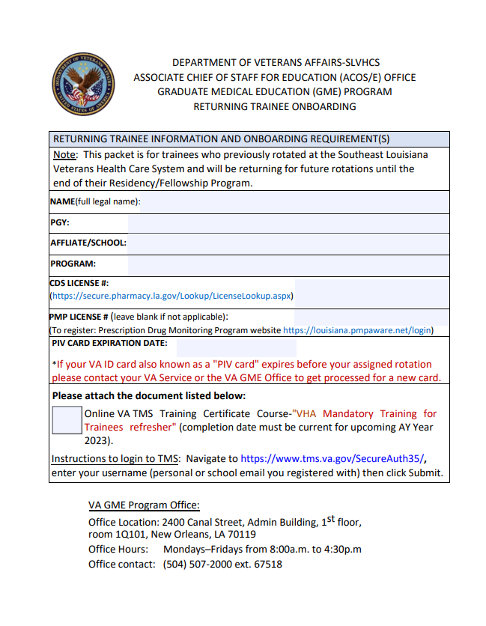
VA updates
How to Submit paperwork to the VA:
VA Onboarding Process Instructions
Returning House Officer Packets:
VA 24-25 Hiring Instructions
Sending Encrypted Emails
Cruz, Crystal (NOLA) Crystal.Cruz2@va.gov , pending VA distribution list.
TQCVL & Coordinator Spreadsheets:
Academic Year Forms (lsuhsc.edu)
New Hire Application Packets- electronically completed via email
Due Dates:
Feb. 29- Returning House Officer Packets
Mar. 28- TQCVL with Spreadsheet & Coordinator Tracker
Apr. 10- New Rotator Application Packets

Slide 8
Upcoming Dates
January 18th-CORE
Jan. 31, 2024 - NRMP: Main March Match Quota Change, SOAP Participation indicator confirmed & Program Withdraw Deadline at 10:59 p.m. CT
Feb. 1, 2024 - NRMP: Main March Match; Ranking Opens
Feb. 13, 2024: Mardi Gras Holiday
Feb. 20, 2024 – Coordinator Meeting Feb. 28, 2024 - NRMP: Main March Match Rank Order List Certification & Reversion Deadline 8pm CT. ROLs must be certified
Mar. 11 – 14, 2024 - NRMP – Match Week
Mar 14, 2024 – SOAP Rounds begin
Mar. 15, 2024 – MATCH DAY
Mar. 5 & March 26, 2024 – Coordinator Meeting

Slide 9
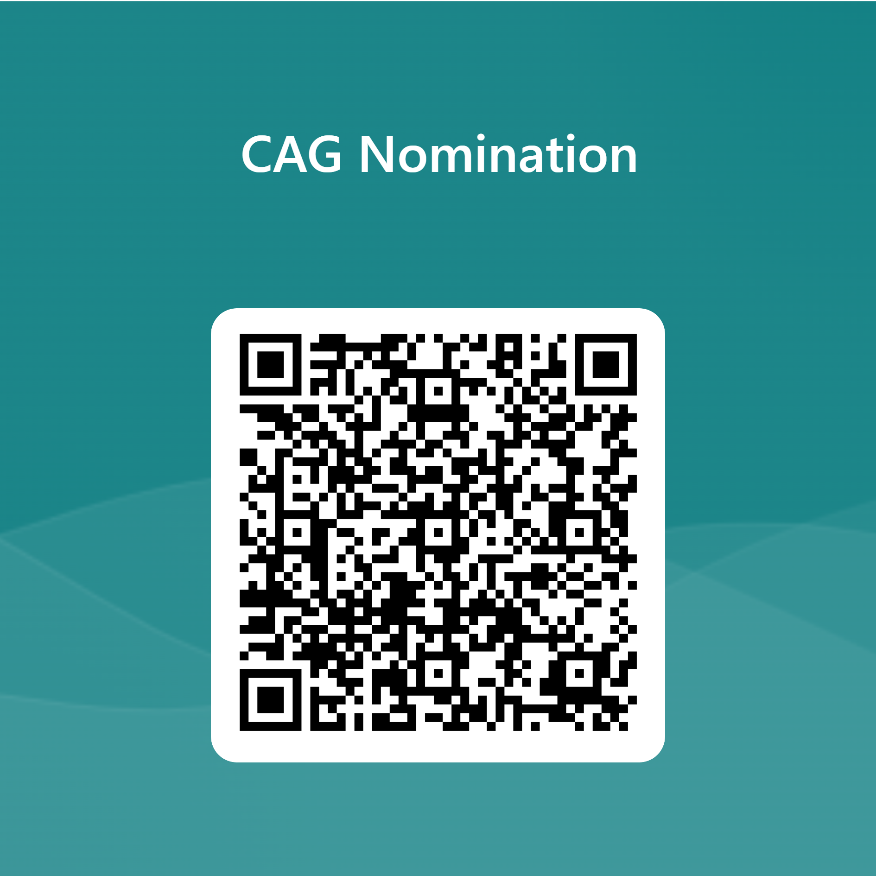
CAG Nominations
Nomination Form
Purpose: Improve communication between program coordinators and GME staff relating to meeting and training content, create meeting agendas and GME led training calendars for program coordinators, and to create best practices regarding program coordinator tasks.
Goals:
Ensure meeting content quality by reviewing information provided, timing of information, and method of information sharing.
Create training calendar for the year (monthly GME/subgroup led trainings)
Structure:
Length of commitment
1 Year: July 1, 2024- June 30, 2025
# Members:
6 total- 1 GME member and 5 program coordinators
Monthly meetings
Membership Criteria:
GME member:
3 Residency Program Coordinators
2 Fellowship Program Coordinators
Length and area of position
Under 3 years in program coordinator role
3+ years in program coordinator role
Program coordinator from outside the New Orleans area (i.e. Baton Rouge, Lake Charles, Bogalusa)

