Slide 1
Post Job Offer Drug Testing
Drug Testing Office
(504) 568-8888 drugtesting@lsuhsc.edu HDC
411 S. Prieur, Suite 233
Notes:
Talk about CAP services

Slide 2
Substance Abuse and Drug Free Workplace Policy - CM-38
Alcohol abuse and the illegal use or abuse of other drugs is associated with numerous health, safety, and social problems. The performance of faculty, staff, residents, students and other LSUHSC-NO affiliated individuals may be adversely affected by engaging in substance abuse.
This policy, including the prohibitions and provisions, shall be used to promote and safeguard the workplace/school environment from the consequences of alcohol and drug use.

Slide 3
Substance Abuse and Drug Free Workplace Policy - CM-38
Providing a safe, productive, and healthy environment that is consistent with providing the highest quality services to patients and the most effective learning environment for students.
Creating and maintaining a drug-free workplace pursuant to the Federal Drug-Free Workplace Act of 1988, the Drug Free Schools and Communities Act Amendment of 1989, and the Louisiana Drug Testing Act of 1990.
Providing a safe and healthy environment for our patients, employees, students, visitors, vendors, suppliers, contractors, and members of our community.

Slide 4
Pre-Employment Drug Testing / Post Job Offer
Third Party Administrator – Applya https://www.i3screen.net/login/
LSUHSC Drug Testing Office
Shauntel Jones
Scott Embley
Business Office Managers or designee “order” post job offer testing
Post job offer testing can occur 90 days prior to the tentative start date
Candidates can not start until drug test is complete and you have received clearance for hire from the Drug Testing Office
Clear for hire email must be dated before the start date
Phone (504) 568-8888
Email: Drugtesting@lsuhsc.edu

Slide 5
Post Job Offer Drug Panel
7 Panel + Oxy
Amphetamines
Barbiturates
Benzodiazepines
Cannabinoids
Cocaine Metabolite
Opiates
Phencyclidine (PCP)

Slide 6
Before Drug Screen can be submitted
Two Documents
Agreement to Submit to an Alcohol and/or Drug Test and Authorization for the Release of Test Result
LSUHSC New Orleans Campus Post Job Offer Drug Testing Instructions for Job Candidates and House Officers
https://www.lsuhsc.edu/orgs/campushealth/drugtesting.aspx
The “agreement to submit to an alcohol and/or drug test and authorization for the release of test result” must be signed by the House Officer and returned
The ““agreement to submit to an alcohol and/or drug test and authorization for the release of test result” must be placed in the House Officer file

Slide 8
Forms
Handbook
Premier Biotech Site

Slide 9
If you need access, email Drugtesting@lsuhsc.edu
You will receive an email from premier biotech and you’ll
have 24 hours to access your account once
you receive the email
Username is your lsuhsc.edu email
Temp password will be provided
You create your own password

Slide 10
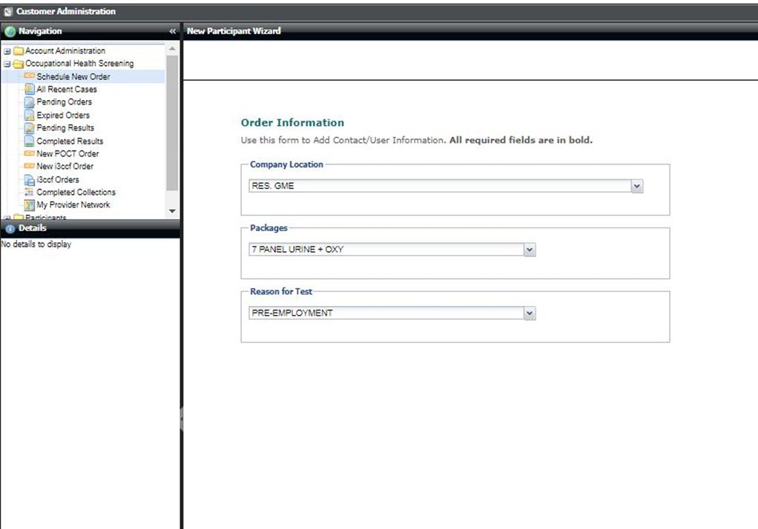

Slide 11
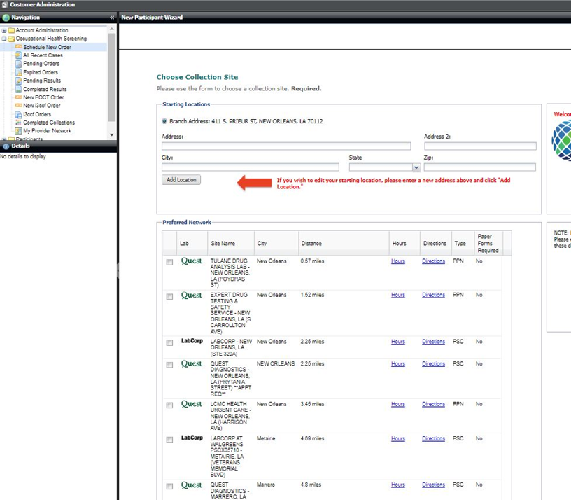
Peoplesoft Chart String
Observed Collection - No
Remember to include
who will receive the
Clear for hire in the
Custom message
Section
Clearance to: NAME and EMAIL

Slide 12
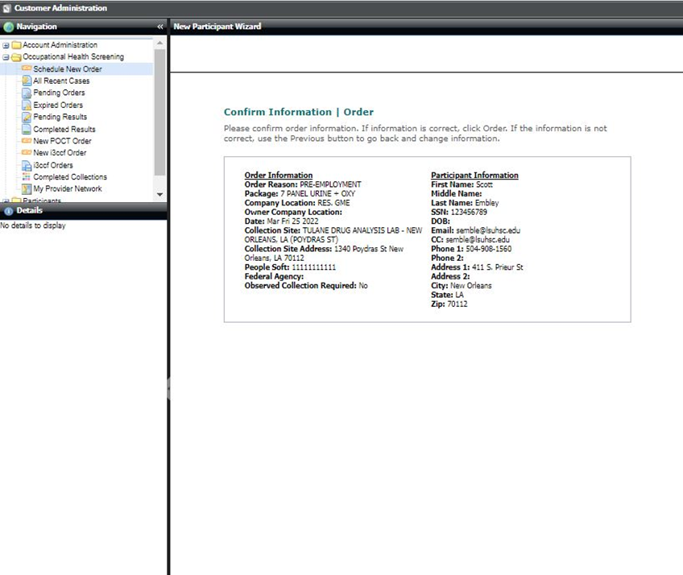
5 working days to take the drug test
once order is submitted.

Slide 13
Emails will come from premier biotech
Must take the Order Confirmation plus 1 form of
Identification with them to the approved collection
site

Slide 14
Challenging the Results of a Drug Test
LSUHSC-NO allows any individual who wishes to challenge the drug test results to do so. You must do so within 72 hours of notification of a positive test result.
If you believe a drug test is in error or wish to challenge the drug test results, it is your responsibility to notify the MRO and the appropriate Administrative Body or their designee. You must have the same sample retested at your own expense at a laboratory that is SAMHSA certified. The second test must be of equal or greater sensitivity for the drug in question as was the initial test.

