Slide 1
Drug Testing
Post Job Offer Drug Testing
Drug Testing Office
(504) 568-8888 drugtesting@lsuhsc.edu HDC
411 S. Prieur, Suite 233

Slide 2
Drug Testing
Substance Abuse and Drug Free Workplace Policy - CM-38
Alcohol abuse and the illegal use or abuse of other drugs is associated with numerous health, safety, and social problems. The performance of faculty, staff, residents, students and other LSUHSC-NO affiliated individuals may be adversely affected by engaging in substance abuse.
This policy, including the prohibitions and provisions, shall be used to promote and safeguard the workplace/school environment from the consequences of alcohol and drug use.

Slide 3
Drug Testing
Substance Abuse and Drug Free Workplace Policy - CM-38
Providing a safe, productive, and healthy environment that is consistent with providing the highest quality services to patients and the most effective learning environment for students.
Creating and maintaining a drug-free workplace pursuant to the Federal Drug-Free Workplace Act of 1988, the Drug Free Schools and Communities Act Amendment of 1989, and the Louisiana Drug Testing Act of 1990.
Providing a safe and healthy environment for our patients, employees, students, visitors, vendors, suppliers, contractors, and members of our community.

Slide 4
Drug Testing
Pre-Employment Drug Testing / Post Job Offer
Third Party Administrator – Premier BioTech https://www.i3screen.net/login/
LSUHSC Drug Testing Office
Shauntel Jones
Scott Embley
Business Office Managers or designee “order” post job offer testing
Post job offer testing can occur 90 days prior to the candidates start date
Candidates can not start until drug test is complete and you have received clearance for hire from the Drug Testing Office
Clear for hire email must be dated before the start date
Phone (504) 568-8888
Email: Drugtesting@lsuhsc.edu

Slide 5
Drug Testing
Post Job Offer Drug Panel
7 Panel + Oxy
Amphetamines
Barbiturates
Benzodiazepines
Cannabinoids
Cocaine Metabolite
Opiates
Phencyclidine (PCP)

Slide 6
Drug Testing
Medical Marijuana
La. R.S. 49:1016 (“No state employer shall subject an employee or prospective employee to negative employment consequences based solely on a positive drug test for marijuana, marijuana components, including tetrahydrocannabinols, or marijuana metabolites if the employee or prospective employee has been clinically diagnosed as suffering from a debilitating medical condition and a licensed physician has recommended marijuana for therapeutic use by the employee in accordance with La. R.S. 40:1046.”)
In accordance with La. R.S. 49:1016, LSUHSC-NO shall not be construed to prohibit from imposing negative employment consequences on an employee who uses or is impaired by marijuana on the premises of the employer or during work hours or an employee whose principal responsibility is to operate a state vehicle, maintain a state vehicle, or supervise any employee who drives or maintains a state vehicle.

Slide 7
Drug Testing
Medical Marijuana
In accordance with La. R.S. 49:1016, LSUHSC-NO shall provide an employee with the opportunity to show that he/she has been clinically diagnosed as suffering from a debilitating medical condition and a licensed physician has recommended marijuana for therapeutic use by the employee in accordance with La. R.S. 40:1046.
La. R.S. 49:1016 does not apply to emergency medical services, law enforcement, public safety officials, any state employee of the horse racing commission, and firefighter services.

Slide 8
Drug Testing
Before Drug Screen can be submitted
Two Documents
Agreement to Submit to an Alcohol and/or Drug Test and Authorization for the Release of Test Result
LSUHSC New Orleans Campus Post Job Offer Drug Testing Instructions for Job Candidates and House Officers
https://www.lsuhsc.edu/orgs/campushealth/drugtesting.aspx
The “agreement to submit to an alcohol and/or drug test and authorization for the release of test result” must be signed by the House Officer and returned
The ““agreement to submit to an alcohol and/or drug test and authorization for the release of test result” must be placed in the House Officer file

Slide 9
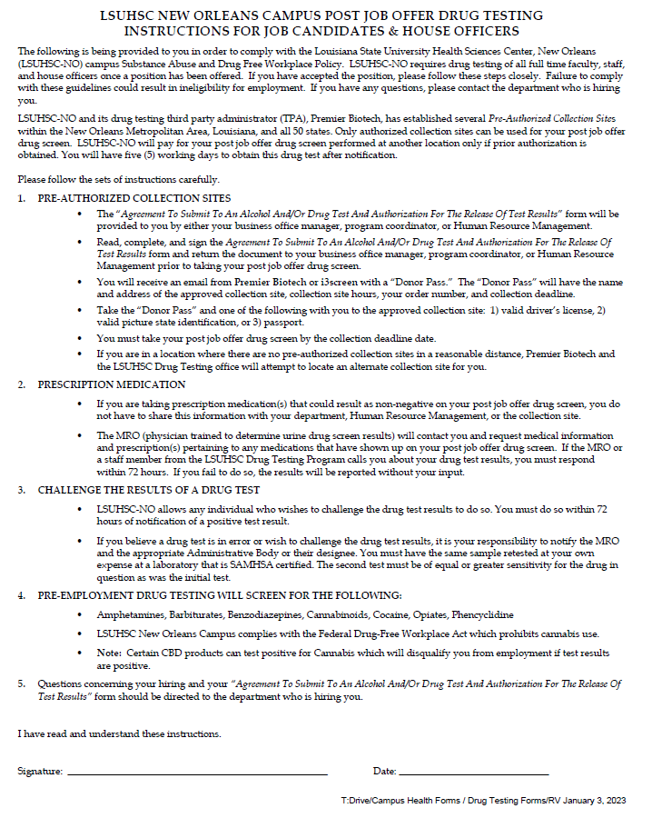
Drug Testing
Your Text Goes Here

Slide 10
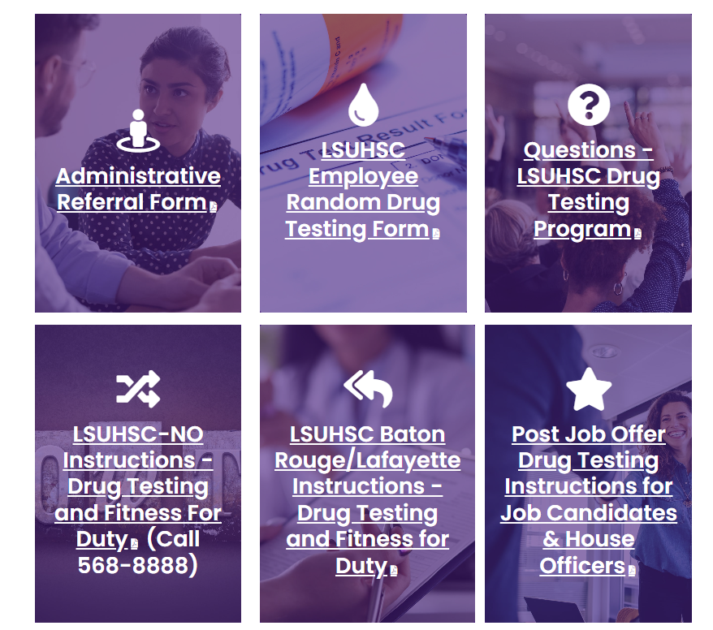
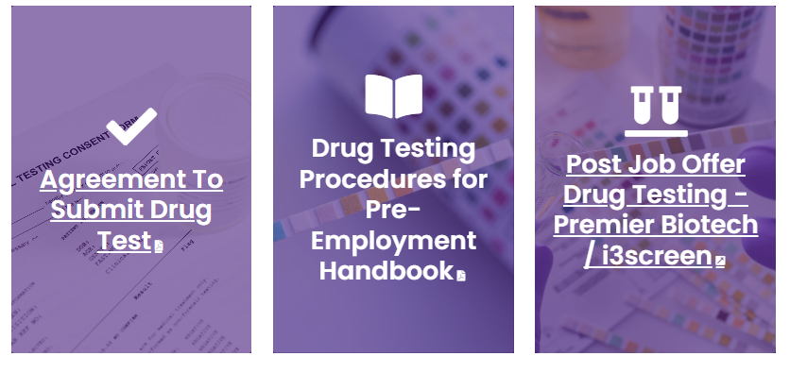
Drug Testing
Forms
Handbook
Premier Biotech Site
Instructions
Handbook
&
I3screen
Agreement form

Slide 11
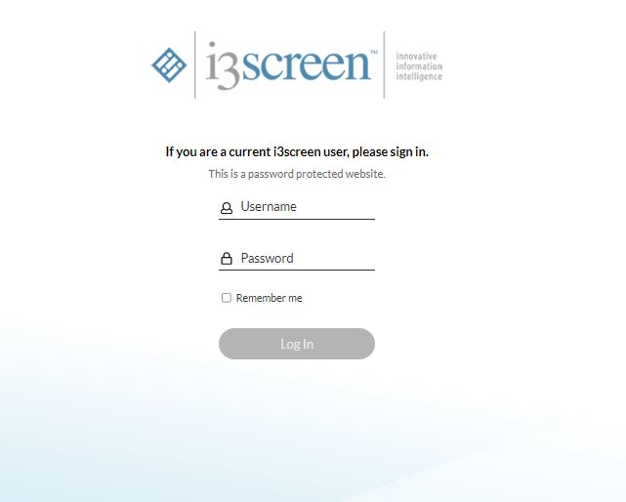
Drug Testing
If you need access, email Drugtesting@lsuhsc.edu
You will receive an email from premier biotech and you’ll have 24 hours to access your account
once you receive the email
Username is your lsuhsc.edu email
Temp password will be provided
You create your own password

Slide 12
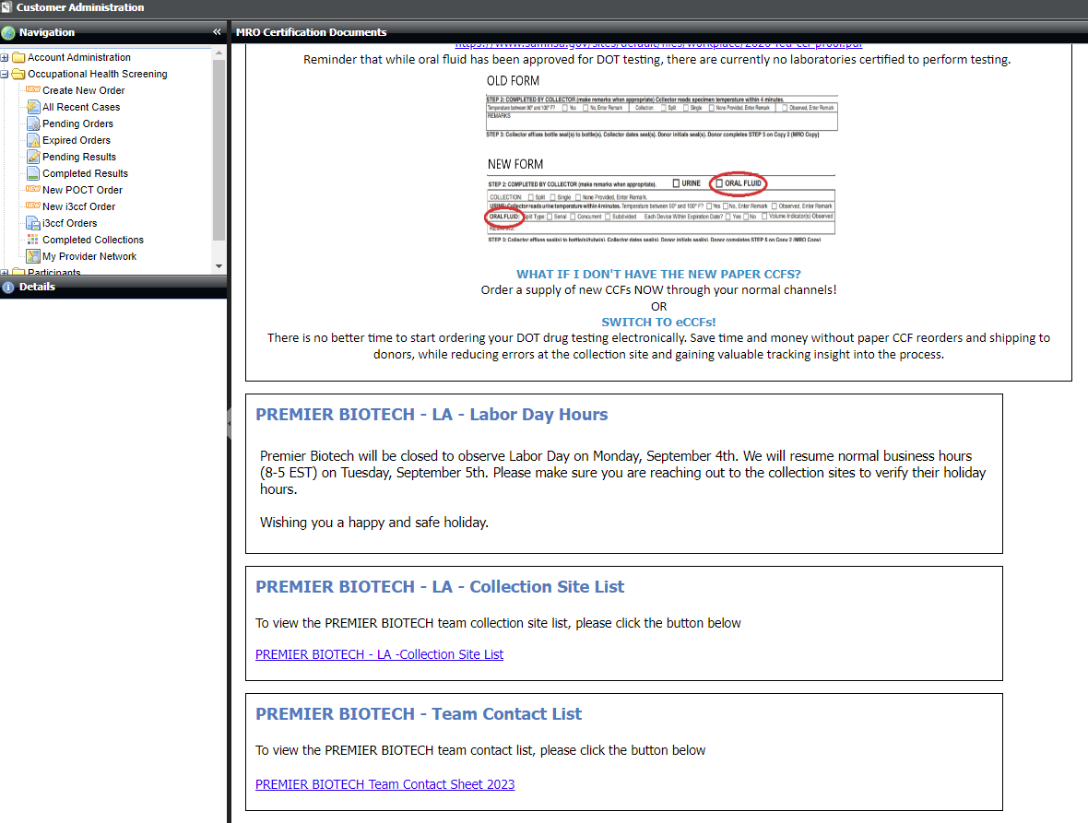
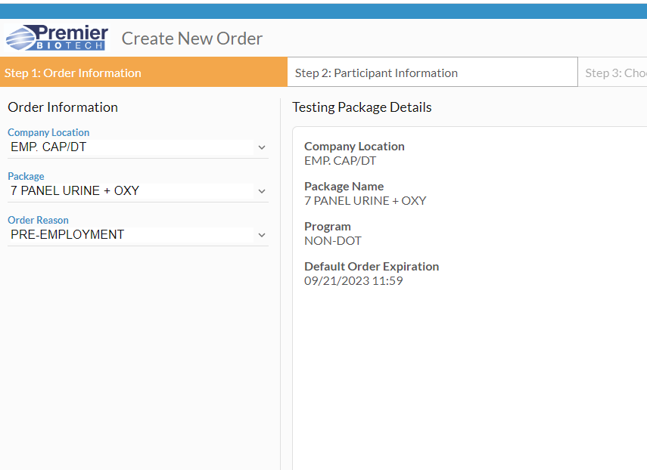
Drug Testing

Slide 13
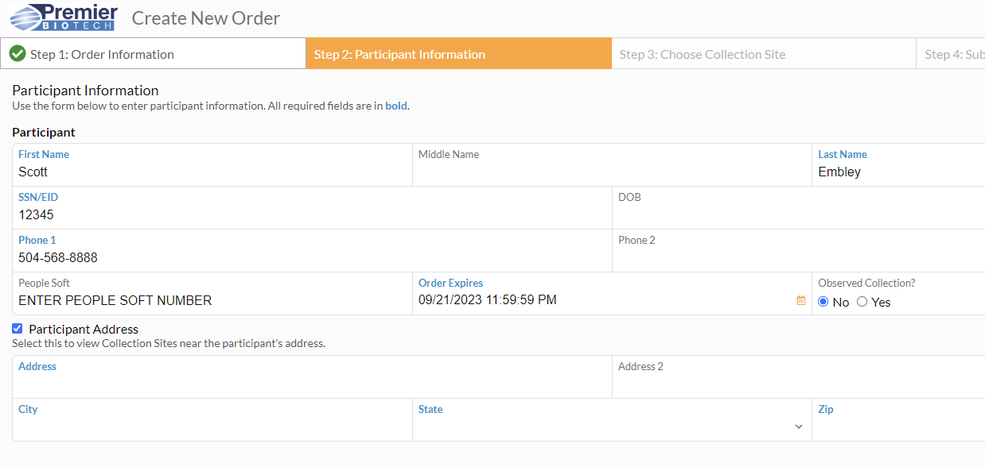
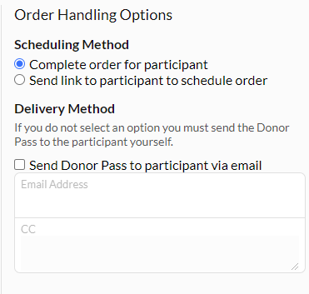
Drug Testing

Slide 14
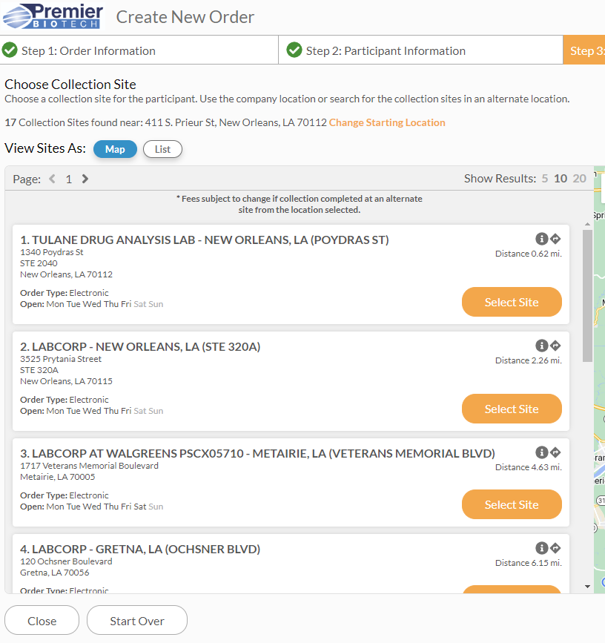
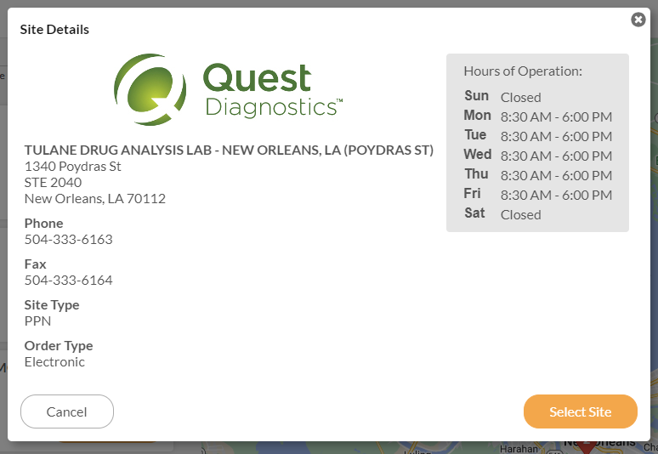
Drug Testing

Slide 15
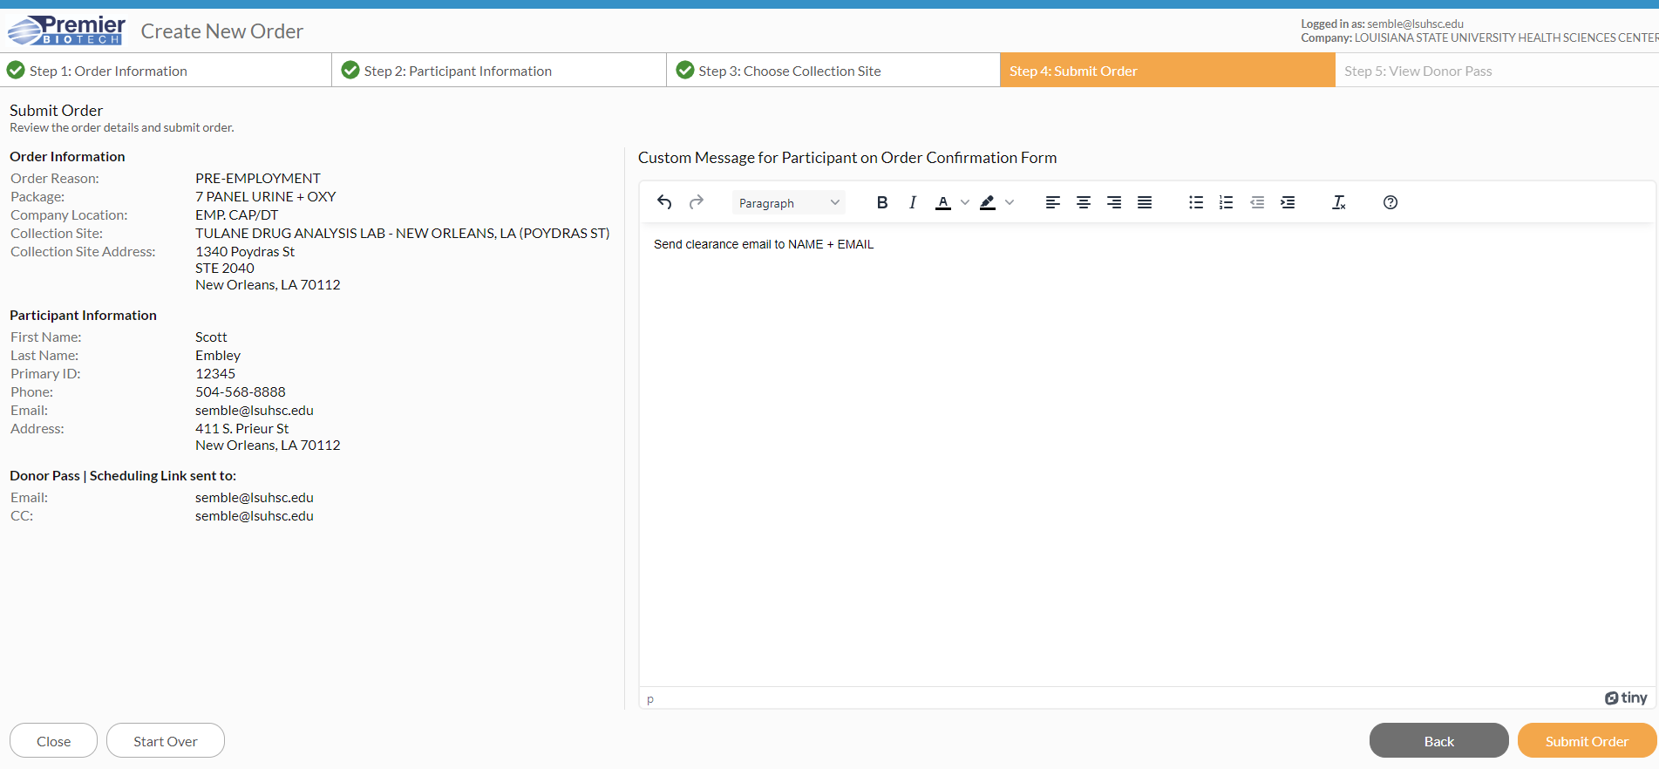
Drug Testing

Slide 16
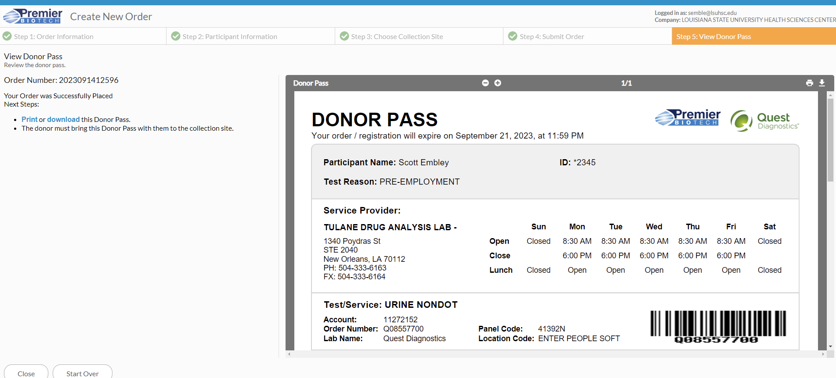
Drug Testing

Slide 17
Drug Testing
Challenging the Results of a Drug Test
LSUHSC-NO allows any individual who wishes to challenge the drug test results to do so. You must do so within 72 hours of notification of a positive test result.
If you believe a drug test is in error or wish to challenge the drug test results, it is your responsibility to notify the MRO and the appropriate Administrative Body or their designee. You must have the same sample retested at your own expense at a laboratory that is SAMHSA certified. The second test must be of equal or greater sensitivity for the drug in question as was the initial test.

