Slide 1
Coordinator Check In
May 4, 2021

Slide 2
Computer Support
Brenda Galle

Slide 3
New Hire Orientation Dates
EPIC Training
June 23, 2021
June 24, 2021
UMCNO Orientation
June 25, 2021
Baton Rouge Orientation
June 28, 2021
LSU New Orleans Onboarding Days
June 29, 2021
June 30, 2021

Slide 4
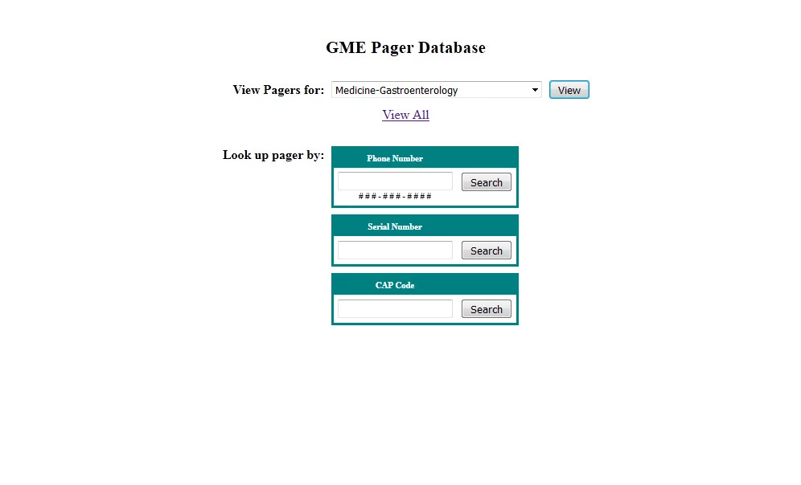
Pager Management
GME Pager Database
Assign Pager to New User
If your program needs more pagers email Ashley Walker by May 28, 2021
Pager Assignments will be accepted July 1, 2021.

Slide 5
GME Tracking System
https://www.medschool.lsuhsc.edu/medical_education/Graduate/Process_Tracking/
New Hire Packets and Appointment Packets are being updated as received by the GME Office.

Slide 6
Online Orientation
Available Today
Requires LSU Computer Account
House Officers can:
View video modules
View Powerpoint Presentations
Sign up for Benefits webinar
Sign up for Onboarding Day (New Orleans HOs)
View other requirements which need to be completed (I-9 documents, medical license, etc.)

Slide 7
Online Orientation
Coordinators can:
View progress for all residents
View all modules and presentations
View list of new hire requirements
Important thing to note:
Additional modules are still being added
Progress updates are not all being updated yet https://www.medschool.lsuhsc.edu/medical_education/graduate/virtualorientation/

Slide 8
REMINDERS
Turn in Malpractice Spreadsheets.
Background Check Emails are starting to come in.
Exit Packets due 30 days after terminations.
TB testing available at HCN – May 3, 2021 to May 14, 2021.

Slide 9
REMINDERS
May Beginning of the Month (BOM) Reports are Due
Payroll Lock is Thursday, May 6, 2021 for May 1-15 Payroll
April End-of-the Month (EOM) Reports are Due May 5, 2021. Submit the Reports as close to the due date as possible and Include PER 3s if needed

Slide 10
REMINDERS: QI FORUM – JUNE 3

