Slide 1
www.tagme.org
Susan Lenoir, MBA, C-TAGME
swack@lsuhsc.edu

Slide 2
DISCLOSURE
I have no actual or potential conflict(s) of interest
in relation to this presentation.

Slide 3
WHY SHOULD I CERTIFY?
According to TAGME:
Improve skill level and content knowledge
Prepare for greater on-the-job responsibilities
Reflect achievement and commitment to goals
Recognize certified vs. non-certified training administrators as a qualifying factor for promotion and/or higher salary
Enhance the training administrator/program coordinator image
Promote visibility of the profession

Slide 4
INITIAL TAGME CERTIFICATION CRITERIA
REQUIREMENTS
Currently employed as a GME professional
Completed 2 consecutive years in this role by application submission
Completed 20 Education Credits within the previous 3 years (11 education credits must be directly focused on GME topics & outside the usual scope of duties and 9 education credits may be general professional growth & development). Up to 6 education credits may be earned through podcasts, webinars or completion of online modules.
1 hour of qualifying activity = 1 TAGME Education Credit
*CCC & PEC Meetings, Routine GME Meetings, etc. DO NOT COUNT

Slide 5
INITIAL TAGME CERTIFICATION CRITERIA
What Does Count Toward Certification?
National, Regional or State Conferences – Costs $$ to attend
Virtual Meetings (FREE) – March 7, 2023 at 2pm CST, Challenges & Trends for Program Administration Staffing by Germane Solutions
Core Meetings (FREE) – Next one is scheduled for April 20, 2023
Daniels Lecture (FREE) – April 21, 2023 “Institutional Culture in Academic Medicine: Your Talk Matters” presented by Dr. Krista Longtin from Indiana University
LSUHSC Workshops (FREE) – Examples of previous ones include Tools to Mitigate Microaggressions (Feb. 27) & Unconscious Bias Training (Feb. 10)
Learn at ACGME (Recordings) (FREE) – www.dl.acgme.org
Academy for Program Coordinators Meetings (FREE) – Monthly
National Society of Academic Medical Administrators (FREE) Bi-monthly (More options with $99 annual membership, such as annual conference)

Slide 6
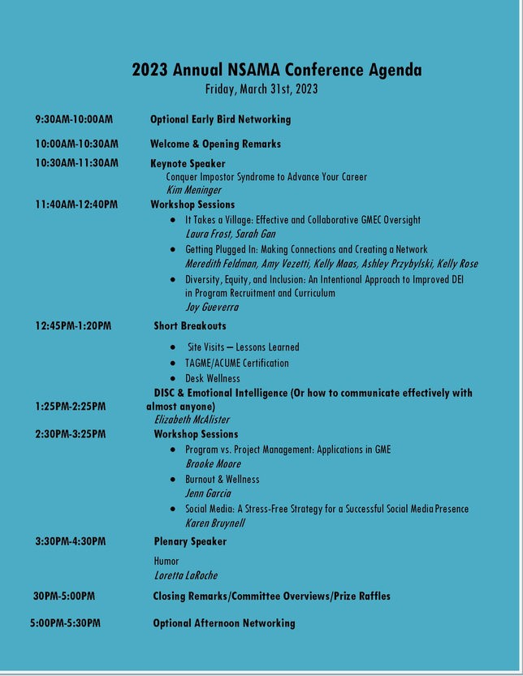
2023 ANNUAL NSAMA CONFERENCE
$99 registration fee, this includes NSAMA membership
Approximately 5.5 TAGME education credits

Slide 7
2023 TAGME TIMELINE
Timeline for 2023 Application Cycle:
1. Application submission –> April 1 through June 1 2. Application review and notification –> Rolling through June 30
3. Assessment scheduling –> Beginning July 5 (upon application approval)
4. Assessment completion –> July 11 through December 2 5. Retake completion –> Through December 16

Slide 8
MAINTENANCE OF CERTIFICATION CRITERIA
REQUIREMENTS
Hold a current TAGME certification
Currently employed as a GME professional
Completed 5 consecutive years in this role by application submission
Completed 25 Education Credits within the previous 5 years (ALL must be directly focused on GME topics or professional growth & development RELEVANT TO YOUR CURRENT ROLE)
1 hour of qualifying activity = 1 TAGME Education Credit
*CCC & PEC Meetings, Routine GME Meetings, etc. DO NOT COUNT

Slide 9
MAINTENANCE OF CERTIFICATION CRITERIA REQUIREMENTS CONTINUED
Completed 2 Personal Professional Growth Experiences within the previous 5 years
Presentations at a national, regional, state, institutional or departmental level
Active committee role at a national, regional, state or institutional level
Peer-reviewed poster presentations or published manuscripts

Slide 10
ABOUT THE ASSESSMENT
Assessment Type | # of Questions / Time Allowed
Initial Certification | 175 / 5 hours
Maintenance of Certification | 100 / 4 hours
Retake – Initial or Maintenance | 125 / 4.5 hours

Slide 11
FEES
Initial Certification | $350
Maintenance of Certification | $350
Retake | $150
Reschedule a canceled appointment | $80

Slide 12
??

