Slide 1
LSU GME Program Coordinator meeting
FEBRUARY 2022

Slide 2
VA On-Boarding: (New and returning Residents and Fellows)
On-Boarding for VA Residents and Fellows (all VA facilities in Louisiana, including VA New Orleans, clinics in Baton Rouge, Slidell, etc.)
VA New Residents/Fellows
New to LSU
Residents/Fellows Continuing in the Same Training Program at LSU, but have never rotated at the VA
Rotated at the Louisiana VA during Medical School. VA GME office will request a copy of the Medical Student match list to try to extend their credentials/access and update them to resident.
VA Returning Residents/Fellows
Previously rotated at the SLVHCS-Louisiana VA in the prior academic year(s) and will remain in the Same Program next academic year.
Previously rotated at the SLVHCS-Louisiana VA in the prior academic year(s) but will be in a Different LSU Residency/Fellowship Program.

Slide 3
VA On-Boarding: Trainee Qualifications and Credentials Verification Letter (TQCVL) (Link found in Knowledge Base)
TQCVL- Due March 31
Prior to participating in training at a VA Facility, each health professions trainee must be listed on a TQCVL to complete onboarding
Program Coordinator completes a TQCVL and attaches a spreadsheet listing Residents/Fellows in the Program that will rotate at the VA, to the TQCVL
Insert Letter Head at the top of the TQCVL
Check the boxes on the form
Include all Residents/Fellow names that may rotate to the VA during 2022-2023 AY on the Spreadsheet to attach to the TQCVL (New and Returning Rotators)
House Officer level is the House Officer level for the new Academic Year 2022-2023
Include copy of current J-1 Visa documentation for all non-citizen trainees
LSU Program Director Signs the TQCVL
Program Coordinator submits the completed and signed TQCVL with the list of House officers to Ms. Crystal Cruz at the VA using the LSU Health FileS file Transfer System and sends a copy to Yolanda Lundsgaard in the LSU GME office
If there are any changes to the List of Residents/Fellows on the original list submitted with the TQCVL, an updated TQCVL list must be submitted to Ms. Crystal Cruz at the VA using the LSU Health FileS file Transfer System and a copy Yolanda Lundsgaard in the LSU GME Office

Slide 4
Example of TQCVL form-Page 1

Slide 5
Example of TQCVL form-Page 2

Slide 6
Example of TQCVL list

Slide 7
VA On-Boarding: Coordinator Tracker
Coordinator Tracker – Due March 31 (Link found in Knowledge Base) Coordinator Tracker provides VA staff with more detailed information for each Resident/Fellow that will rotate at the VA and is part of the VA onboarding process.
The Program Coordinator Completes the Coordinator Tracker
Include the rotation dates, if known at the time completing the Coordinator Tracker, if rotation dates are not known, leave blank.
Program Coordinator submits the completed Coordinator Tracker to Ms. Crystal Cruz, at the VA, using the LSU Health FileS file Transfer System.

Slide 8
VA On-Boarding: New Trainee Requirements-application packet
VA New Residents/Fellows Application– Due May 6
Resident/Fellow Completes the VA Application for Health Professions Trainee (link is found in Knowledge Base)
Application must be completed electronically. Do Not Handwrite. Electronic Signature is accepted
Resident/Fellows complete the Mandatory TMS Training and print the certificate(s) (link is found in the Application)
Resident/Fellow attaches Selective Service Registration Confirmation: https://www.sss.gov/Home/Verification
Resident/Fellow attaches the completed VA COVID-19 Attestation, (VA form 10230).
Resident/Fellow submits the completed Application, with the TMS Certificate(s), to their Program Coordinator
Resident/Fellow schedules Fingerprinting and Photo Appointment vhanolgmefingerprinting@va.gov. Appointment are scheduled Tuesdays and Thursdays only from 8am-3pm.
Program Coordinator confirms all pages of the application are included in the Packet (check items on cover page that prints with the application)
Program Coordinator makes a copy of the application and notes when it was sent to the GME Office to place in the Resident's/Fellow's file
Program Coordinator will submit all New Resident/Fellow Applications to Ms. Crystal Cruz, at the VA, using the LSU FileS file Transfer System. DO NOT SEND PACKETS BY EMAIL (Due to PII).

Slide 9
VA On-Boarding: New Trainee Requirements-application checklist
Trainee Application Packet- must be completed by all new Residents/Fellows
Application Checklist
Appointment Letter (WOC Form)
Declaration For Federal Employment (OF 306)
Application For Health Professions Trainees (VA form 10-2850D)
Appointment Affidavit form (VA GME office will sign the Notary Section)
Drug Testing Notification Form
TMS Training
VHA Mandatory Training for Trainees Certificate
VHA Mandatory Refresher Training Certificate
HIPPA Training Certificate
COVID-19 Form

Slide 10
VA On-Boarding: TMS training (annual training. Date must be current for the academic year)

Slide 11
VA On-Boarding: New Trainee Requirements- COVID-19 Vaccination form

Slide 12
VA On-Boarding: Returning Trainee requirements
Returning VA Residents/Fellows Returning Packet– Due May 6
VA Application for Health Professions Trainee is NOT required
Resident/Fellow Completes the Mandatory TMS Refresher Training and downloads a copy of their Certificate
Resident/Fellow submits the TMS Certificate to their Program Coordinator
Resident/Fellow submits the completed VA COVID-19 Vaccination Form (COVID Attestation VA form 10230)
Resident downloads the Returning Trainee Application Packet and sends the entire packet including the cover page to their Program Coordinator. (Link found in Knowledge Base)
Program Coordinator confirms all items have been submitted by Resident/Fellow
Program Coordinator submits the Returning Trainee Packet to Ms. Crystal Cruz, at the VA, using the LSU Health FileS file Transfer System.

Slide 13
VA On-Boarding: Returning Trainee paperwork (must attach TMS certificate and COVID form)

Slide 14
VA On-Boarding: Rotation Schedules
Program Coordinators should send an email with the academic year program rotation schedule to the VA GME Manager and VA Clinic ADPAC. Program Coordinators should send updates to the VA GME office and clinic contact when there is a switch in rotation or other change to the schedule.
Service/Program | VA Service ADPAC Name | Email
Anesthesiology | Antionette Payne | Antionette.payne@va.gov
Dermatology | Ramona Griffin | Ramona.griffin2@va.gov
Dental | Kerri Ulrich | kerri.ulrich@va.gov
Emergency Medicine | Joycelyn Farve | Joycelyn.farve@va.gov
GI-Hospice and Palliative care | James Dejoie | James.DeJoie@va.gov
Medicine | Walter Morrow | Walter.morrow@va.gov
Mental Health | James Anderson | James.anderson35@va.gov
Neurology | Rebecca Pettingill | Rebecca.Pettingill@va.gov
Pathology | Cheryl Lanier | cheryl.lanier@va.gov
PM&R | Rebecca Pettingill | Rebecca.Pettingill@va.gov
Radiology | Mary Maurice | Mary.maurice@va.gov
Surgery | Gerald Bailey | Gerald.bailey2@va.gov
Baton Rouge Internal Medicine | Richard Lucas | Richard.Lucas2@va.gov
Ambulatory Medicine | Rebecca Pettingill | Rebecca.Pettingill@va.gov

Slide 15
VA Disbursement: Accurate Educational Activity Records ensure that trainee leave and attendance are appropriately tracked, invoices are reconciled and calculations for payment are accurate.
Disbursement Policy Updates
National Educational Activity Record (EARs) Tracker Implementation January 1 2022
Required by OAA
We have been using this new tracker since July 2021.
All LSUHSC programs have switched to a 5day schedule.
EARs completed by VA administrative staff with assistance from site director
Goal to send EARs sheet to LSUHSC at the end of the month

Slide 16
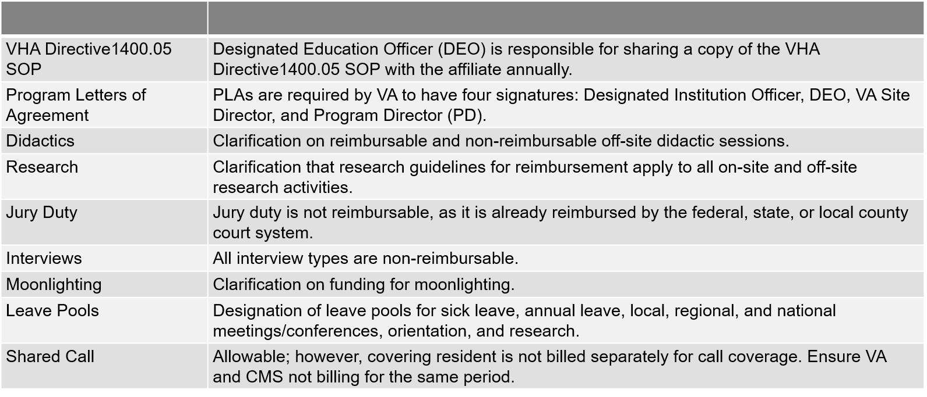
VA Disbursement:
VHA Directive 1400.05 SOP changes

Slide 17
VA Disbursement:
Leave | Reimbursable
Annual Leave (AL)/ Vacation | Yes. Vacation time is factored into the daily rate: PGY4 $71,895/year, 28 days vacation 365-28 days vacation = 337 working days $71,895 / 337 = $213.34 daily rate VA does pay for vacation time but the bill will show a “zero dollar” reimbursement for the actual vacation day.
Sick Leave | Yes. VA matches LSUHSC sick leave policy of 14 days. This will show as a paid day on the bill. Sick leave includes personal medical/dental appointments Scheduled appointments should be coordinated and discussed with site director.
Weekends | VA pays for a proportional share of weekends

Slide 18
VA Disbursement:
Leave | Reimbursable
Inservice Exam | Yes. Code as “Present” and annotate in margin
Licensing Exam (Step 3) | No
Specialty Board Exam | Yes and includes travel time; however, only pay proportional share
Local/Regional/National Conference | Yes, based on “pooled leave”
Off-campus research | No. None of the current LSUHSC GME programs have been approved for off-campus research.
Didactics | Yes, if your program was approved by the GME office. Don’t use “educational leave” just mark “present”.
Interviews | No
Post-call | No, unless taking VA call

Slide 19
VA Disbursement:
VA's Proportional Share
Column1 | # of VA Funded FTE | # of Affiliate Residents | VA's Proportionate Share
Anesthesiology | 12.0 | 25.0 | 48%
Colon and rectal Surgery | 0.5 | 1.0 | 50%
Dermatology | 6.0 | 17.0 | 35%
Emergency Medicine | 13.0 | 49.0 | 27%
Family Medicine Kenner | 1.5 | 18.0 | 8%
Family Medicine Bogalusa | 1.5 | 18.0 | 8%
Hematology & Oncology | 1.5 | 7.0 | 21%
Internal Medicine NOLA | 5.0 | 58.0 | 9%
Internal Medicine Baton Rouge | 3.0 | 40.0 | 8%
Interventional Radiology | 5.0 | 9.0 | 56%
Neurologic Surgery | 0.5 | 9.0 | 6%
Neurology | 5.0 | 16.0 | 31%
Neuroradiology | 1.0 | 2.0 | 50%
Ophthalmology | 7.0 | 28.0 | 25%
Orthopaedic Surgery | 4.0 | 20.0 | 20%
Pain Medicine | 3.5 | 5.0 | 70%
Pathology | 1.5 | 12.0 | 13%
PM&R | 10.0 | 24.0 | 42%
Plastic Surgery | 1.0 | 6.0 | 17%
Psychiatry NOLA | 2.0 | 44.0 | 5%
Psychiatry Baton Rouge | 2.0 | 29.0 | 7%
Radiology | 4.0 | 17.0 | 24%
Rheumatology | 1.0 | 4.0 | 25%
Surgery - General | 8.0 | 61.0 | 13%
Surgical Critical Care | 1.3 | 2.0 | 63%
Vascular Surgery | 3.0 | 10.0 | 30%

Slide 20
VA Disbursement: Pooled leave
Take the approved VA FTE and multiply by allowable leave
Conference leave = 5 days/FTE max
LSU Dermatology approved for 6 VA FTE
6FTE x 5 days = 30 total conference leave days
A single trainee cannot exceed 5 days/year
Once 30 days used, conference leave can be approved but will be non-reimbursable

Slide 21
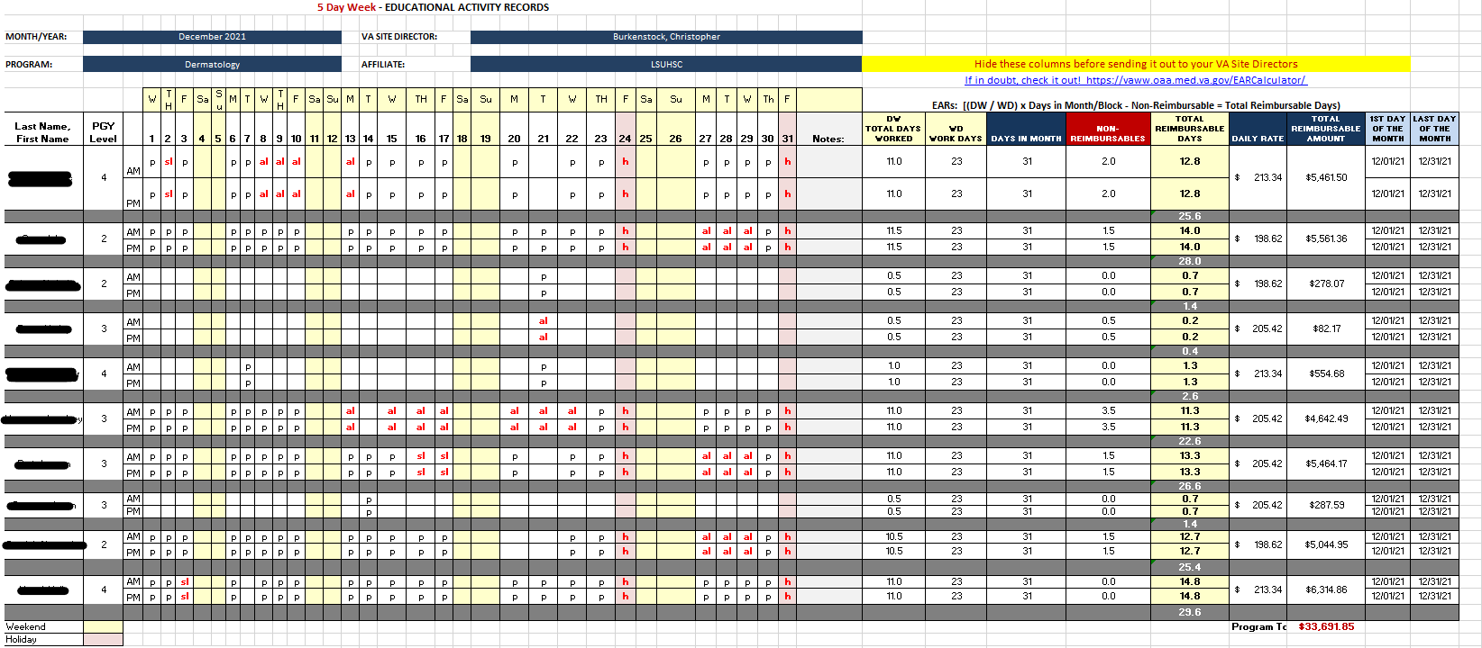
VA Disbursement:

Slide 22
VA Disbursement:

Slide 23
VA OFFICE CONTACT
ASSOCIATE CHIEF OF STAFF FOR EDUCATION (ACOS/E) GRADUATE MEDICAL EDUCATION (GME) PROGRAM
Irene Grundy, M.D. (DEO)
Crystal Cruz (GME Manager)
Office Location: 2400 Canal Street, Admin Building
1st floor, room 1Q101, New Orleans, LA 70119
Office Hours: Mondays–Fridays from 8:00a.m. to 4:30p.m
Office contact: (504) 507-2000 ext. 67518

